Slide 2
Space Lander Challenge

Slide 3
7 Minutes of Terror: Curiosity Rover’s Landing

Slide 4
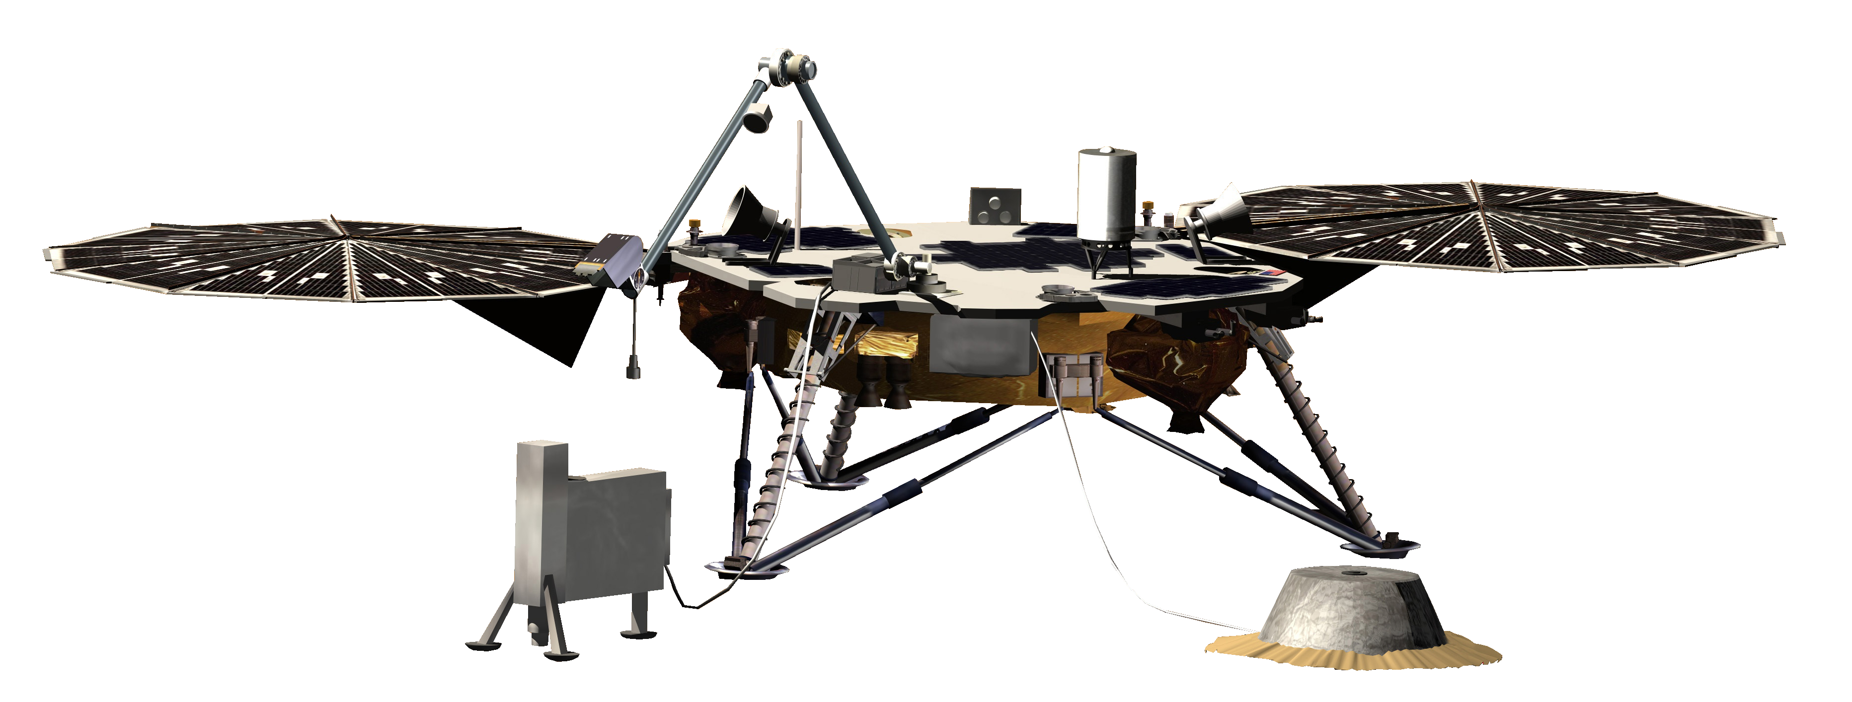
Space Lander Challenge
Design and build a lander that will land upright after a drop of 1.5 meters without blocking the solar panel
You can only use the supplies in the bag
You have 30 minutes to design and build your lander
You can test it as many times as you want.
InSight Mars Lander (NASA)
Notes:
Instructions for space lander challenge (full instructions available in separate document)
4

Slide 5
Space Lander Challenge
Success Levels:
1. Your lander lands upright after a 1.5m drop three times in a row
2. Your lander lands upright after being dropped upside down from 1.5m
3. Your lander lands upright after being thrown in the air
4. Your lander succeeds in 1-3 and uses minimal materials
InSight Mars Lander (NASA)
Notes:
Instructions for space lander challenge (full instructions available in separate document)
5

Slide 6
Good Luck!
InSight Mars Lander (NASA)
Notes:
Instructions for space lander challenge (full instructions available in separate document)
6

