Slide 2
Meteorites: Rocks from Space
Prepared by: Jennifer Newman
Updated by: Nedim Smailovic
@westernuSpace
space.uwo.ca/outreach
facebook.com/westernuSpace

Slide 3
Rocks from Space
Meteorites are rocks that survive entry through the atmosphere and land on the surface
Meteoroid is the name for a rock that is still in space (think asteroid but smaller in size)
Meteors are the bright lights that are seen as rocks fall through the atmosphere
Fireballs are especially bright meteors and these often produce meteorites
Notes:
(these are some common terms that may come up during the presentation; terms are similar so best to distinguish the differences early on)
Meteors (like those observed during meteor showers) generally do not produce meteorites. They are too small and meteor showers are the result of comet debris which usually comprise of dust and icy rubble and not larger more solid rocks that would be able to survive passage through the atmosphere.

Slide 4
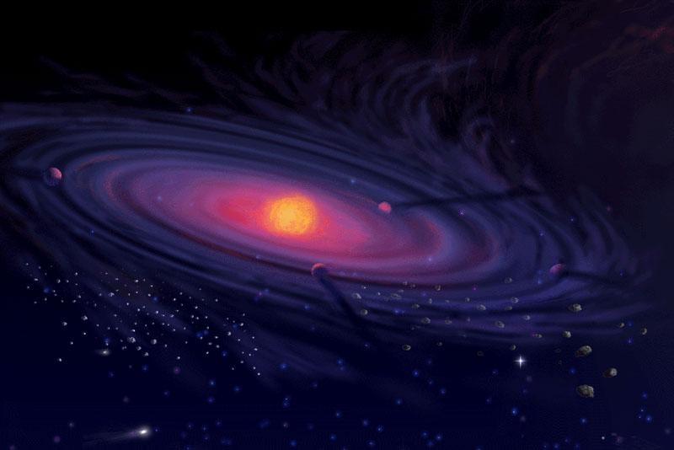
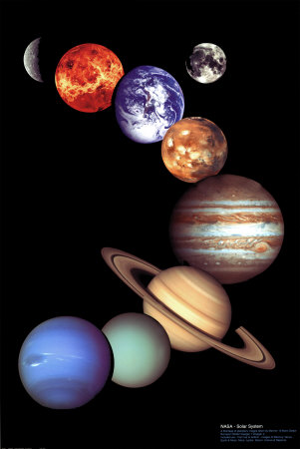
Where do these rocks from space come from?
Notes:
But why are we interested in meteorites, besides the obvious novelty value!
Start with the big picture.
The Hubble Space Telescope has allowed us to see further into the cosmos than ever before, to see some of the millions of galaxies similar to our own.
When we look at our own Solar System, we see a variety of different planets and Moons and a nice "order" to things.
But the formation of our Solar System, was nothing but cataclysmic.
Image shows the early stages of planet formation and the process of accretion.
The question of the formation of the solar system can be tackled from different points of view. It can be studied by examining meteorites, which are pieces of asteroids that fall on Earth and leave a shooting star in the sky as they heat up and volatilize during atmospheric entry. Some of these meteorites formed at the same time as the Sun and their compositions and properties can therefore be used to infer the conditions that prevailed in the protosolar nebula around the nascent Sun. The science of studying meteorites is called cosmochemistry.

Slide 5
Notes:
This spectacular image from NASA's Spitzer Space Telescope shows the "mountains" where stars are born.
Dubbed "Mountains of Creation" by Spitzer scientists, these towering pillars of cool gas and dust are illuminated at their tips with light from warm embryonic stars.
The Spitzer's view differs from Hubble's because infrared light penetrates dust, whereas visible light is blocked by it. In the Spitzer image, hundreds of forming stars (white/yellow) can seen for the first time inside the central pillar, and dozens inside the tall pillar to the left. Scientists believe these star clusters were triggered into existence by radiation and winds from an "initiator" star more than 10 times the mass of our Sun. This star is not pictured, but the finger-like pillars "point" toward its location above the image frame.
The Spitzer picture also reveals stars (blue) a bit older than the ones in the pillar tips in the evacuated areas between the clouds. Scientists believe these stars were born around the same time as the massive initiator star not pictured. A third group of young stars occupies the bright area below the central pillar. It is not known whether these stars formed in a related or separate event. Some of the blue dots are foreground stars that are not members of this nebula.
The red color in the Spitzer image represents organic molecules known as polycyclic aromatic hydrocarbons. These building blocks of life are often found in star-forming clouds of gas and dust. Like small dust grains, they are heated by the light from the young stars, then emit energy in infrared wavelengths.
Notably, organic molecules have been found in carbonaceous chondrites.

Slide 6
Why study meteorites?
Meteorites provide clues to how the Solar System formed
Our Solar System was formed from a cloud of gas and dust
These dust particles (presolar grains) can still be found in some meteorites
Tells us the age of the solar system
Very old - 4.57 billion years!
They are older than any rock on Earth
Notes:
The Solar System was formed from a cloud of gas and dust. Most of these dust particles, called presolar grains, vaporized when the solar system heated up and did not survive the formation of the Solar System. However, some of these dust particles can still be found in some of the meteorites that land on Earth.
By determining the age of the oldest meteroids, scientists were able to determine the solar system is 4.57 billion years old.
Why study meteorites? https://www.amnh.org/exhibitions/permanent-exhibitions/earth-and-planetary-sciences-halls/arthur-ross-hall-of-meteorites/meteorites/what-is-a-meteorite/what-do-meteorites-tell-us
Information about presolar grains: http://presolargrains.net/

Slide 7
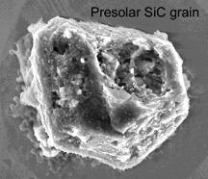
Circa 4.57 billion years ago
Notes:
All of this has led to what you see here – the birth of our Solar System, as shown by an artist’s impression.
In this case the artist is Bill Hartmann who is also a scientist. So his painting relies on the scientific evidence such as what I have just shown you.
What we see here is a highly active and early Sun, surrounded by a disk of dust and gas from which asteroids and planets are forming.
But there are other things that we know about the Solar System from the meteorites that are difficult to show in this picture, which we would not know any other way than by looking at the meteorites.
The first is the timing of all of this. From looking at elements formed by radioactive decay, we know that this could be a picture of what the SS looked like 4 and a half billion years ago.
The other thing we see in meteorites like Allende are presolar grains; these are mineral grains that formed around other stars.
They are even older than 4.5 billion years, because they come from stars that had existed even before the sun started to burn.
There is also further evidence of other stars having been present at the birth of the Sun: that evidence is an isotope of iron, iron 60.
Tiny crystalline grains found in the fine-grained matrix of primitive meteorites. They are assumed to be older than the solar system, probably formed in supernovae or the stellar outflows of red giant (AGB) stars before incorporation in the molecular cloud from the solar system formed. Presolar grains survived the collapse of the solar nebula, and also the subsequent formation of planetesimals because they consist of refractory minerals.

Slide 8
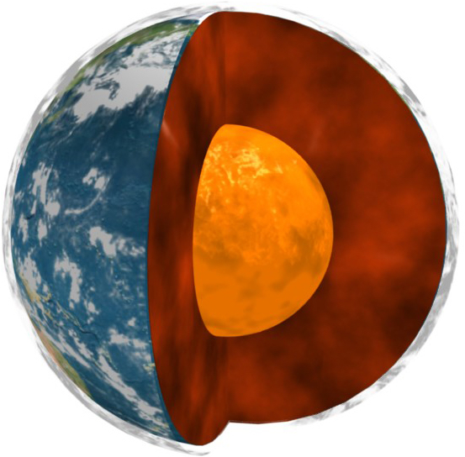
Why study meteorites?
Low-cost research samples
We don’t have to launch rockets or probes to collect and bring samples to Earth
Allows us to study the structure of planets (such as Earth)
Notes:
Meteorites can be used to determine the structure of different planets. The most dense materials (such as the iron-nickel metal which make up iron meteorites) sinks to the centre of the planet forming the core, while the less dense material forms the mantle and crust.
Image source: https://www.nasa.gov/topics/earth/features/earth20110309.html

Slide 9
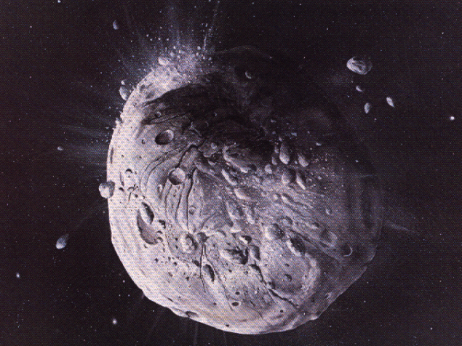
How do meteorites get to Earth?
Notes:
So how do meteorites get to Earth?
Cosmic collisions!
Material from collision flows off in random directions and eventually in orbit around the sun and cross path with Earth

Slide 10
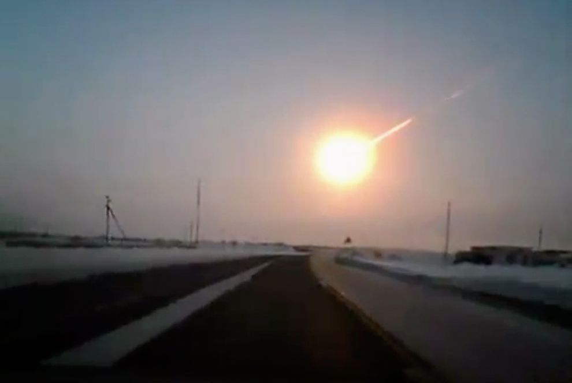
When an asteroid enters the atmosphere, it is then called a “meteor”
Chelyabinsk fireball over Russia, 15 Feb 2013
Notes:
Largest most recent fireball event occurred in Russia in 2013. Many meteorites have been recovered from this event.

Slide 11
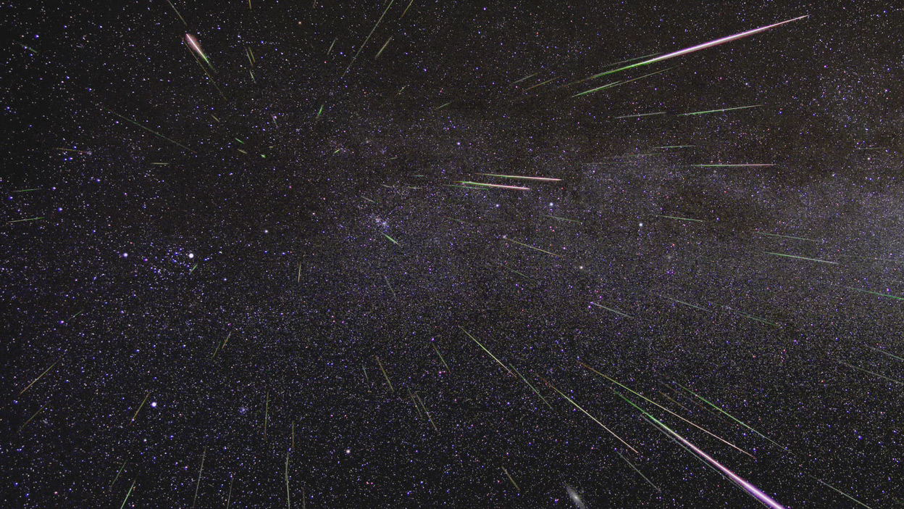
Meteor Showers
Group of meteoroids which enter Earth’s atmosphere
Best observed at night, without a full moon
Easier to see in an area without city lights
Notes:
The image shows the 2009 Perseid meteor shower.
Tips for watching meteor showers: https://www.jpl.nasa.gov/asteroidwatch/meteor.php
Image source: https://www.nasa.gov/topics/solarsystem/features/watchtheskies/perseid-meteor-shower-aug11-12.html

Slide 12
Annual Meteor Showers
Name | Date of Peak 2016 | Date of Peak 2017 | Date of Peak 2018
Quadrantids | Night of Jan 3 | Night of Jan 3 | Night of Jan 3
Lyrids | Night of Apr 21 | Night of Apr 22 | Night of Apr 22
Eta Aquarids | Night of May 4 | Night of May 6 | Night of May 6
Perseids | Night of Aug 11 | Night of Aug 12 | Night of Aug 12
Orionids | Night of Oct 21 | Night of Oct 21 | Night of Oct 21
Leonids | Night of Nov 16 | Night of Nov 17 | Night of Nov 17
Geminids | Night of Dec 13 | Night of Dec 13 | Night of Dec 13
Notes:
Some meteor showers can be observed over multiple evenings, only date of peak (best day to observe) is given.
Typically the dates of meteor showers don’t change much year to year but the number of meteors that can be potentially observed can vary. Best to do a quick internet search when the date of a meteor shower approaches to get more details and which part of the sky to look in.

Slide 13
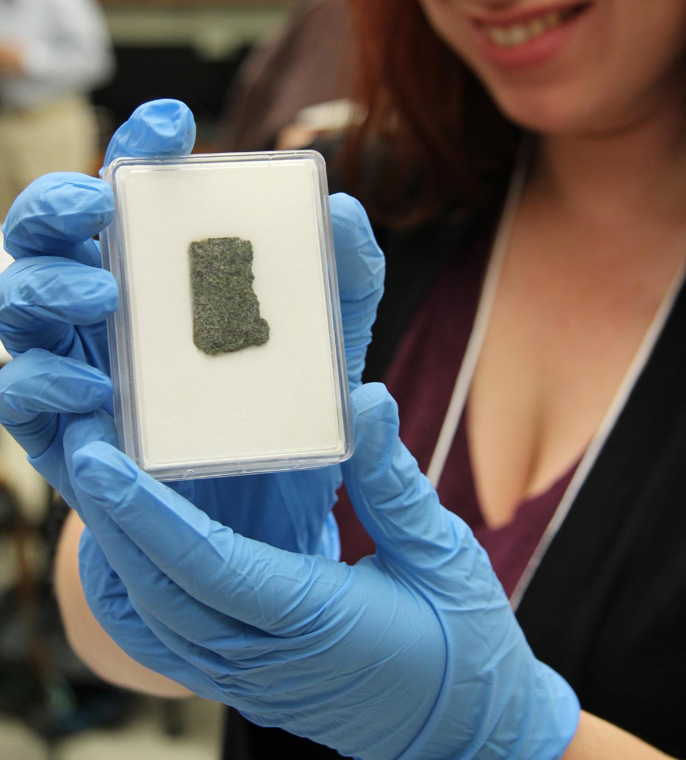
Types of meteorites
Many different types, but divided into two main groups
Chondrites
Non-chondrites
Notes:
There are many types of meteorites and some types may be divided even further (won’t go into those details here)

Slide 14
Features of meteorites
Fusion crust
Dark black outer coating or layer of meteorites
Attracts a magnet
Most meteorites contain some metal
Heavy for its size, due to presence of metal
Notes:
These are the most obvious features of meteorites that distinguish them from common Earth rocks.
Fusion crust is at most several millimeters thick along the outer surface of a meteorite. Forms when rock falls through atmosphere which causes the outermost surface of the meteorite to melt. Fusion crust is usually smooth.
The metal content of meteorites causes the magnet to “stick” to the meteorite. The presence of metal also makes meteorites feel heavier than expected when compared to an average Earth rock of similar size.

Slide 15
Notes:
Shows undifferentiated (left) to fully differentiated (right) bodies
Chondritic meteorites come from smaller asteroids that are too small to have undergone the differentiation process
Talk about core formation
Core formation is a result of differentiation where the denser metals (iron and nickel) sink to the middle of the body to form the metallic core.
Iron meteorites come from the core of a differentiated body.
Pallasites come from the mantle of a differentiated body, nearer to the core boundary than the crust, based on their high metal content (about 50%)
Achondrites come from the crust of differentiated bodies. These meteorites contain NO metal (lost to the core during differentiation)

Slide 16
meteorites
chondrites
non chondrites
asteroids
achondrites
irons
pallasites
asteroids
Moon
Mars
Notes:
Simplified overview of the different types of meteorites. Each type has multiple sub-types. Sources of each type are indicated (asteroids, moon or Mars)
Irons and pallasites are only known to come from asteroids. Achondrites can come from asteroids, the Moon or Mars. Achondrites potentially can come from other large rocky bodies in the solar system (Mercury, other moons) but have not yet nee identified, partly because compositions from these other bodies have not been determined fully.
All chondrites come from smaller asteroids, i.e. ones that were not large enough to undergo differentiation.

Slide 17
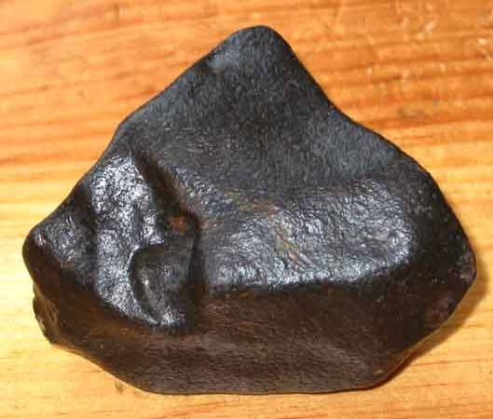
Chondrites
Most common type of meteorite
Also known as stony meteorites
Contain chondrules
From undifferentiated bodies, so they contain small amounts of metal
Notes:
Chondrites have similar compositions as rock on Earth but there are some notable differences, exceptions on next slide…
http://tinyurl.com/ltu2z39

Slide 18
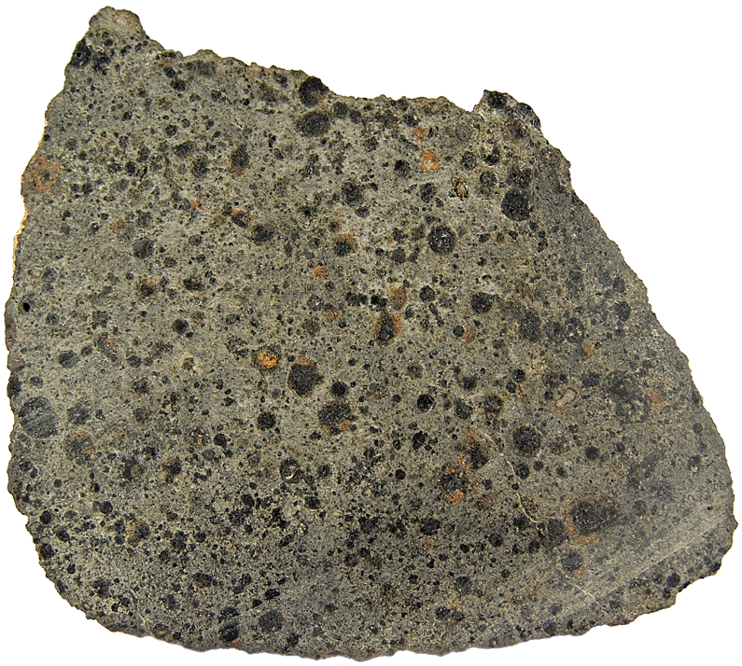
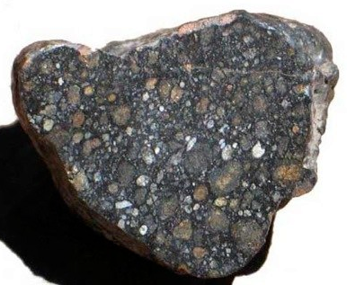
Notes:
All chondrites contain chondrules: small sphere-like inclusions. Chondrules were some of the earliest objects to form in the solar system and are not found in any rocks on Earth.
Most chondrites contain a small portion of iron-nickel metal, which makes them feel slightly heavier than if they contained no metal (like Earth rocks)
http://tinyurl.com/la5p5rj
http://tinyurl.com/26fur6
http://tinyurl.com/mv8nk8x

Slide 19
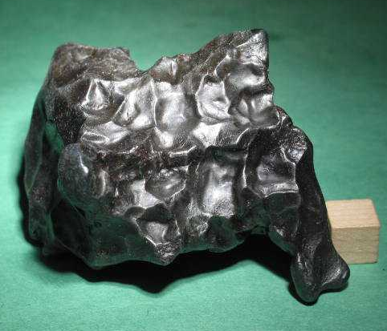
Non-chondrites: Irons
Made up of iron-nickel metal
When polished and etched they show a pattern unique to meteorites, called Widmanstätten
From the metallic core of a differentiated body body
Notes:
Iron meteorites are solid pieces metal and are quite heavy as a result.
Widmanstätten pattern is the outlines of giant individual iron and nickel crystals; can’t get single crystals of them that large on Earth, which is how we know they’re from space
Widmanstätten pronounced: Vid-min-stat-ten (this is a German word, “W” sounds like a “V”)
http://tinyurl.com/ldtk3us

Slide 20
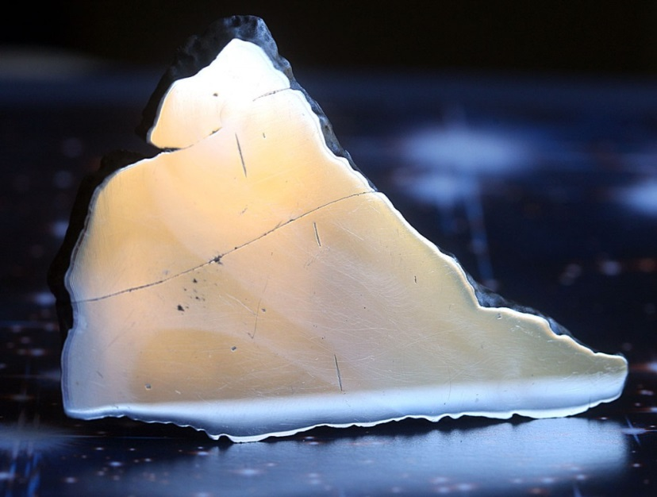
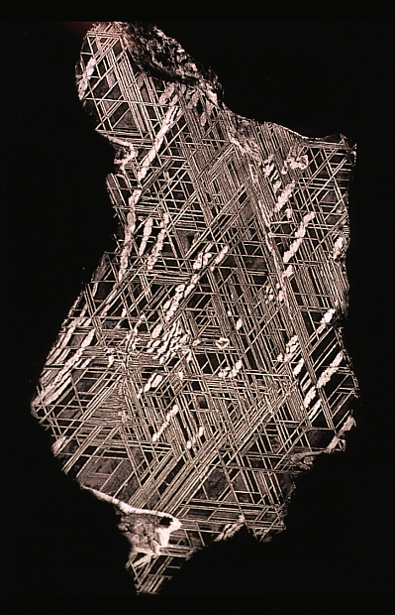
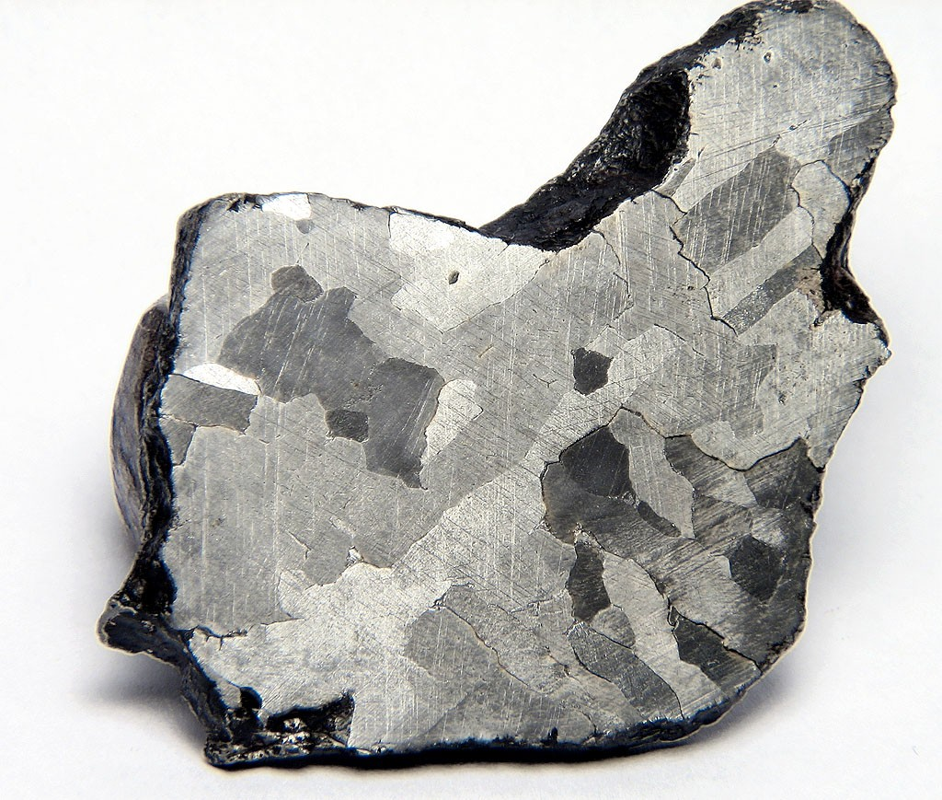
Notes:
Top left image is an iron meteorite that has been cut and polished. The polishing makes the surface very reflective like a mirror. The bottom left and right images are examples of polished meteorites that have then been etched with a special acid to expose the Widmanstatten pattern. The different Widmanstatten patterns indicated different types of iron meteorites and indicate different cooling rates (bottom left slower cooling over longer period of time vs. right sample with a finer pattern indicating shorter and more rapid cooling- though cooling in either case still occurred over millions of years).
http://tinyurl.com/mzndquc
http://tinyurl.com/lywqnkl
http://tinyurl.com/kl2u8yu

Slide 21
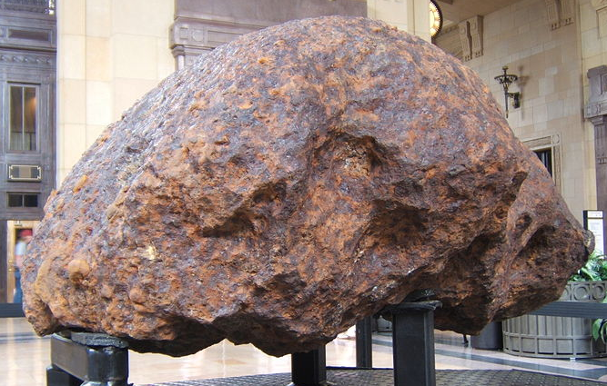
Non-chondrites: Pallasites
Made up of nearly equal parts of iron-nickel metal and large olivine crystals
Also called stony-iron meteorites
From mantle of differentiated body
Notes:
Pallasites form in the mantle of a differentiated body, near its iron-nickel core
Pallasite are one of the more rare types of meteorites, but are among the most beautiful (see next slide!!)
http://tinyurl.com/m8zl7jh

Slide 22
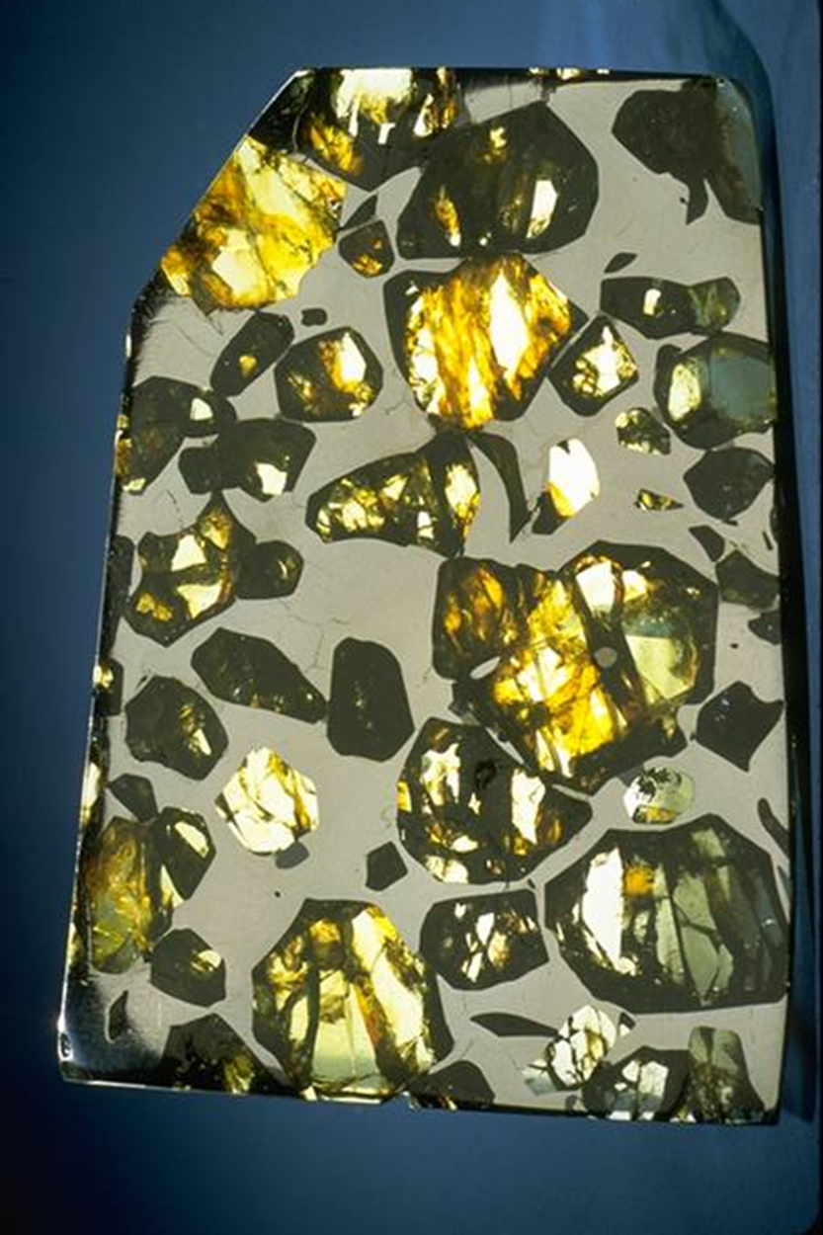
Notes:
Pallasites are about 50% metal and 50% olivine crystals (olivine crystals can range from green to orange in colour)
http://tinyurl.com/kf9jqvo
http://tinyurl.com/m5kjuhv

Slide 23
Non-chondrites: Achondrites
Achondrites are a type of stony meteorite but unlike chondrites they do not contain any chondrules (no metal present either)
Similar to basalts (or lavas) on Earth
Come from the crust of differentiated bodies including asteroids, the Moon and Mars
Notes:
The “A” in the word achondrite indicates that there is a lack of chondrules. Achondrites are a rare type of meteorite and their lack of metal and chondrules make them difficult to identify.
An achondrite is a stony meteorite that does not contain chondrules. It consists of material similar to terrestrial basalts or plutonic rocks and has been differentiated and reprocessed to a lesser or greater degree due to melting and recrystallization on or within meteorite parent bodies. As a result, achondrites have distinct textures and mineralogies indicative of igneous processes.

Slide 24
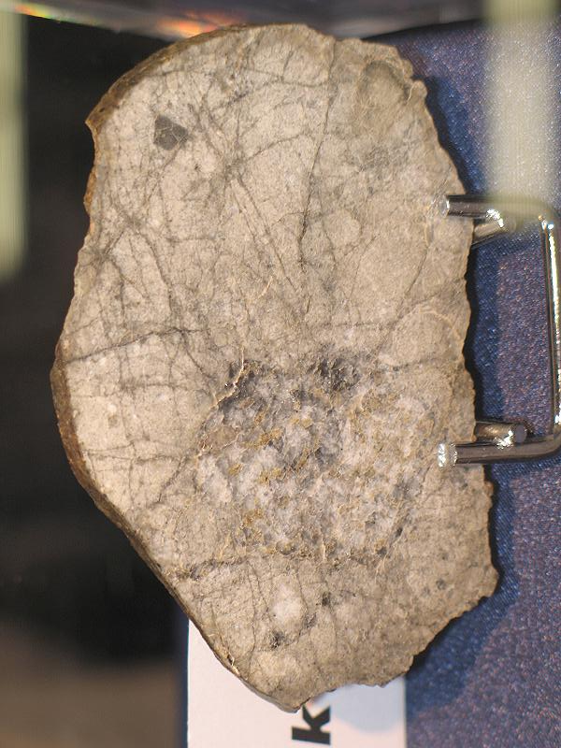
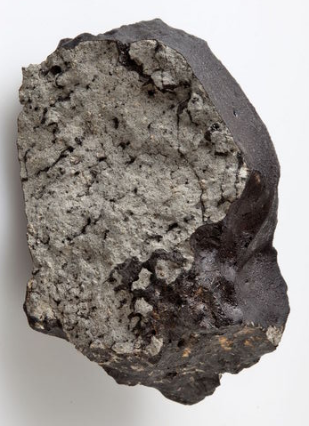
Lunar meteorite (NWA 4881)
Martian meteorite (Tissint)
Notes:
Achondrite meteorites are the most similar to Earth rocks, making them very difficult to identify. But also makes them very valuable, especially Martian meteorites since these are the only samples we have from Mars to study!!
http://tinyurl.com/loaxstw
http://tinyurl.com/lyvcwgv

Slide 25
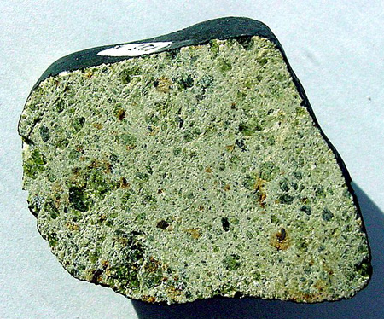
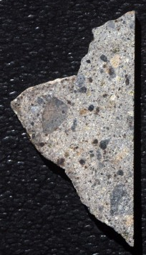
Achondrite types from asteroids: Howardite (left) and Diogenite (right)
Notes:
These achondrites most likely came from different asteroids. The inclusions seen inside these meteorites are not chondrules but small fragments of other rocks from the asteroid.
http://tinyurl.com/nysutyx
http://tinyurl.com/mxhodaq

Slide 26
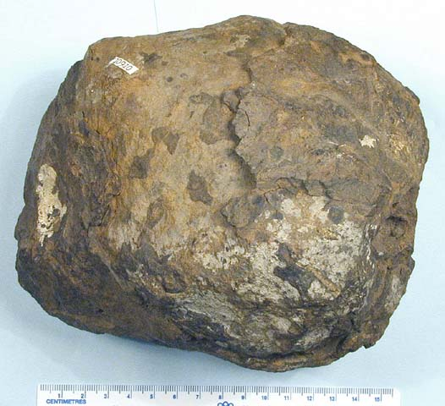
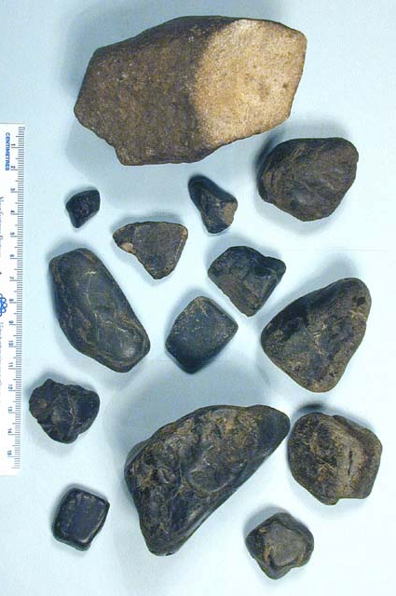
chert and clay ironstone
Notes:
The colours of these rocks can look similar to the fusion crust on stony meteorites, but unlike stony meteorites that have a very thin fusion crust, these rocks have the same composition throughout (they don’t have a crust)
http://tinyurl.com/kswwpsb

Slide 27
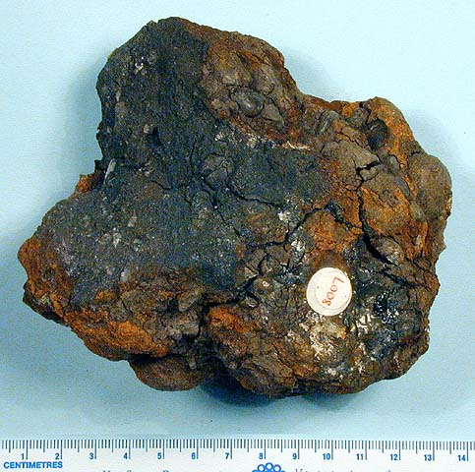
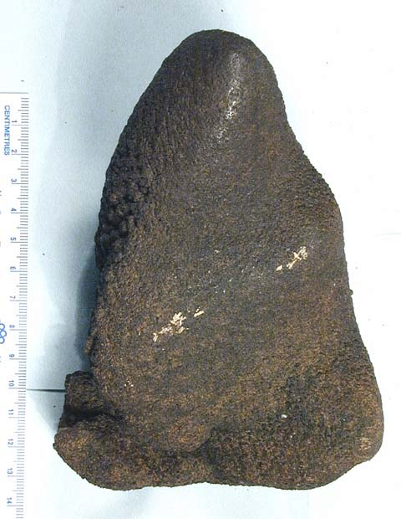
fused iron filings and pyritized conglomerate
Notes:
Due to the iron present in these rocks they will attract a magnet, but nevertheless, they are not meteorites (any iron that is present has been oxidized-no metal is present)
http://tinyurl.com/kswwpsb

Slide 28
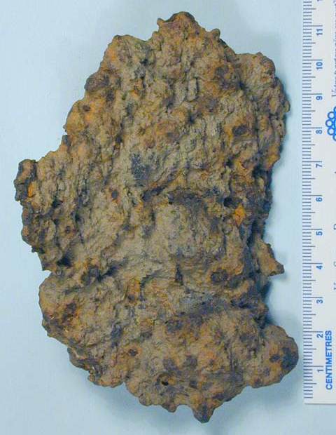
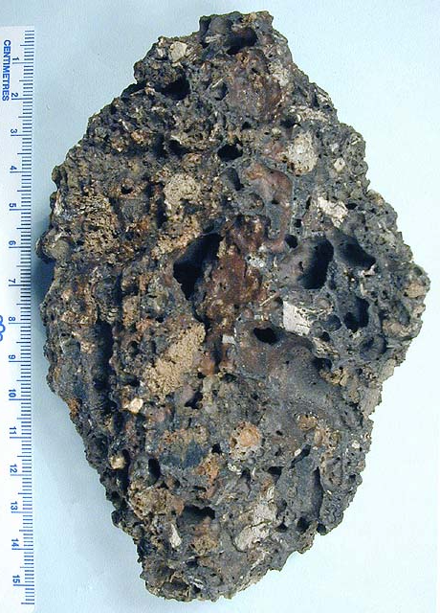
slag
Notes:
Slag could have slight magnetic properties and often appear rusty or have inclusions that could be interpreted as chondrules, but slag also tends to have holes or bubbles where gas pockets formed (meteorites do not contain such holes or bubbles)
http://tinyurl.com/kswwpsb

Slide 29
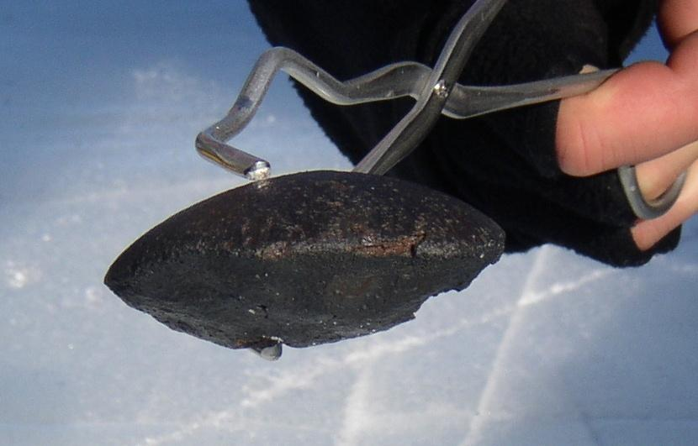
Where are meteorites found?
Potentially anywhere!
Easiest to find in African deserts or Antarctica
But unfortunately most meteorites are likely lost when they fall into the oceans
Notes:
African deserts make meteorites easy to find because dark coloured rocks sitting on light coloured sand are easy to identify. Same goes for Antarctica where meteorites are recovered from the snow or ice surfaces. These areas also are free of dirt and vegetation that could easy cover them up. They are also arid/dry places so the meteorites will be less weathered and rusted so will remain there longer than in wetter locations.

Slide 30
Thank you!
Questions?

