Slide 2
Robotic Arm Challenge
Dr. Parshati Patel and Sarah Simpson

Slide 3
Robotic Arm
A robotic arm is a programmable manipulator.
It has segments connected by rotary and linear joints. These joints allow for controlled movements.
Tasks that utilize robot arms depend on accuracy and repeatability.
These applications typically require repetitive motions.

Slide 4
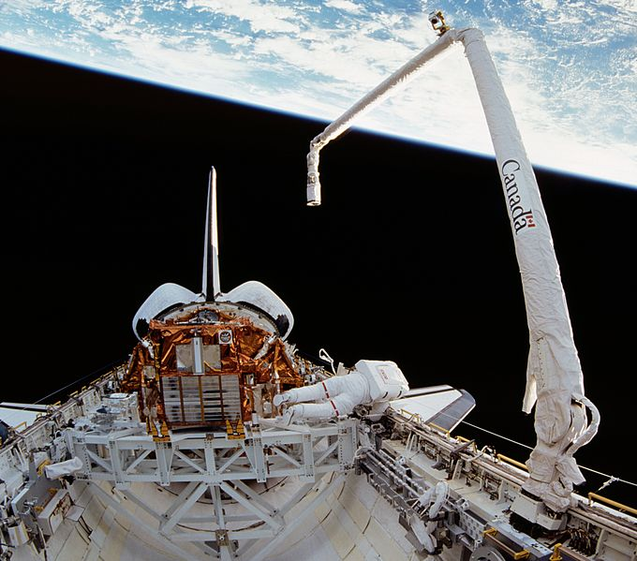
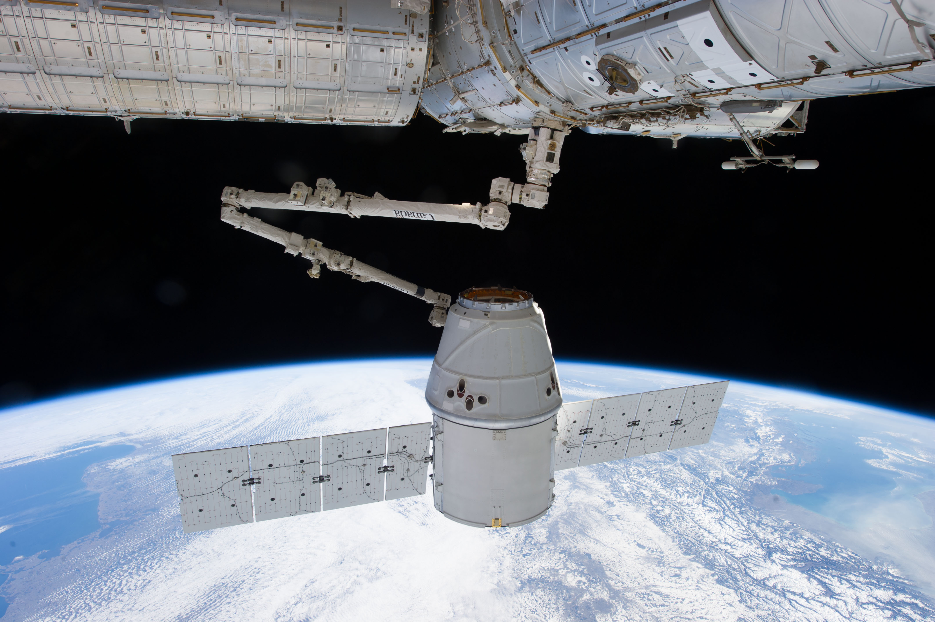
Canadarm

Slide 6
Robotic Arm Challenge
Build a robotic arm:
with a minimum of 3 working joints
that can grasp an asteroid (rock) from space (the floor)
That can deposit it in the cargo bay of the space station (the tabletop).

Slide 7
Robotic Arm Challenge Rules
Only incorporate the materials provided.
Scissors are allowed but they may not be incorporated into the design.
The robotic arm must be attached to the table only. It may not be supported by a student or other objects.
The cargo bay is the table surface. The asteroid (rock) must be deposited directly behind the arm attachment on the table.

Slide 8
Robotic Arm Challenge Rules
It must be operated without directly touching the arm with your hands. A material (i.e., craft sticks) may touch the arm. Be creative!
Include a minimum of 3 working joints. A joint is an attachment point between two parts that is flexible, movable or articulating. Think about the joints and ligaments in your body!
The arm must grab and release the asteroid. The rock should not be taped or stuck to the arm.
Depositing the asteroid must be a controlled drop. No flinging the rock! In space it would keep moving forever!

Slide 9
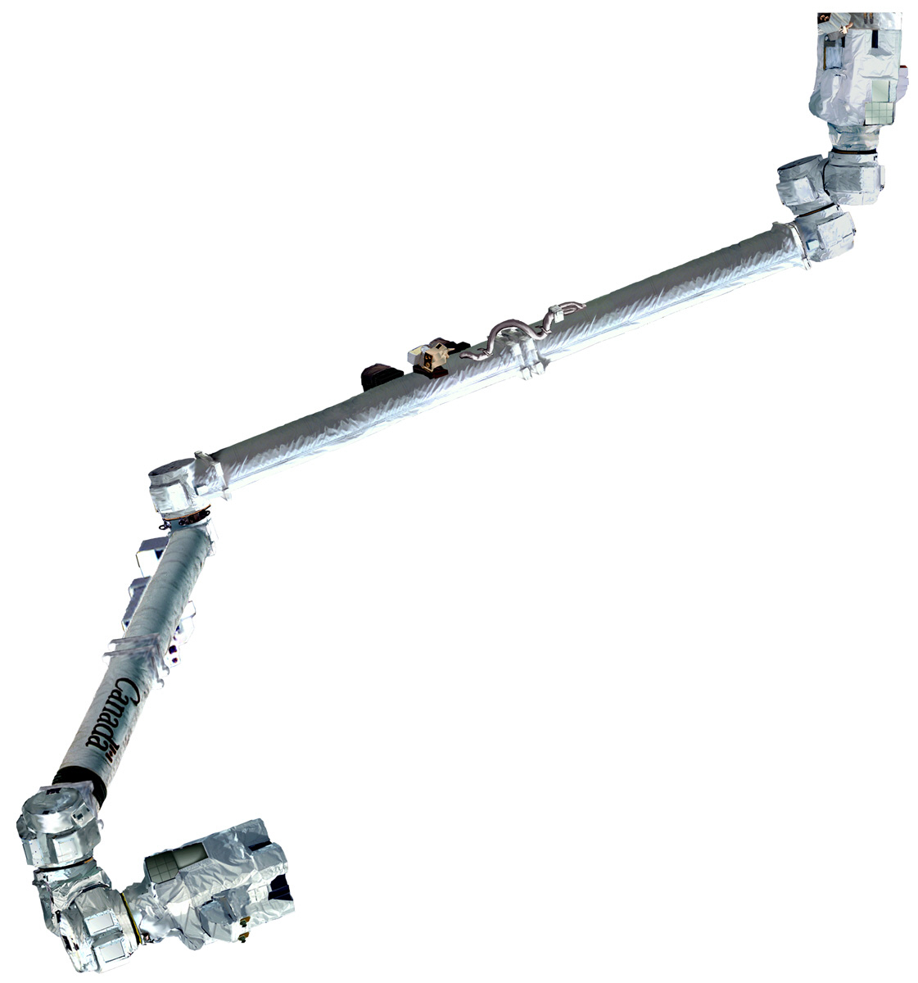
Good Luck!

Slide 10
Thank you!
Questions?

