Slide 2
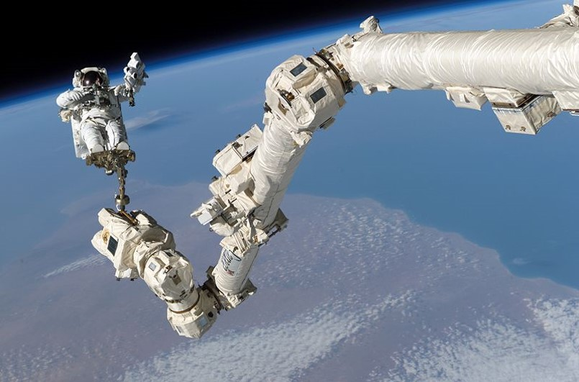
Mining Space
Prepared by: David Kirsh
Updated By: Christy Caudill & Duncan Maunder
Notes:
Hello, my name is XXX and I am from the CPSX at Western Univeristy.
Resources:
http://www.space.com/15391-asteroid-mining-space-planetary-resources-infographic.html
http://gizmodo.com/5904589/new-space-mining-company-unveils-plans-to-bring-asteroids-to-moon-orbit-today
http://en.wikipedia.org/wiki/Space-based_solar_power
http://io9.com/5980863/new-proposal-for-3d-printed-houses-on-the-moon-made-from-lunar-dust
http://io9.com/5963955/how-space+based-solar-power-will-solve-all-our-energy-needs

Slide 3
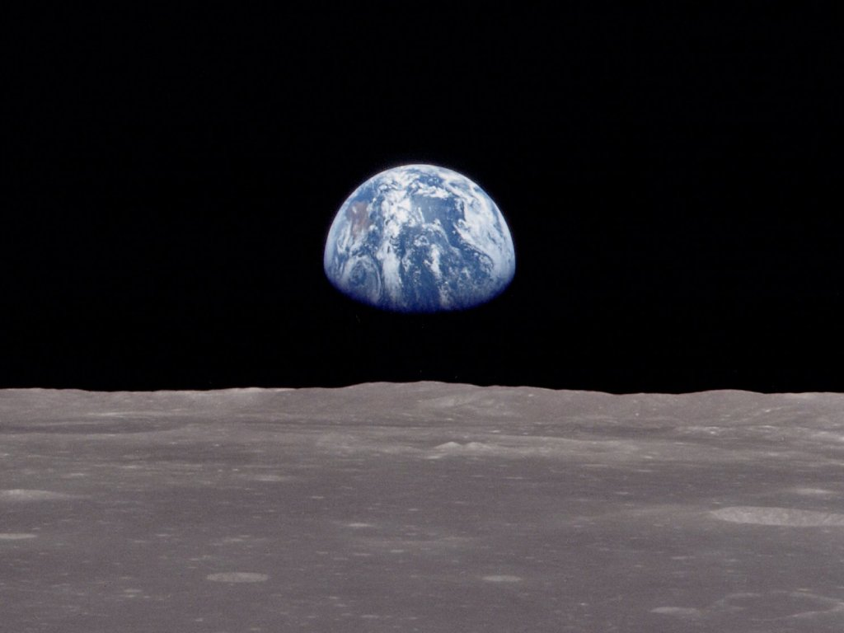
Our Finite World
Notes:
We often see our planet as infinite – and from our perspective it is huge and seems infinitely large with infinite resources that we can continually use.
But, when we look at an image like this, we can see that our world is not infinite. In fact, it’s really a small speck in the galaxy, the universe. It is precious, it is fragile, it is finite and (for right now) it is our only home.

Slide 4
Our Finite World
What will we run out of first?
Notes:
Our resources on Earth are definitely limited. Resources like oil and coal but also metals need thousands of years to form and currently we use more than we actually have and we use is quicker than Earth can regenerate them. We need to figure out how we can use the resources on our planet without destroying it even more than we have already, and we need to have a plan B, not if we run out of resources, because that will definitely happen, but when we run out of them. So what do you think will be the first resource we will run out of?

Slide 5
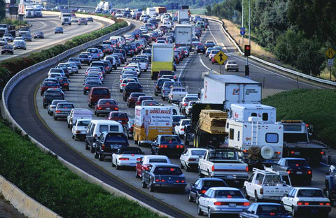
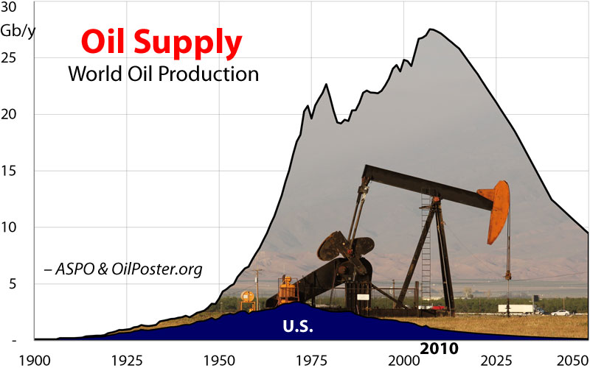
Peak Oil?
Notes:
Oil is one of the resources we use most, it is in every day live. You got here in the morning by bus or car. We use a lot of oil! We do have a lot of oil on earth...but it’s still only a finite amount. In fact, we have already gone past the peak of our world oil supply. The peak was in 2010 and from there on our supplies per year only got smaller, and continue to decrease, which means increased oil and gas prices.

Slide 6
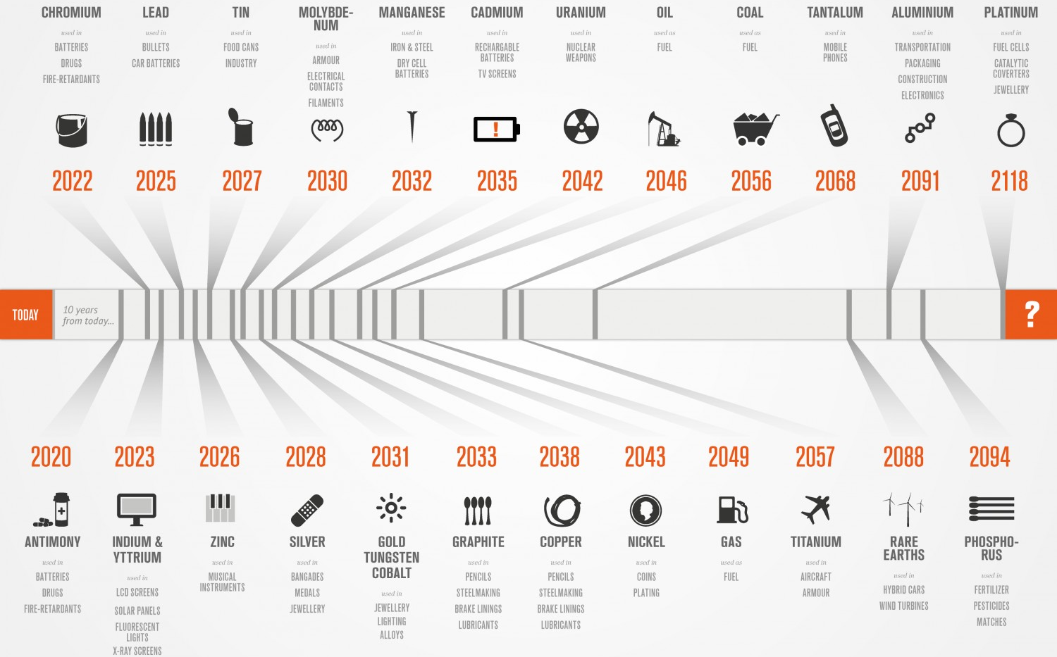
Everything Runs out …
Notes:
http://www.sciencescene.com/Environmental%20Science/03MatterandEnergy/03-Objectives.htm
But oil is not the only resource we should worry about. There are a lot more of these non-renewable resources, that we will eventually run out. Antimony, metal we use for batteries and drugs, will be depleted in 2020. Tantalum used in mobile phones will, at the current usage rate run out in 2068, silver will be depleted in 2028 and I could go on and on.

Slide 7
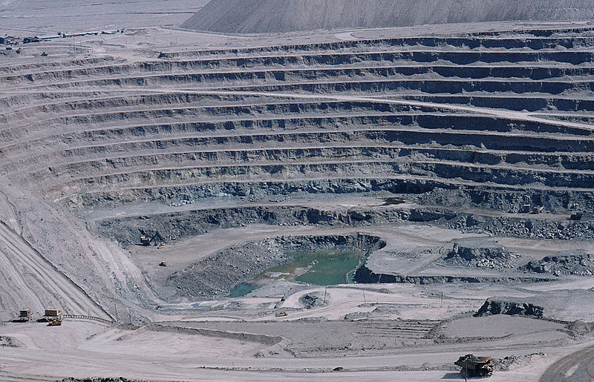
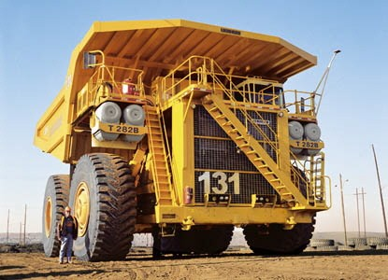
If we could mine more...
Copper : 40 years
Hundreds of tonnes of rock moved for one tonne of copper, or a few hundred grams of gold
Notes:
Copper is mined in huge open pits, where hundreds of tonnes of rock must be moved for each tonne of copper. This is the Chuquicamata mine in Chile, and it is one of the biggest open pit mines in the world. It is 4.3 km long, 3 km wide and over 900 m deep Can you tell what this little yellow dot is at the bottom of the hole? It’s a huge dump truck – you can see a full grown man standing beside it for scale.
This is the problem with mining on Earth: it is very inefficient. For example, to get a few hundred grams of gold or one tonne of copper, we need to move hundreds of tonnes of rock. This left over stuff is called “overburden
7

Slide 8
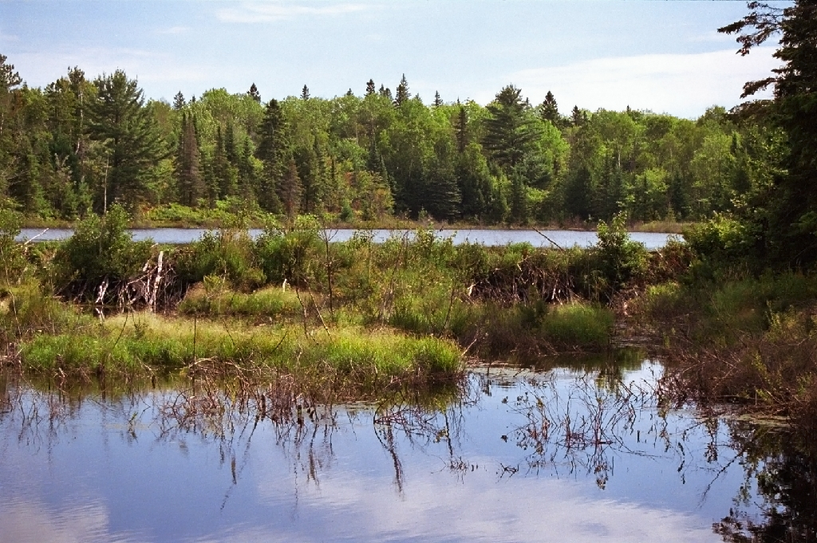
Would we want to?
Copper : 40 years
Photo: Thean, thewaystation.ca
Killarney, Ontario
Notes:
This is what wilderness areas in the Sudbury region look like.
And anywhere we're going to be establishing new mines is out in virgin territory, too-- untouched wilderness. What's that worth?
Do we want to ruin it, if we can avoid it?
8

Slide 9
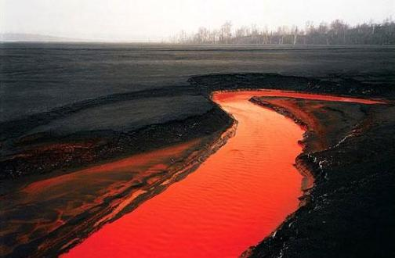
Would we want to?
Copper : 40 years
Photo: Edward Burtynsky,
- “Nickel Tailings # 34” Sudbury, Ontario
Notes:
When ore from mines is refined into metals there is another form of waste created called “tailings”. Mine tailings can be toxic for the environment. This isn't lava, but water contaminated with what's left over when you pull the rock from the mine-- 'tailings'. The red colour is because of highly toxic levels of dissolved iron. It used to look like (next slide).
The Sudbury area has been a centre for mining since the 1800s. The land suffered a lot of damage over that time, resulting in landscapes like the one pictured. In the 1970s works started to be done to rescue the land around Sudbury, and since then more than 9 million tress have been planted as a part of their regreening effort
9

Slide 10
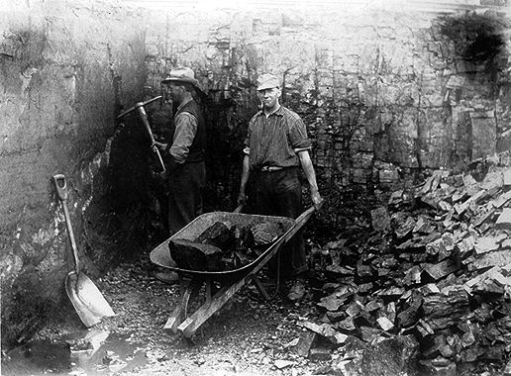
What does this mean for Canada?
Mining has been a significant primary industry in Canada for hundreds of years
It is especially important in northern communities
Important minerals mined in Canada include: gold, silver, platinum, iron, copper, lead, zinc, nickel, coal, and uranium
Notes:
Most of the minerals mined in Canada are at risk of being depleted in the next 100 years
What might the impact on mining communities be if the mineral being mined is depleted?

Slide 11
Going beyond...
Notes:
Well…what about going beyond our own planet?

Slide 12
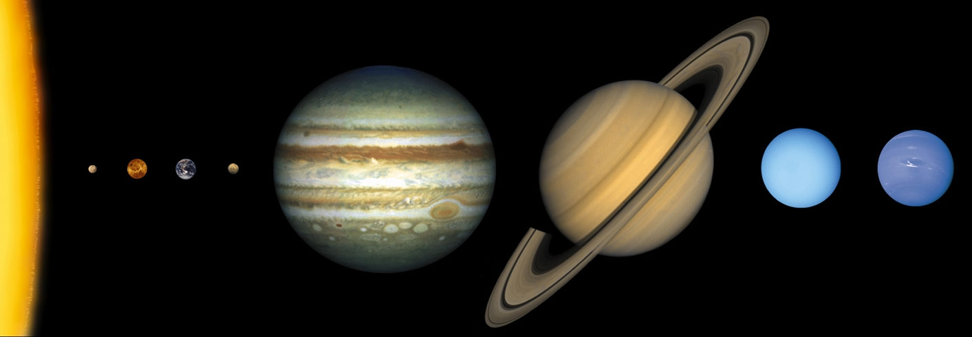
The other worlds?
Notes:
What about mining other planets in our solar system? Does anyone see any issues with this?
One obvious problem is that the four outer planets in our solar system are made out of gas. We could “mine” them for hydrogen and helium, but they’re far away, it is difficult to get there and we don’t have any experience of being on a gas planet let alone mining them, so that is not really an opportunity. Plus, they are bathed in radiation, so it would be very dangerous.
Moon won't work. We've never found any ore, and the geoloic processes on Earth (plate tectonics, water) that concentrate metals just aren't available on the Moon.
For the terrestrial planets, we don’t really know how enriched they are easy it would be to mine. If they’re like Earth, which we expect them to be, we would run into the same problem of having to move tons and tons of rock in order to get small amount of resources. Mars is still too far. We can barely get a rover there; nevermind one of those huge mine trucks. It's not practical to bring anything back - NASA hasn't even brought back tiny samples, nevermind the hundreds of tonnes of stuff we need for industry. Venus is hot enough to melt lead at the surface and is extremely inhospitable with acid rain, and high surface pressures . We can't go there even if we would be able to bring all the equipment there and bring stuff back.
Mercury, also too far away, too hot and too much radiation.
Where else could we look? (get responses from the audience --- hopefully someone will say asteroids!)

Slide 13
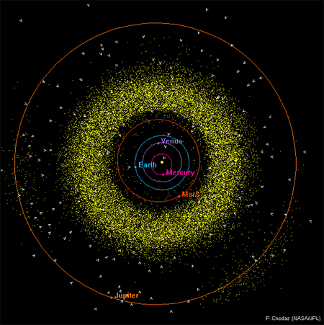
Asteroids: little chunks of resources
There are 1152 known asteroids easier to get to than the moon.
Notes:
Asteroids might be a good option! They are abundant in the Solar System. There is the so-called Asteroid Belt between Mars and Jupiter, which is full of Asteroids of different composition and size. Asteroids are basically leftovers or remnants of bodies that never grew large enough to become planets. Some of them can get quite close to Earth, the so called Near-Earth Asteroids. Their orbits are not always in the asteroid belt but can get close to Earth orbit and even cross Earth orbit, and when that happens they are easier to get to and from than the Moon (because of smaller gravity), and the resources are relatively easier to get at.

Slide 14
Types of asteroids
Asteroids are classified based on their composition
Three main types:
S – Stony asteroids
C – Carbonaceous asteroids
M – Metallic asteroids
Notes:
Carbonaceous asteroids are the most common → about 75% of known asteroids

Slide 15
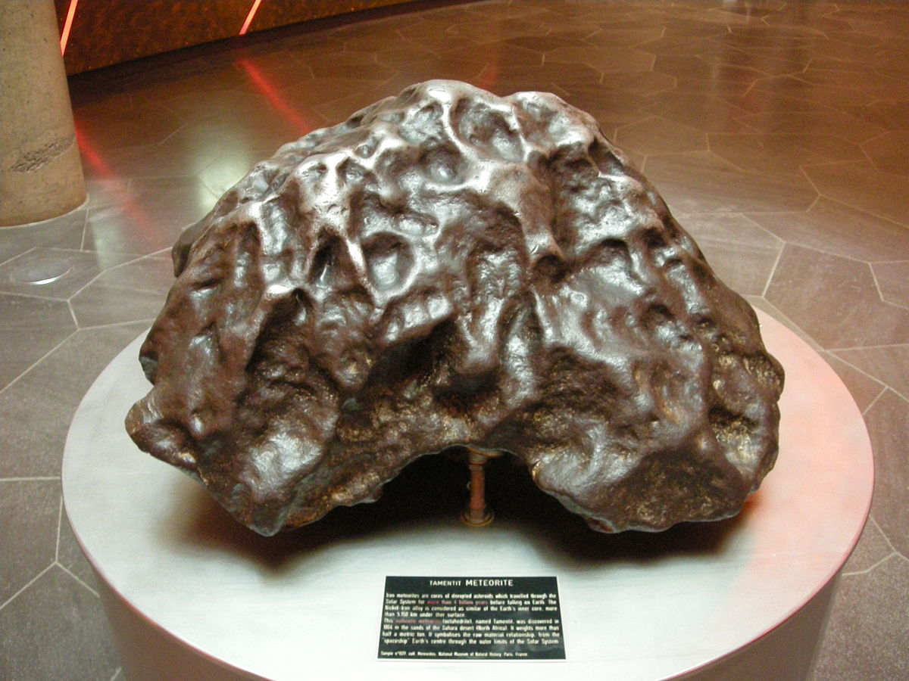
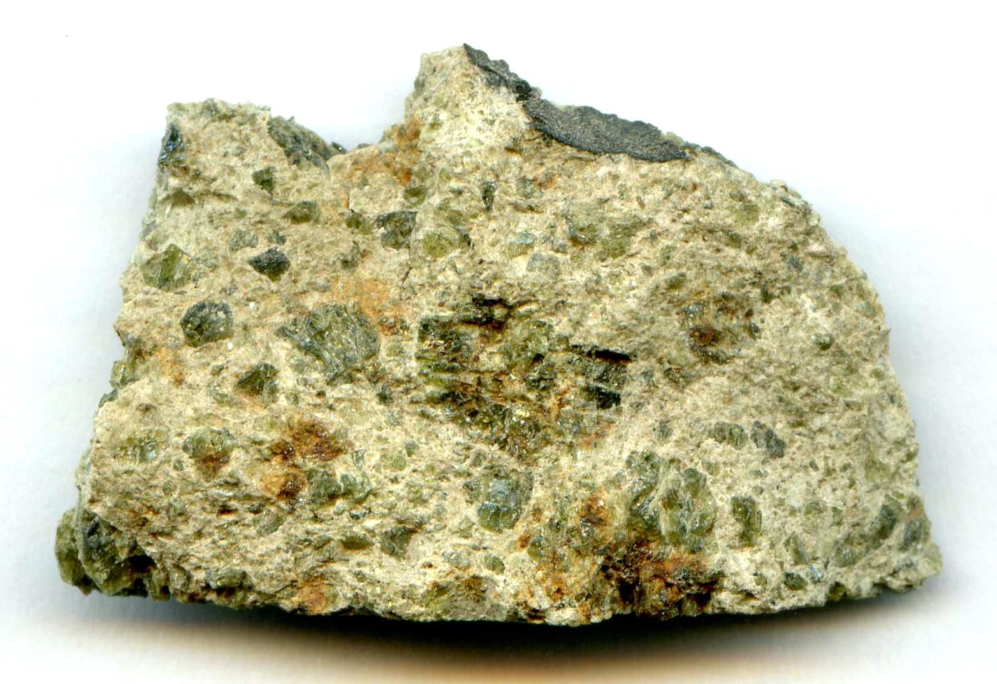
Types of asteroids
We can tell the composition based on the colour and brightness of the asteroid
S – Stony asteroids (greenish to reddish)
C – Carbonaceous asteroids (greyish)
M – Metallic asteroids (reddish)
Notes:
Scientists use instruments to measure the light emitted by asteroids in order to classify them. We can compare the spectrum from asteroids with the spectrum of meteorite samples to figure out where the meteorites may have come from.
Left image: stony meteorite, notice the greenish colour
Right image: iron rich metallic meteorite. The iron gives it a reddish tinge

Slide 16
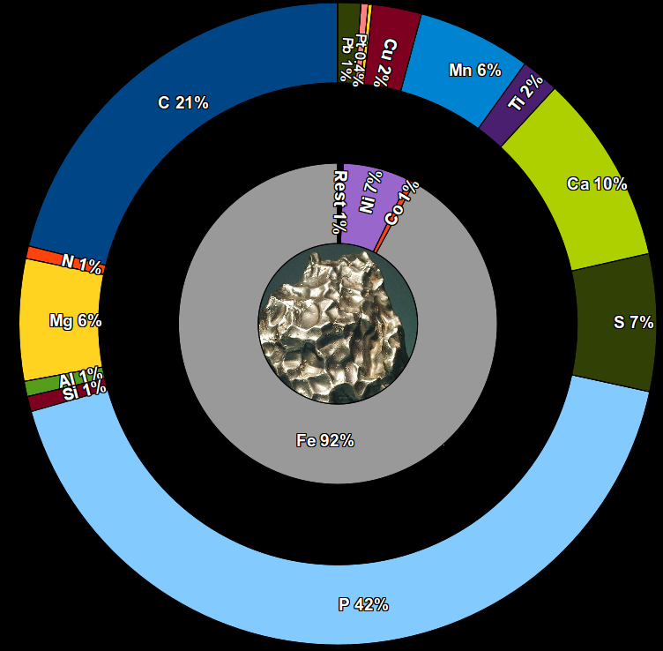
Pre-sorted
Notes:
Iron-rich M-type asteroids would be very valuable to us on Earth. They mainly consist of iron, nickel, and Cobalt, and 1% other elements which you can see in the outer circle - platinum, silver, aluminum, Titanium…all those wonderful things that we like to use here. 0.4% Pt of 1% might not sound like a lot, but in fact this ratio is a lot higher than what we find on Earth.
Example/Fun Fact: A scientist named Hazel Prichard is trying to find a way to recover platinum from dust on the side of roads. Only a handful of dust pieces out of every million are platinum, but this is still an area worth looking in to. That’s how rare platinum is!

Slide 17
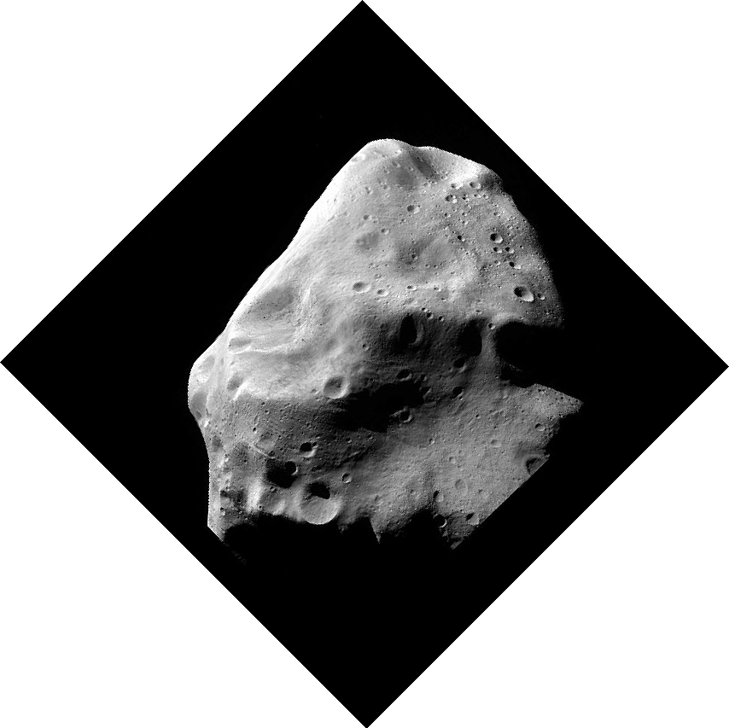
A metallic asteroid 100m across
would be worth
2.2 billion dollars
if brought back to Earth.
Notes:
So, if we brought back even 1 small asteroid (about 100 m across), that would be worth 2.2 Billion dollars, and it would hold more platinum than we have EVER mined on Earth...EVER!!!
This idea is all well and good, but how plausible is it? There are already companies that have started looking into it!

Slide 18
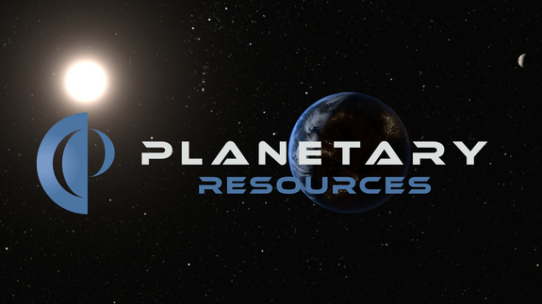
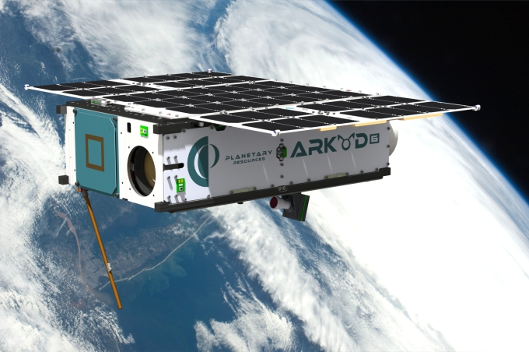
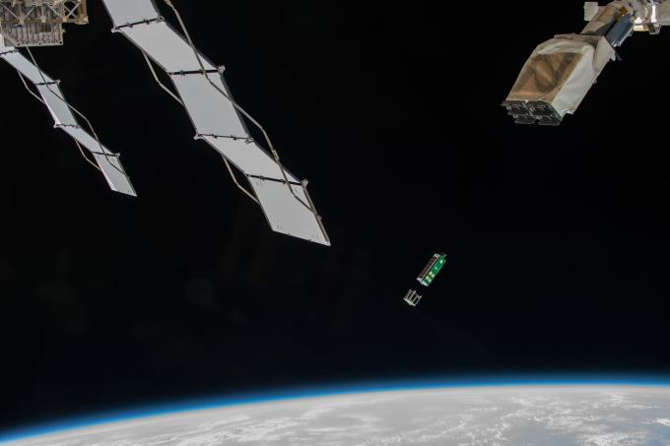
April 2012
Notes:
Planetary Resources was founded in April 2012, and includes several high-flying billionaires such as James Cameron (director of Titanic and Avatar), Peter Diamandis (CEO of XPRIZE Foundation) and Larry Page (Google founder) working together with some very experienced scientists and engineers who have worked with NASA and other space missions.
They launched their first spacecraft successfully into space in April this year, first to the International Space Station and from there into Earth’s orbit where they tested the spacecraft, its technology and system

Slide 19
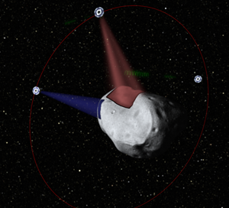
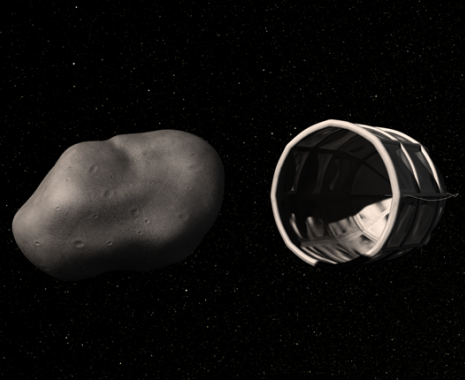
April 2012
Notes:
They plan on mapping thousands of small asteroids to determine their position, composition and accessibility of resources. They will then choose the best candidates, and at some point plan to capture them using basically what looks like a bucket and deliver it to a point of need --- either in orbit around Earth or elsewhere in the Solar System. But this is all still unclear.
Remember, asteroid composition is determined using spectroscopy. Checking composition to look for Carbonaceous and Metallic asteroids, which are the most useful for collecting resources.

Slide 20
Notes:
Before they start mining precious metals from asteroids, they intend to produce fuel in space from specific asteroids, so-called carbonaceous chondrites, which rich in water that can be broken down into H and O , which can be used to make highly efficient rocket fuel. The oxygen can also be used breathable air, or you can use the water for hydration.
Fully enclose a small asteroid or position a cold plate in the vicinity of a large asteroid. Concentrate and direct freely-available thermal energy from the sun onto the asteroid. At temperature, water will volatilize similar to what occurs naturally with approaching comets. The gaseous water will freeze on contact with the cold plate in a largely pre-concentrated form. Once the desired quantities are captured, release or depart from the asteroid to deliver the fuel to the point of need, in Earth orbit, or elsewhere in the Solar System.

Slide 21
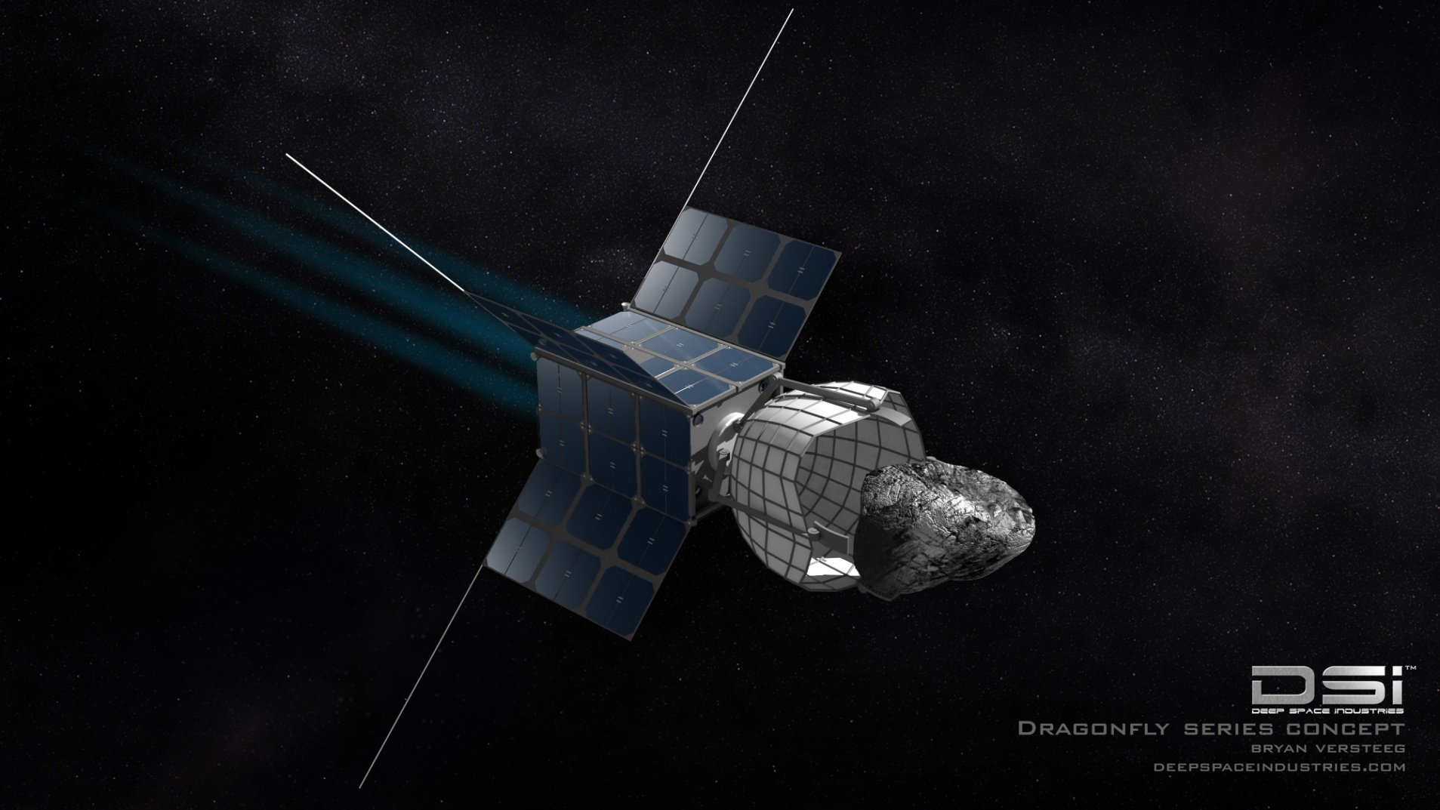
January 2013
Notes:
Another company, Deep Space Industries was formed in January 2013 and they have a more in depth plan of actually mining asteroids for metals.
In the first step, the Prospecting, they plan to send tiny so called Firefly spacecrafts that are only 30cm long and 15cm wide to promising asteroids and study them more in depth (detailed composition, water, PGEs, REE, structure, spin rate, etc.) and to locate and evaluate resources.

Slide 22
January 2013
Notes:
The next step is to harvest and extract valuable material from the asteroid using Harvestor spacecrafts, which will then transport the material to a processing depot in Earth orbit where then the detailed separation and processing of the material happens.

Slide 23
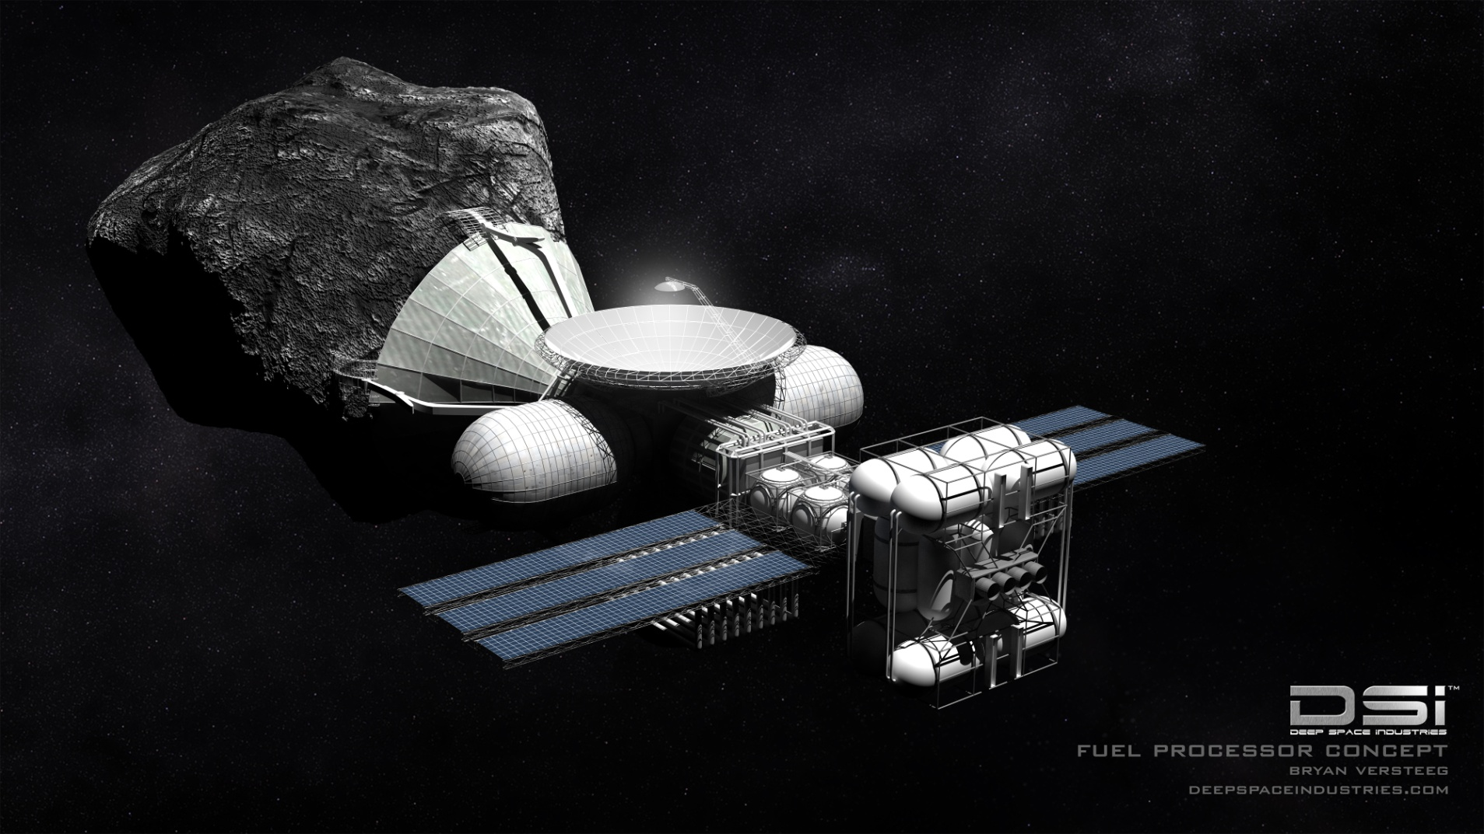
January 2013
Notes:
The next step is to harvest and extract valuable material from the asteroid using Harvestor spacecrafts, which will then transport the material to a processing depot in Earth orbit where then the detailed separation and processing of the material happens.

Slide 24
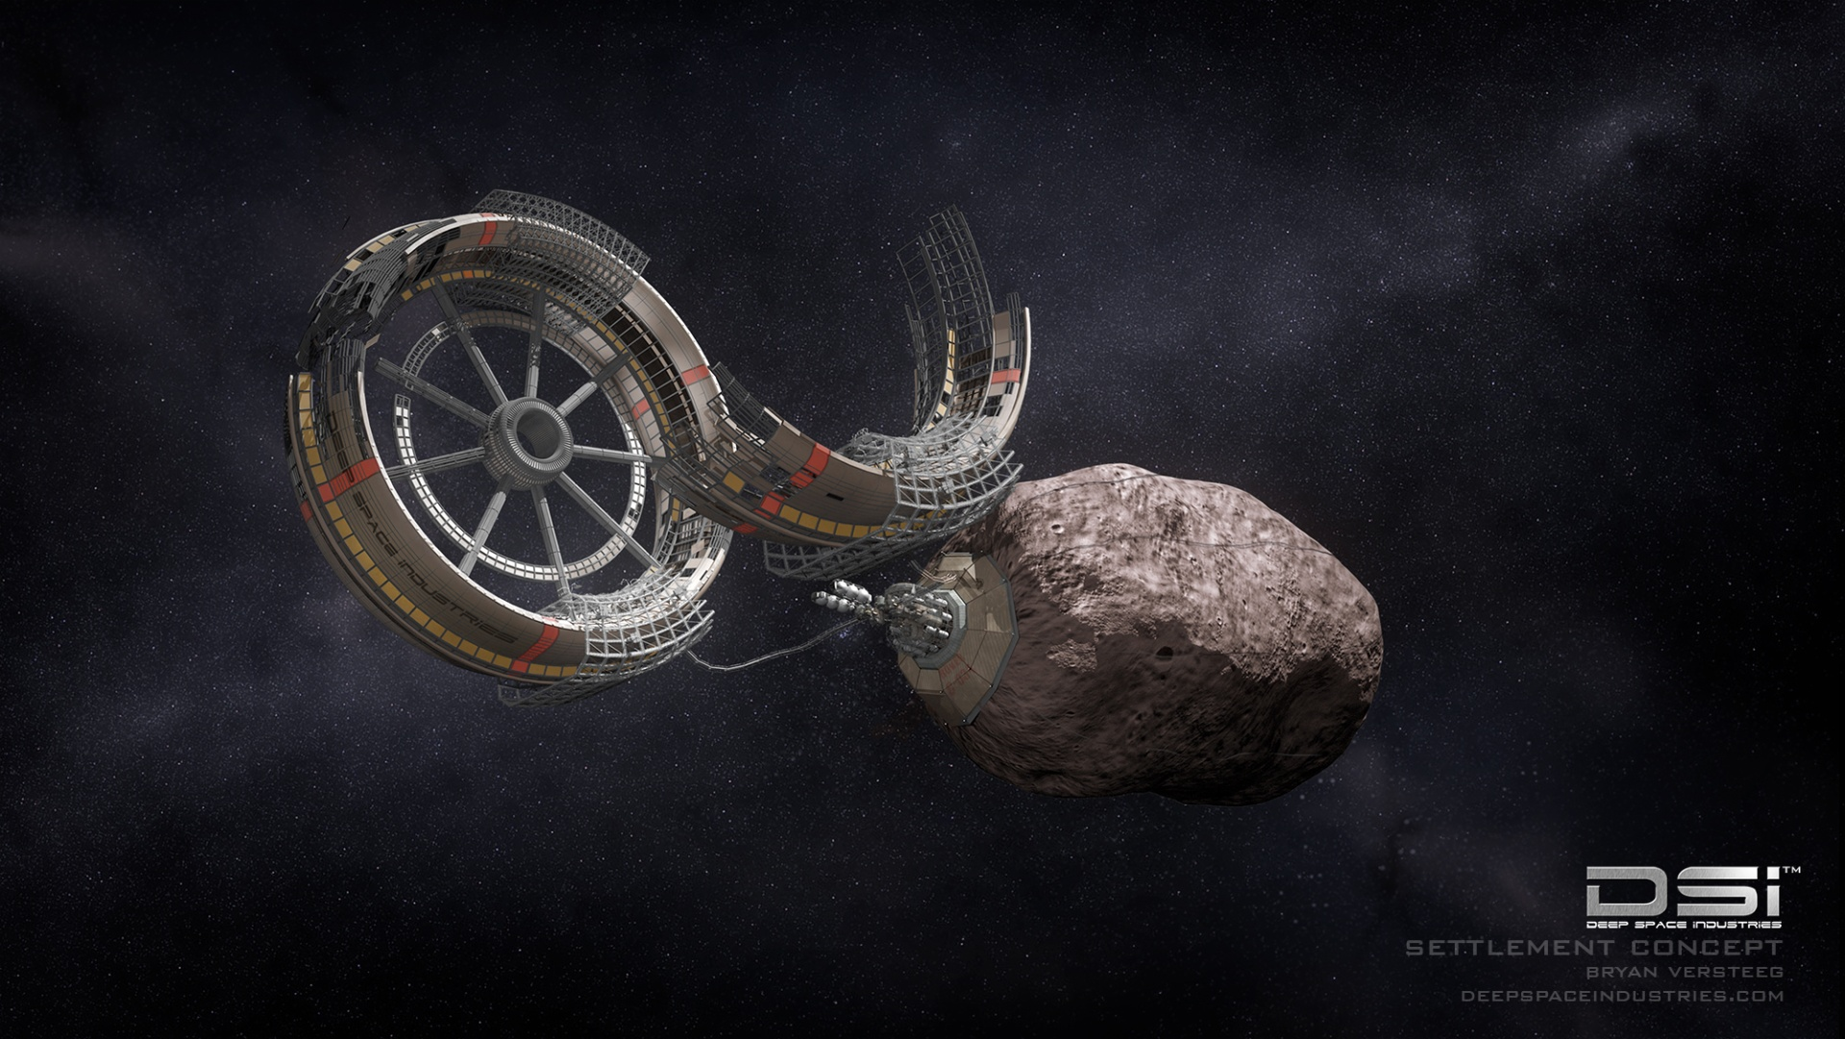
January 2013
Notes:
They then plan on manufacturing parts, equipment and end products there in Earth orbit. This is a challenge but also has advantages, for example you can produce large equipment which that would never fit into a launch vehicle, right there in space, or the absence of atmosphere keeps metal-forming processes free from oxygen, so that nearly 100 percent pure iron can be easily produced; free from impurities, it is stronger than terrestrial iron and can hold water indefinitely without rusting.

Slide 25
January 2013
Notes:
If Deep Space Industries has its way, there’ll be a small robotic lander on a nearby asteroid in just three years (by 2019). That’s the latest phase of the California-based asteroid mining company’s plan to bring about an outer space real estate boom by creating a resource supply chain off Earth.

Slide 26
PROMPT
Percussive and Rotary Multi-Purpose Tool
Deltion Innovations is an Ontario company that is developing a mining tool that can be used to drill and collect material from planetary surfaces
The company was awarded a contract from the Canadian Space Agency in 2016 to work on the tool
Notes:
The drill is being designed to be used on the moon to drill and collect ice. It is much more efficient to get water (ice) in space than it is to send it up from Earth.
The hope is that the PROMPT tool would be ready for a mission in 2018

Slide 27
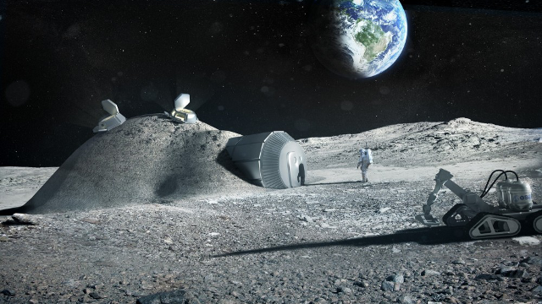
3D Printing on the Moon
Notes:
The moon is a great place to build a “launching station” because it’s close to Earth (only takes 3 days to get there), but it is much easier (and therefore less expensive) to launch spacecraft and equipment off the moon.
But, taking supplies to the Moon to build habitats, etc., is very costly. So, another idea is to use 3D printing techniques using the top layer of dust (called regolith) on the Moon. Just as we’ve seen people here on Earth build whole houses with a 3D printer, we can do the same on the Moon….and not have to take any supplies with us except the printer!

Slide 28
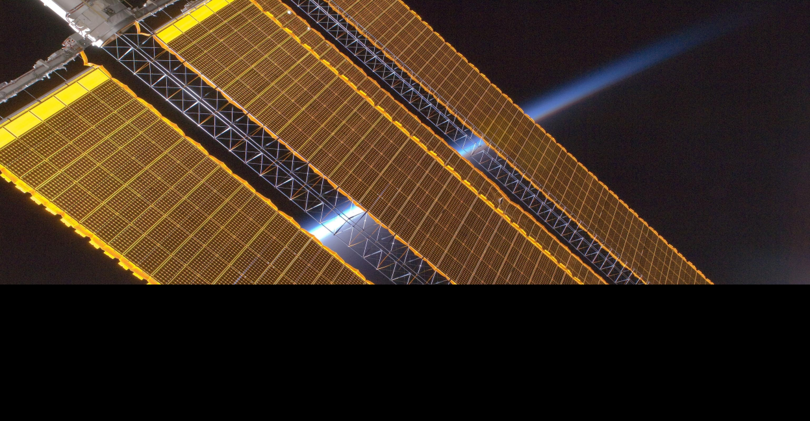
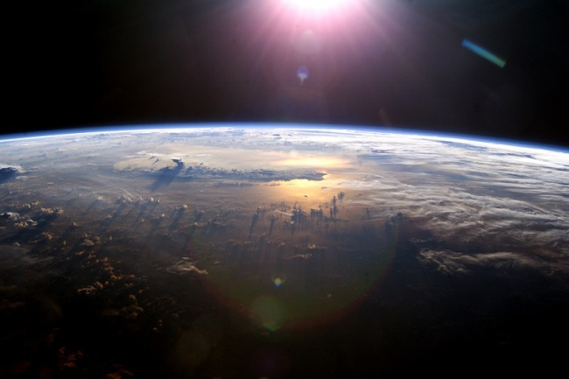
Solar Power
Is more efficient in space!
On Earth the atmosphere absorbs around 25% of solar energy.
Solar power on Earth also has to account for night and cloudy weather.
Notes:
One other benefit with working in space, is that the Sun is shining all the time AND there are no clouds or atmosphere to lessen that power. So, these missions will all depend on solar power.
On Earth, solar power isn’t very efficient.
In space, the Sun puts out 1366 W/m^2. We have an atmosphere that absorbs about 25% of that energy, and the sun isn’t up in the sky all the time, so that takes down the power. Finally, we have clouds, so in the end we only get about 10% of the sun’s energy.

Slide 29
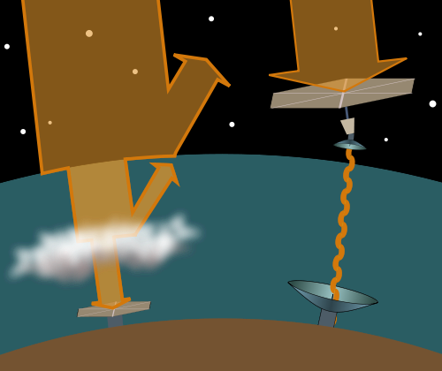
Space Solar Power
In Space :
Microwaves could transmit energy right to Earth’s surface with Earth with 80% efficiency.
That's SEVEN TIMES as much power as solar panels in London can get, and the panels are always collecting sunlight!
Notes:
Not only can missions in space use solar energy to power themselves, but we can harness this power in space to use on Earth. If we put a large solar panel in space to collect energy from the sun, and then beamed it down using microwaves (not harmful to us) it would be much more efficient!

Slide 30
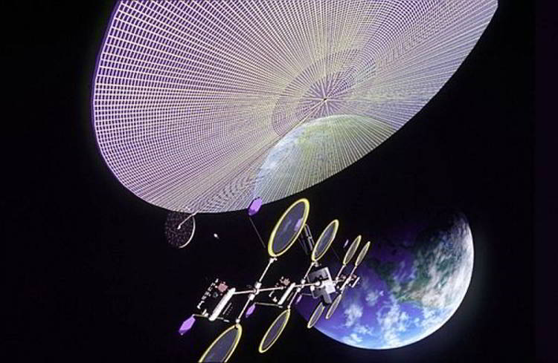
Notes:
Of course, the reason why we haven’t done this yet is we’d have to make large solar panels in space --- this is very difficult and expensive. And here manufacturing in space could help us. Several companies are working on different ideas though --- maybe we’ll eventually see this type of technology in the future!

Slide 31
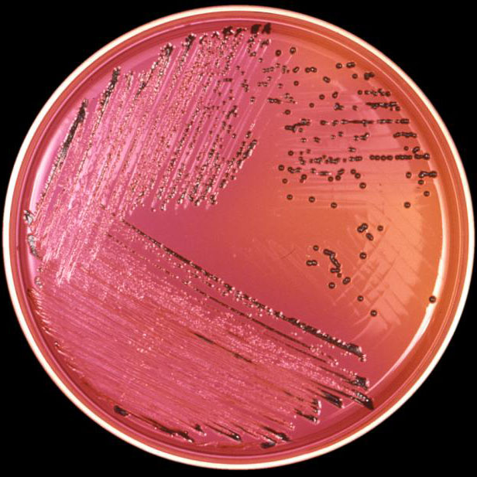
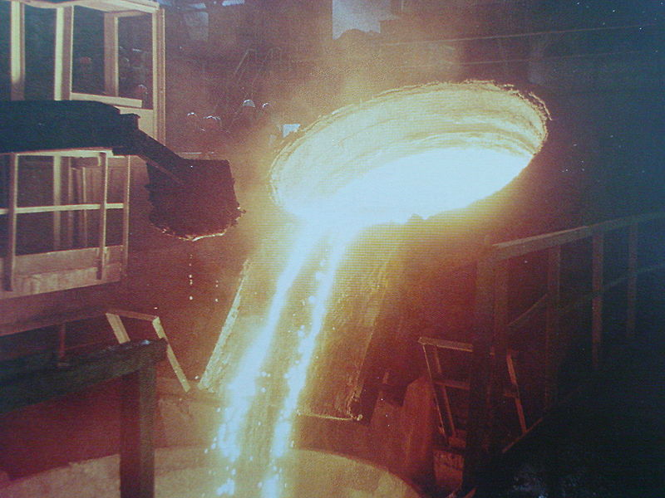
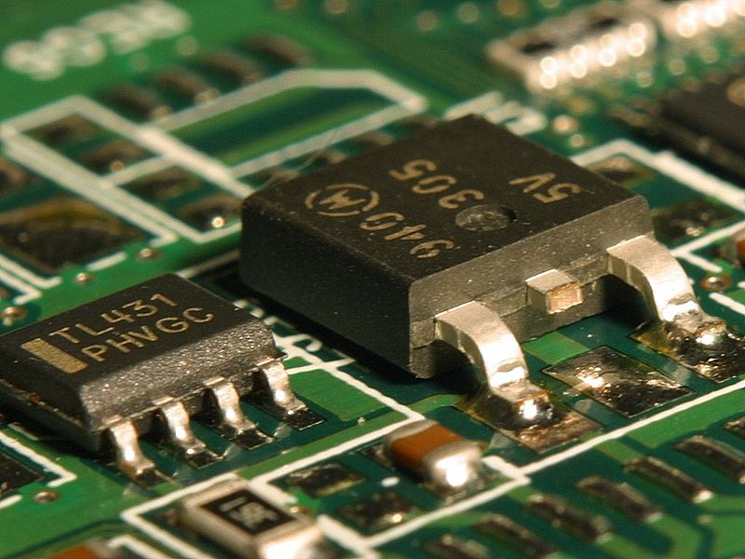
While we're up there...
Medicine
Metallurgy
Manufacturing
Notes:
There are other benefits for working in space too:
Metallurgy:
Experiments on Mir and ISS show that you can make stronger, lighter alloys in zero-g than you can on Earth.
Manufacturing:
Crystal growing processes like the ones that make solar cells and computer chips work better in zero-g. Anything that requires hard vacuum benefits from being outside in space; we can't get all the air out of even the best vacuum chambers here on Earth
Medicine:
Purifying pharmaceuticals is easier without gravity. So is working with microbes: the last shuttle brought down a test vaccine for Salmonella from ISS; the same company is also working on one for MRSA. That is a huge deal—the amount of money saved from people not getting salmonella would pay for the entire space program so far.

Slide 32
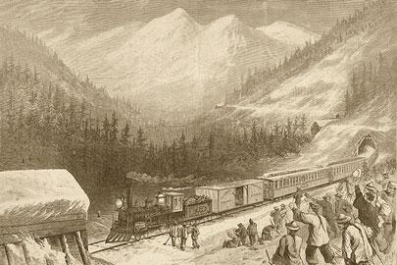
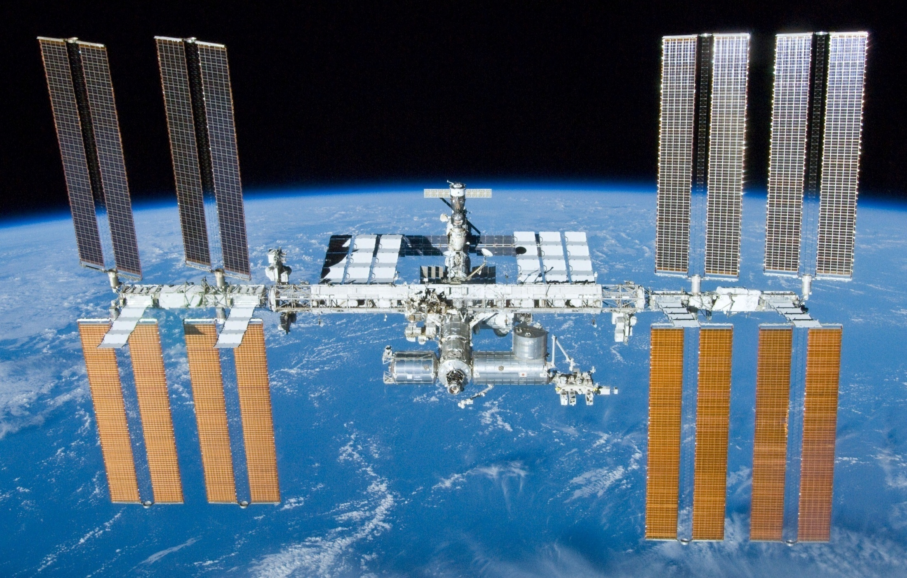
Dreams, or Inevitability?
Notes:
This might sound like science fiction right now, but lets look at the facts:
- Our civilization runs on energy, and we're rapidly depleting our most essential source: fossil fuels.
- We're running out of other resources we need to replace existing infrastructure, and mining is a horribly polluting business we don't want to do here.
The asteroids can provide us with all the elements we need to mine on Earth, and we can get at them without polluting the biosphere.
we can use those resources more effectively, in space, to generate energy directly and beam it down to Earth. Unlike solar power on earth, space-based solar power is always on and not affected by cloud cover.
It seems futuristic, but people are putting these ideas into practice as we speak. Who knows? Maybe in 10-20 years, we’ll start seeing these missions as reality. Remember, things like cell phones, GPS, and satellite TV used to seem crazy, too!

Slide 33
Thank you!
Questions?

