Slide 2
Benefits & Challenges of Space Exploration
Prepared by: Raymond Francis
Updated by: Cassidy Gagnon

Slide 3
Brainstorm #1
Can you think of:
Challenges of space exploration? Sending humans to space?
What are the main stages of a successful mission to another planet, from start to end?
???

Slide 4
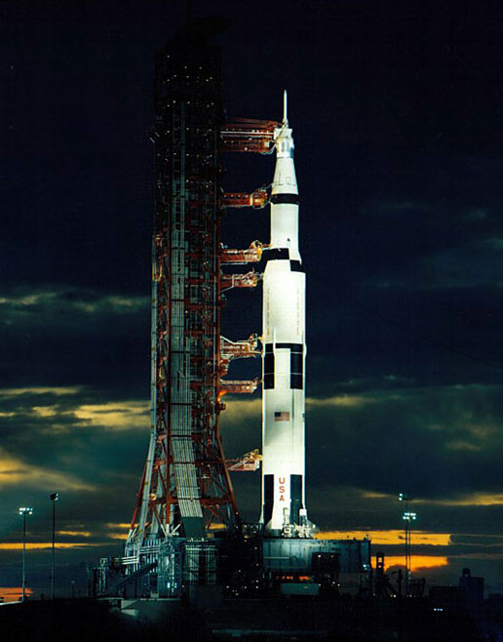
Outline
Space exploration is a hazardous, yet rewarding, prospect!
We'll look at each
stage of a space mission:
1 - Going to space
2 - Surviving in space
3 - Working in space
4 - Visiting the planets
5 - Returning to Earth Space Successes
4
Notes:
We will talk about the difficulties associated with each of the give stages of space missions.
4

Slide 5
What are Space Hazards?
5
Notes:
Ask students to write or draw what they think could be a space hazard
5

Slide 6
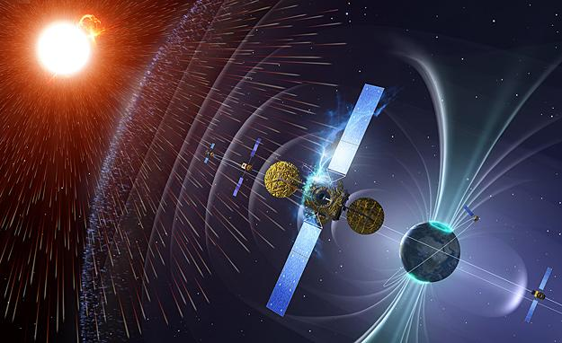
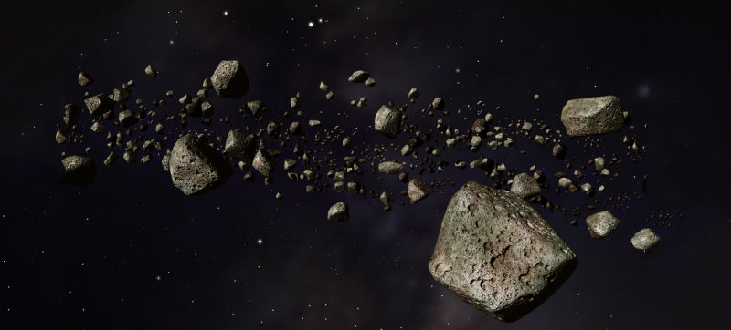
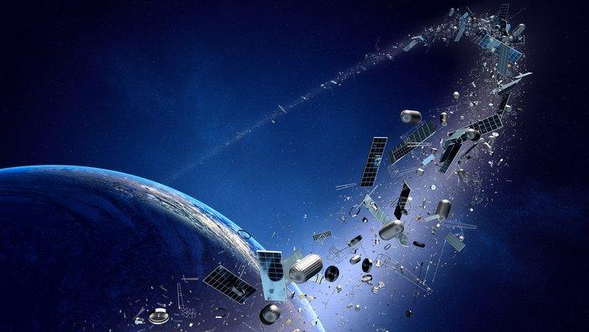
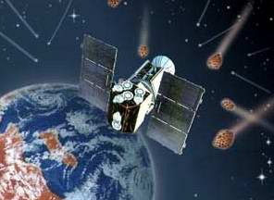
What are Space Hazards?
6
Notes:
Ask students to write or draw what they think could be a space hazard
6

Slide 7
Going to space
To attain orbit, you need:
Velocity ( ISS: ~7.4 km/s )
Altitude ( ISS: 400 km )
Energy ( E = mv²/2 + mgh)
7
Notes:
The energy needed to attain the orbit of the International Space Station is:
E = [(450,000kg)(7,400m/s)^2]/2 + (450,000kg)(9.81 m/s^2)(400,000m)
E = 1.41 x 10^(13) Joules
E = 14 TJ 🡪 about ¼ of the energy of the Hiroshima bomb
7

Slide 8
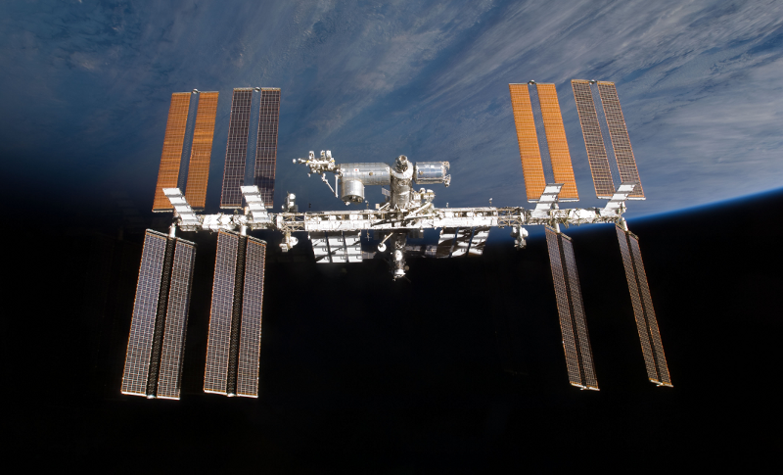
Going to space
To get into orbit, we need velocity, altitude, and energy.
Rocket science is simple…
Aerospace engineering is hard.
8
Notes:
Rocket science is easy in the sense that we can figure out the numbers we need by using equations we already have.
BUT, figuring out how to build something that will achieve these numbers successfully, safely, and in a cost-effective way is incredibly difficult!
8

Slide 9
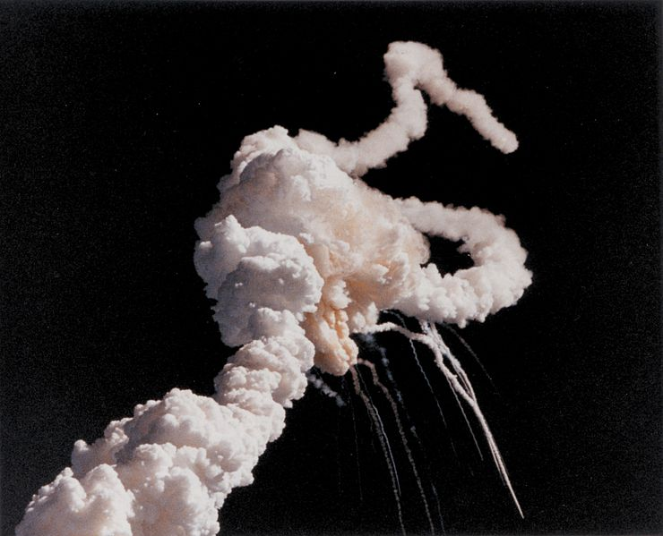
Launch Vehicles
Complex, powerful machines
A challenge to build... sometimes they fail
Space Shuttle Challenger (1986)
Failure of O-ring on solid-fuel rocket booster
9
Notes:
Problems with launch vehicles:
An example: STS-51-L: Challenger (1986)
- O-ring seal on booster was not tight. The booster came off and impacted the fuel tank, causing an explosion. Crew of 7 died.
9

Slide 10
Launch Vehicles - Video: Ariane 501
10
Notes:
Another example: Ariane 501
1996, ESA
Error in software design
Veered off track after 37s and destroyed by automatic self-destruct system
Cost: $370 million – most expensive coding error in history!
10

Slide 11
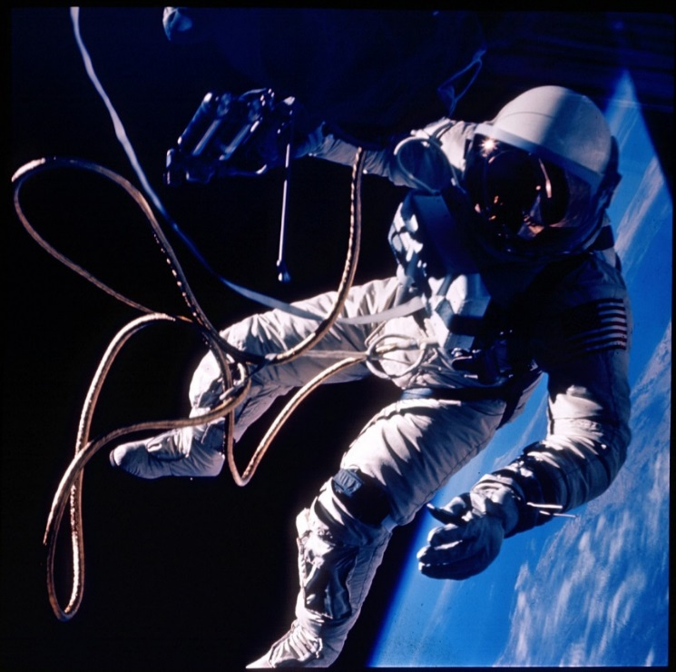
Surviving in space
Humans evolved on Earth's surface
Space is a very different environment
11
Notes:
Humans have evolved to live on the surface of the Earth, so being in space for any length of time can cause a multitude of health problems.
11

Slide 12
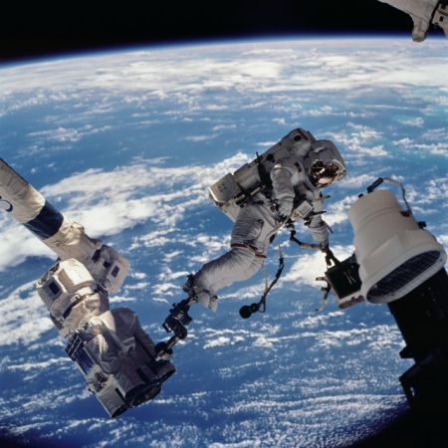
Surviving in space
Vacuum of space
Motion sickness
Radiation
Micrometeorites
Body adaptations
Psychological harm
12
Notes:
Vacuum: we cannot breathe in space.
Motion sickness: A few minutes or a few hours after entering weightlessness, astronauts experience space motion sickness, which is characterized by headaches, malaise, nausea and vomiting. Sixty to seventy percent of the astronauts experience these symptoms.
Radiation: Space radiation exists in the space environment. On the Earth, the atmosphere and magnetic field provide a shield for humans, and prevent space radiation from penetrating to the Earth's surface. Due to the absence of such shielding in the space environment, astronauts are subjected to greater amounts of space radiation than they would receive on the Earth. Therefore, the space radiation may seriously affect the astronauts.
Micrometeorites: travel 10s of km/s, which can be very dangerous if they hit a space suit or a spacecraft.
12

Slide 13
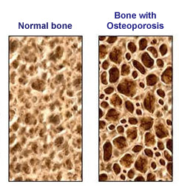
Surviving in space
Effects on cardiovascular system
“Fluid shift” causes stuffy noses, headaches, puffy faces, and causes blindness
Effects on bone
Bone loss due to lack of gravity (3.2% over 10 days)
Effects on muscle
Muscles quickly deteriorate
13
Notes:
Cardio: Human beings living on Earth are affected by gravity because about two-thirds of our daily activities are standing or sitting. Because of this great amounts of body fluids such as blood pool in the lower part of the body. The human body is equipped with various mechanisms to oppose gravity to maintain sufficient blood flow to the brain. In micro gravity environment, the quantity and the distribution of body fluid alters since it is free of the gravitational effect. This is the known as "fluid shift." Symptoms caused by fluid shift are stuffy nose, headache, and puffy face.
Bones: Bones are systems involved in maintaining posture. The adult human body has 1,000 to 1,200 grams of calcium and 400 to 500 grams of phosphorus. However, once gravitational stress is removed, bone calcium and phosphorus are excessively excreted in urine and faeces. It is seen that 3.2% of average bone loss occurred after nearly 10 days of weightlessness. The loss of calcium in urine may produce urinary stone, which might cause severe pain, the decrease of bone density will lead to bone fracture. Therefore, countermeasures are necessary. One countermeasure proposed to prevent bone loss is onboard exercise mainly with the treadmill and ergo meter.
Muscle: The human body floats within the orbiting spacecraft. Therefore, astronauts can move around in spacecraft just by softly pushing against its wall. In a micro gravity environment, muscles rapidly weaken due to the lack of use.
13

Slide 14
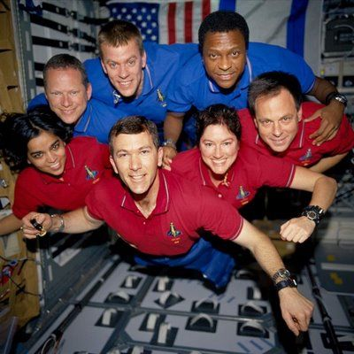
Working in space
Small failures lead to big problems
People make mistakes
Equipment can't be perfectly reliable
Lack of resources (can only use what you have with you)
14
Notes:
Big problems because astronauts do not have a lot of resources (including other people to help), abilities, or tools on hand to fix problems. Just like with most computers and machines, they are not 100% reliable.
14

Slide 15
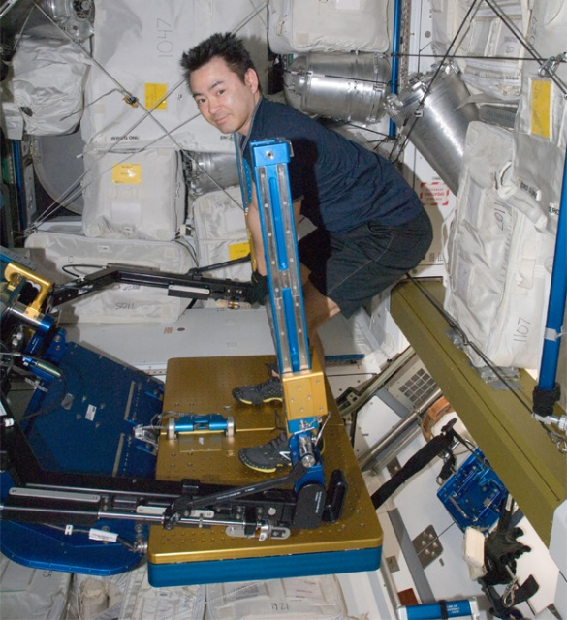
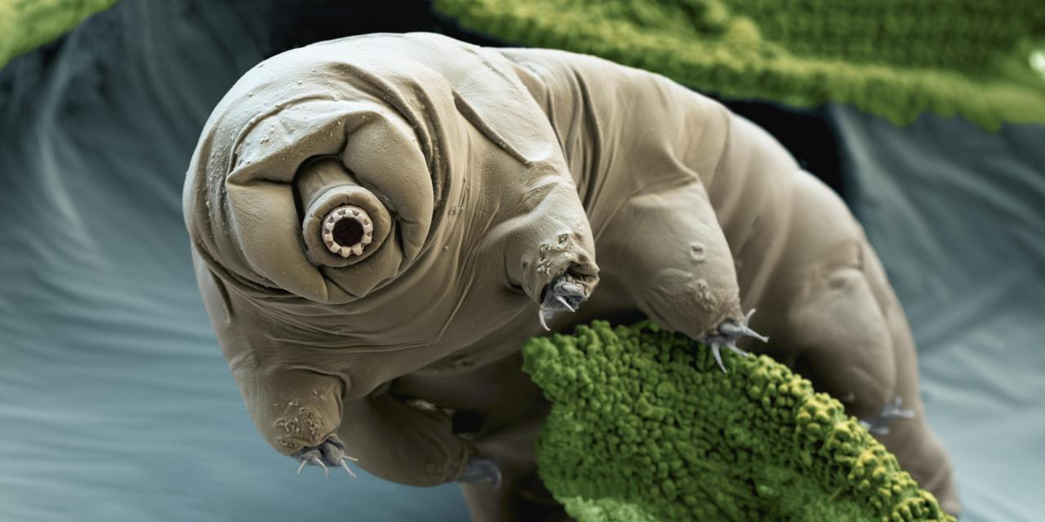
Working in Space
Experiments done on the International Space Station (ISS)
NASA’s Advanced Resistive Exercise Device – helps crew members do weight-bearing exercise to reduce loss of bone density and skeletal muscles
ESA Tardigrades – Swedish and German scientist sent up tardigrades (known to survive under conditions that would kill most organisms) to space to see how they would manage in the harsh environment

Slide 16
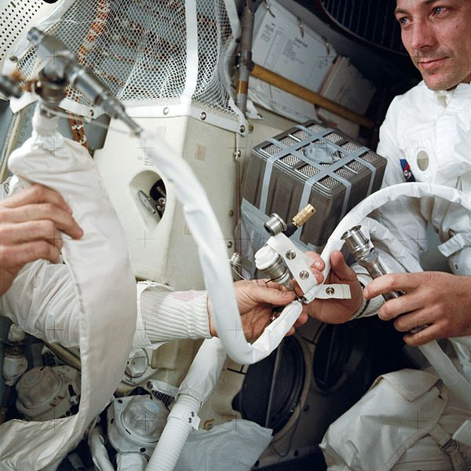
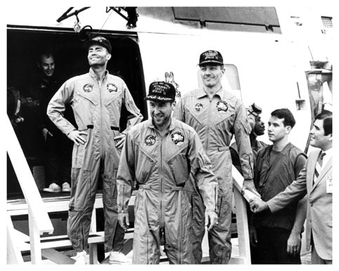
Operations - Apollo XIII
Oxygen tank exploded
Limited power, loss of heat, shortage of water
Crew had to jury-rig CO₂ removal system
16
Notes:
Example: Apollo 13: 1970
Oxygen tank exploded while over 200,000 km from Earth
Crew had to figure out how to fly back and land with low power and without the ability to use the engines
The command module was shut down and they used the lunar module (what normally lands on the moon) as a lifeboat (went back into CM for landing on earth)
Used Moon’s gravity to get back to Earth
16

Slide 17
Operations - Video: Mir collision
17
Notes:
About Mir Collision
17

Slide 18
Visiting the planets
Lots of things to consider! Can you name a few?
18
Notes:
So, let’s assume we can launch and get to a planet/moon of our choice. Then what? There are lots of things to consider!
18

Slide 19
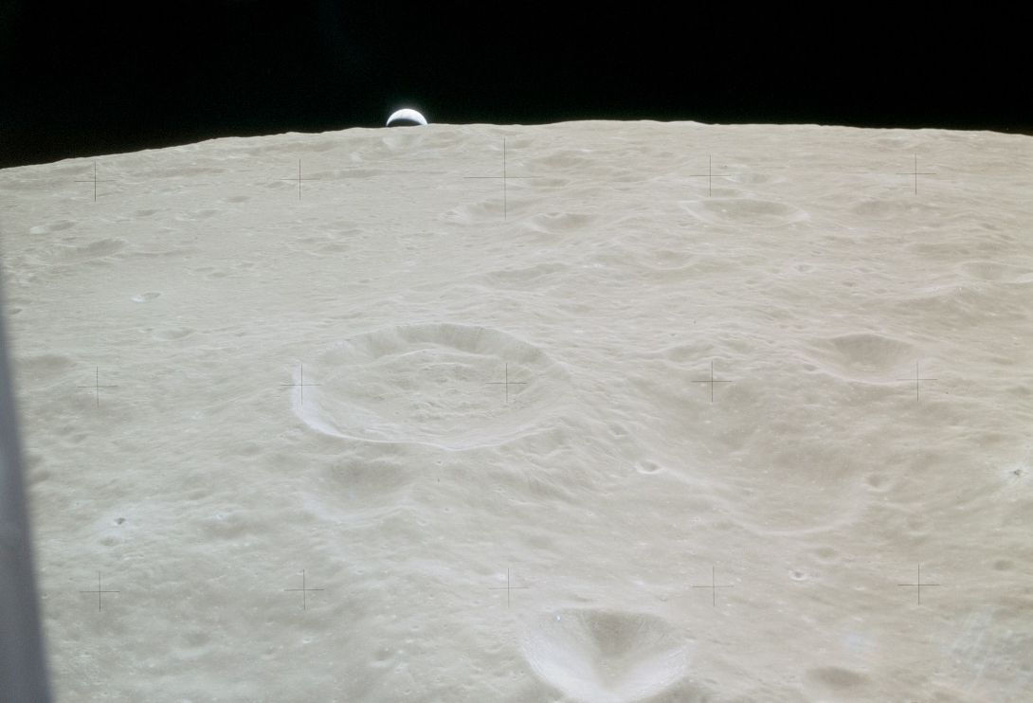
Surface environments
Earth’s Moon
Like space, with a little gravity
Temperature -200 to +120 °C
Electrostatic, abrasive dust
19
Notes:
- The Moon’s gravity is only 1/6th of that of Earth
Huge temperature variations
No atmosphere to protect against solar rays
There are concerns that the dust found on the lunar surface could cause harmful effects on any manned outpost technology and crew members:
- Abrasive nature of the dust particles may rub and wear down surfaces through friction;
- Negative effect on coatings used on gaskets to seal equipment from space, optical lenses that include solar panels and windows as well as wiring;
- Possible damage to an astronaut's lungs, nervous, and cardiovascular systems.
19

Slide 20
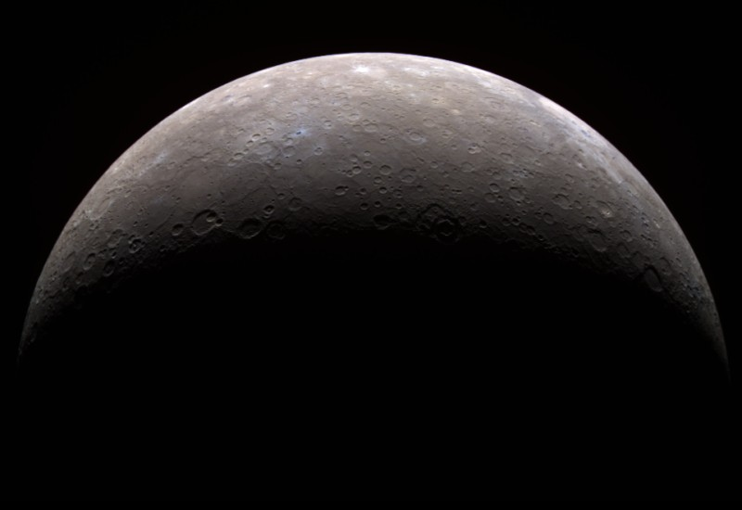
Surface environments
Mercury
Like the moon, but hotter
Temperature -190 to 430 °C
Sunlight 10x as strong as at Earth
20
Notes:
Huge temperature range because of slow rotation of Mercury (116 Earth days); large amount of radiation because of being so close to the Sun and no atmosphere.
20

Slide 21
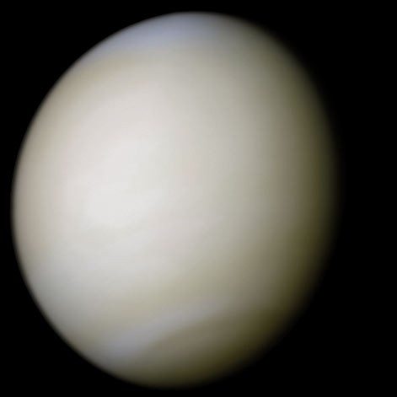
Surface environments
Venus
An atmosphere, but not a nice one
Temperature ~460 °C
Atmospheric pressure 9,300 kPa
Sulphuric acid clouds and rain
21
Notes:
- Temperature is so high because of Green House effect from clouds
Atmospheric pressure is much higher than on Earth is 101.3 kPa (total weight of air above a certain area on the ground)
Sulphuric acid clouds and rain can do serious damage
Longest a mission to Venus has ever survived was about 50 minutes!! Not a great place for humans
21

Slide 22
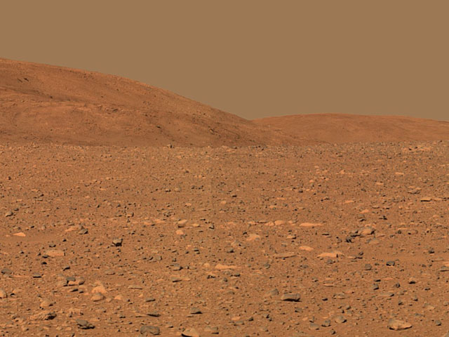
Surface environments
Mars
An atmosphere, but no magnetic field
Temperature -87 to 20 °C
Atmospheric pressure 0.4 – 0.87 kPa
Global dust storms
22
Notes:
Mars isn’t a bad option – it’s the most earth-like planet in our solar system
- Temperature range isn’t ideal, but livable
Pressure much lower than Earlth’s (101.3 kPa) – would have to wear pressurized suits when outside
Dust storms can create issues with equipment and space suits; might mean astronauts can’t go outside during those times (and they can last a long time)
- No magnetic field means bombardment from solar particles and cosmic rays
22

Slide 23
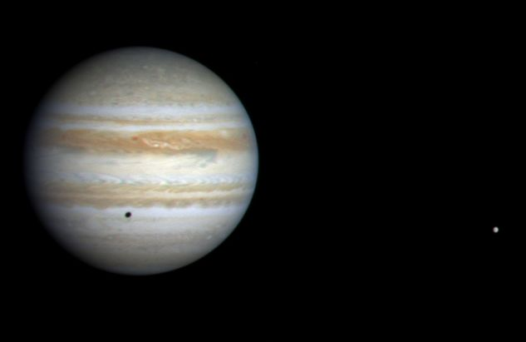
Surface environments
Jupiter (and the other gas giants)
All atmosphere
No solid surface
Jupiter's moons bathed in intense radiation
23
Notes:
Very cold temperatures (-100C to -200C) on outer planets
No where to land!
Radiation from Jupiter very intense on moons
Not really great options for humans
23

Slide 24
Entering orbit and landing
Notes:
Video is internet only. If you have internet accees, show the following video. Otherwise, hide this slide.
https://www.theguardian.com/science/video/2016/oct/19/esa-mars-orbiter-successful-schiaparelli-probe-status-unknown-video
Schiaparelli launched in March 2016 along with the Trace Gas Orbiter. Together, the two spacecraft make up the ExoMars 2016 mission — the first part of the two-phase ExoMars program, which ESA leads with assistance from its chief partner, the Russian federal space agency Roscosmos.
The European Space Agency has released new images of its doomed Mars lander, which is thought to have disintegrated after hitting the planet’s surface at high speed – rather than touching down gently as planned.
A giant crater caused by the Schiaparelli spacecraft’s impact can be made out and visible nearby are two different components of the lander – its heatshield and parachute.
The images show that the craft touched down well within its target landing zone, but that something went catastrophically wrong during the descent.

Slide 25
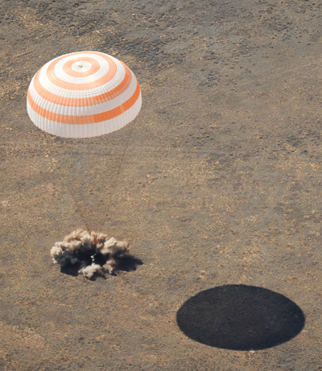
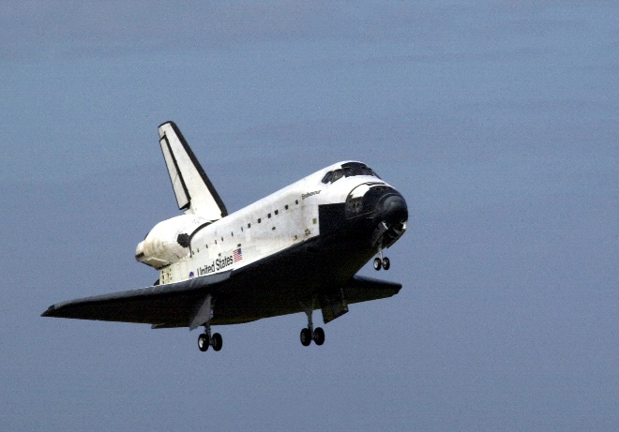
Returning to Earth
To attain orbit, you needed:
Velocity, Altitude, Energy
Now we need to get rid of those
Slow down with:
rockets?
atmospheric friction?
25
Notes:
Getting to orbit needs high velocity, altitude, and energy --- when coming back to earth we need to reduce all of these to zero. Space shuttle used atmospheric friction (basically came in belly first to slow the shuttle as much as possible) as it came down to land.
25

Slide 26
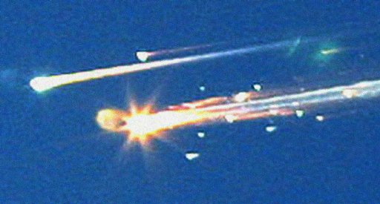
Re-entry
Space shuttle Columbia (2003)
Hole punctured in wing during launch
Heated up during re-entry
26
Notes:
Example: STS-107: Columbia (2003)
Piece of foam broke off during launch, which damaged thermal protection system on wing
Wing overheated and came apart during re-entry
All 7 astronauts on board died
26

Slide 27
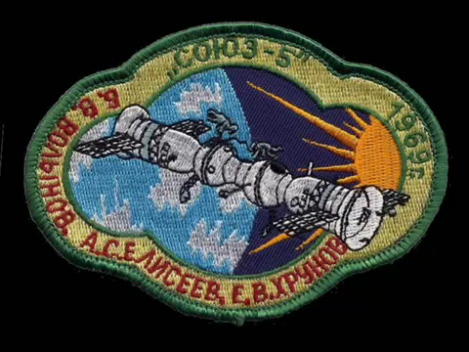
Re-entry - Video: Re-entry of Soyuz-5
27
Notes:
Another example: Soyuz 5: 1969
Module did not separate on re-entry, causing the whole module to come in at a wrong angle (heating it up more than usual, etc.)
Cosmonaut survived the crash!!
27

Slide 28
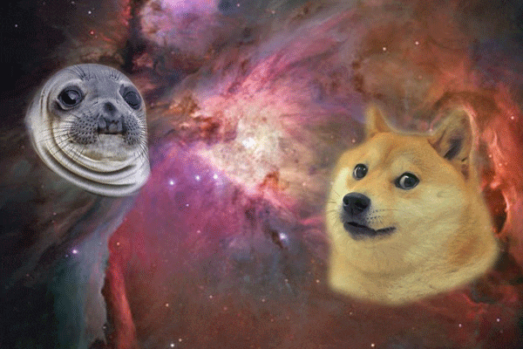
Brainstorm #2
What are some of the benefits of and successes in space exploration?
???

Slide 29
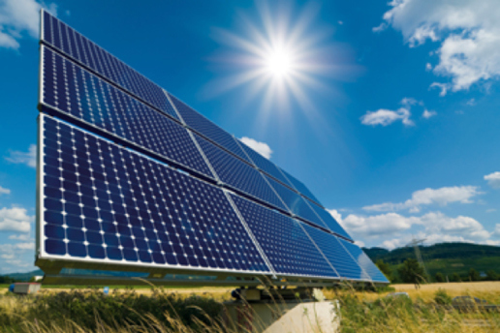
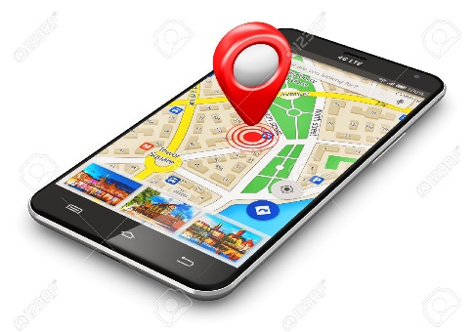
Benefits to Modern Society
More efficient, sustainable energy sources.
Healthcare technologies (think Fitbits!)
Technologies to help fight global warming and its effects on humans.
Navigation & communication.
Exploring our galactic neighborhood (and beyond!)
29
Notes:
29

Slide 30
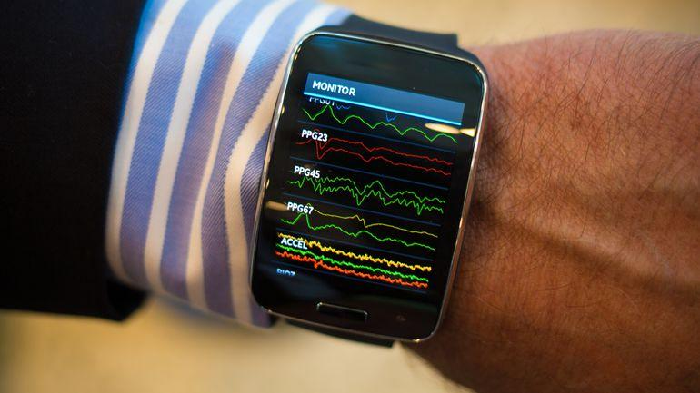
Health & Medicine
Benefits to Modern Society
Biometric sensors: LifeBEAM
CNET
Samsung Simband
NASA Spinofff 2018
Notes:
Biometric sensors: they’re everywhere now! Fitbits, Samsung, Apple Watches. Weightless weight lifting: portable exercise devices to help build and maintain muscle/bone density while in weightless environments. From NASA 2018 Spinoff brochure: Loss of bone density and muscle during long stays in zero gravity posed a dilemma without a clear solution: weights are useless in a weightless environment. Paul Francis was working on exercise equipment based on resistance rather than weight, called SpiraFlex, and answered NASA’s call for ideas. Francis worked with Johnson Space Center to build SpiraFlex FlexPacks into a system with up to 300 pounds of resistance. He’s now founded Kansas City, Missouri-based OYO Fitness to market the SpiraFlex-based DoubleFlex portable gym.

Slide 31
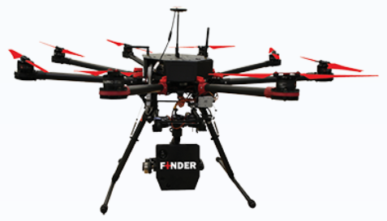
Public Safety
Benefits to Modern Society
R4 FINDER: Remote sensing
NASA detects weak signals/track tiny movements, like satellite orbits.
Technology was developed to detect human breathing, heartbeat.
Can detect vital signs through 30 feet of dense rubble with 80% accuracy.
Used to aid in Nepal 2015 earthquake rescue efforts
Notes:
From NASA Spinoff PDF (2018): NASA often analyzes weak signals to identify slight physical movements, such as alterations in a satellite’s path that might indicate gravity fluctuations. In the early 2000s, federal agencies approached the Jet Propulsion Laboratory (JPL), wondering about using this capability to remotely detect human vital signs.
JPL called the prototype it developed FINDER.
By picking out the faint but correlating movements of human breathing and heartbeats, FINDER can detect unseen survivors buried under rubble.
The founders of R4 Inc., based in Edgewood, Maryland, licensed FINDER, and the company spent the next couple of years developing it into a device first responders could use in real-world situations.
A major success came when a 7.8-magnitude earthquake rocked Nepal in April 2015. One of R4’s founders arrived with two FINDER prototypes and detected four victims trapped under debris. All four men, who had been buried as deep as 10 feet, survived.
FINDER has since proven capable of detecting humans through 30 feet of dense rubble with 80 percent accuracy. R4 has also designed prototype versions to mount on a remote-controlled octocopter, a truck, and a motorcycle.

Slide 32
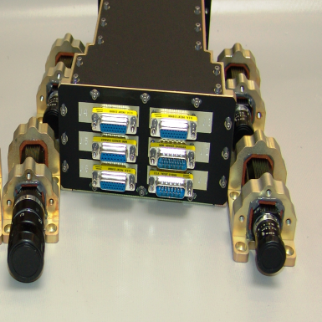
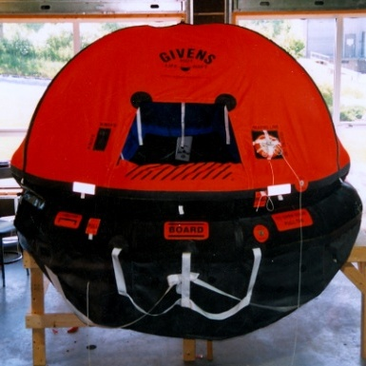
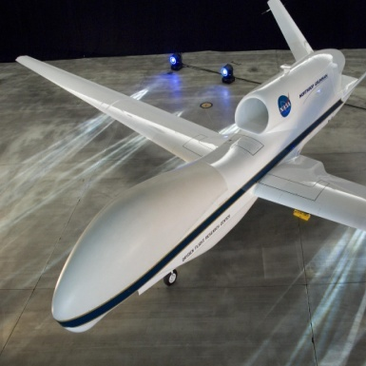
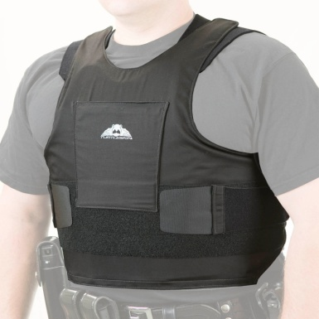
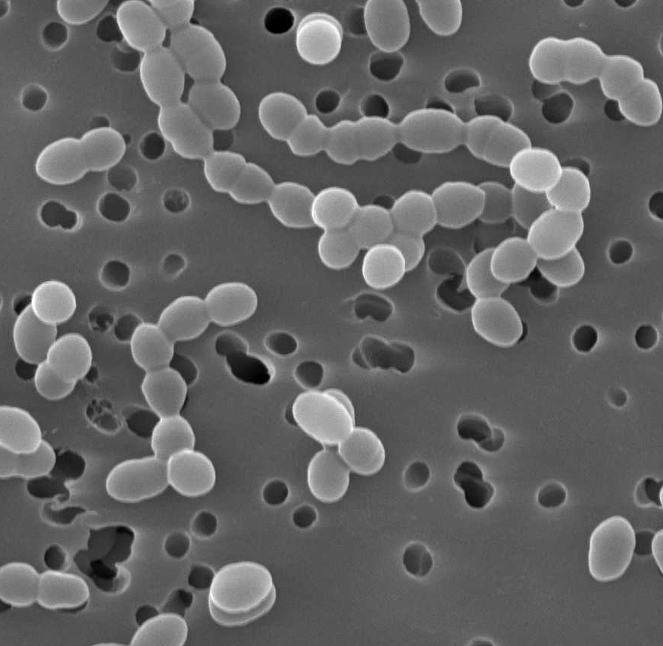
Importance of Spin-Offs
Benefits to Modern Society
Saved Lives
Created Jobs
Enhanced Safety
Created New Markets
Made the Planet Cleaner
Educated and Entertained
Increased Efficiency
Improved Economic Competitiveness
http://www.sti.nasa.gov/tto/
Notes:
Spinoff images from L to R:
Ecliptic RocketCam Video System (cool video footage), http://www.sti.nasa.gov/spinoff/spinitem?title=Onboard+Systems+Record+Unique+Videos+of+Space+Missions
Turtleskin Body Armor (vest made with fabric designed for Pathfinder airbags), http://www.sti.nasa.gov/spinoff/spinitem?title=Tough+Textiles+Protect+Payloads+and+Public+Safety+Officers
Givens Buoy Life Raft (designed based on rafts used in Apollo splashdown landings), http://www.sti.nasa.gov/spinoff/spinitem?title=Apollo-Era+Life+Rafts+Save+Hundreds+of+Sailors
Micro-Bac Remediation Bacteria Solution (phototrophic cell for water purification in space and now on farms), http://www.sti.nasa.gov/spinoff/spinitem?title=Bacteria+Provide+Cleanup+of+Oil+Spills%2C+Wastewater
Global Hawk UAV, with Composite Airframe Manufactured by Aurora Flight Systems Inc. (lightweight aircraft technologies used for unmanned aerial vehicles (UAVs)), http://www.sti.nasa.gov/spinoff/spinitem?title=Technologies+Advance+UAVs+for+Science%2C+Military
Image credit: http://spinoff.nasa.gov/resources.html

Slide 33
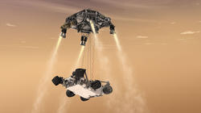
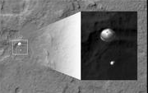
Successes in Space Exploration
ISS
Many moon landings
Orbital and rover missions
Private and public partnerships
International mission cooperations
All preparing us for visiting
other planetary bodies!
33
Notes:
Although space exploration is challenging, we have developed successful space programs.
Images: This artist's concept shows the sky crane maneuver during the descent of NASA's Curiosity rover to the Martian surface; NASA's Curiosity rover and its parachute were spotted by NASA's Mars Reconnaissance Orbiter, HiRISE camera, as Curiosity descended to the surface on Aug. 5 PDT
33

Slide 34
Can you IMAGINE Life WITHOUT Space?

Slide 35
Recent space successes
Cassini mission of Saturn
Confirmed that Enceladus has a global ocean of liquid water beneath its icy surface
New Horizons mission to Pluto and beyond!
Preparations to go back to the Moon (Google XPRIZE)
Finalists: India, Japan, Israel, USA, and an international team
Juno orbiting Jupiter to unlock questions about the gas giant.
Trace Gas Orbiter (TGO) insertion to Mars orbit to study traces of methane on Mars – biologic??
Three habitable Earth-like planets, no further away than 40 light years from Earth
Revisiting Venus with heat-resistant computer chips
35
Notes:
Before detecting these planets we did not even know that potentially habitable Earth-sized planets orbit also around ultracool dwarf stars. This discovery increases drastically our chances to find life elsewhere in the Galaxy in the near future. Given the Jupiter-size of the host star and the proximity of the system, it will soon be possible to study the three planets' atmospheric composition, to assess their habitability and to determine whether they host any form of life. (http://ec.europa.eu/research/infocentre/article_en.cfm?&artid=39557&caller=SuccessStories)
35

Slide 36
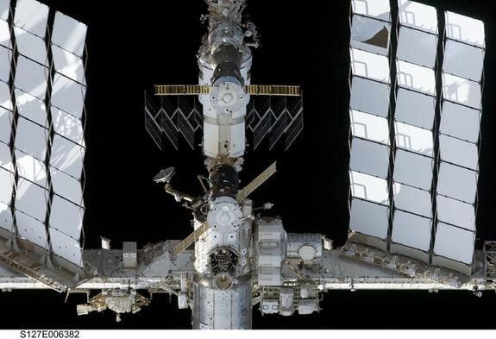
International mission cooperations
36
Notes:
The International Space Station (ISS) Program’s greatest accomplishment is as much a human achievement as it is a technological one.
The principals are the space agencies of the United States, Russia, Europe, Japan, and Canada. The ISS has been the most politically complex space exploration program ever undertaken.
36

Slide 37
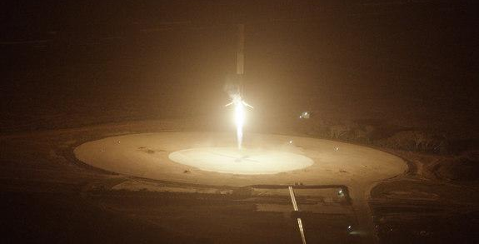
Private and public partnerships
37
Notes:
In a history-making launch on Dec. 21, 2015, the private spaceflight company SpaceX blasted one of its two-stage Falcon 9 rockets into space, then returned the first stage of the rocket back to Earth.
A viable reusable rocket could dramatically lower the cost of spaceflight, and make Elon Musk’s “goal of building a city on Mars” actually achievable.
Blue Origin landing: https://www.youtube.com/watch?v=9pillaOxGCo
SpaceX landing: https://youtu.be/RPGUQySBikQ
SpaceX landing fails video: https://www.youtube.com/watch?v=bvim4rsNHkQ
37

Slide 38
Notes:
The space station also advances our understanding of how the body changes in space and how to protect astronaut health.
Our next step is deep space, where NASA will send a robotic mission to capture and redirect an asteroid to orbit the moon. Astronauts aboard the Orion spacecraft will explore the asteroid in the 2020s, returning to Earth with samples. This experience in human spaceflight beyond low-Earth orbit will help NASA test new systems and capabilities, such as Solar Electric Propulsion, which we’ll need to send cargo as part of human missions to Mars. Beginning in FY 2018, NASA’s powerful Space Launch System rocket will enable these “proving ground” missions to test new capabilities. Human missions to Mars will rely on Orion and an evolved version of SLS that will be the most powerful launch vehicle ever flown.
NASA also is a leader in a Global Exploration Roadmap, working with international partners and the U.S. commercial space industry on a coordinated expansion of human presence into the solar system, with human missions to the surface of Mars as the driving goal.

Slide 39
Review
- Space is an inhospitable environment
- Planetary surfaces aren't always nice, either
- Getting to and from space is a challenge
- Spacecraft operations require care and planning
- Aerospace engineering is hard…
… but we continue to dream big and reach space exploration goals!
39
Notes:
We see that aerospace engineering can be difficult. There are a lot of factors to consider, but we have come along way in 50 years! And there is a lot more to do!
39

Slide 40
Space Lander Challenge
Your challenge is to design and build a lander that will land upright after a drop of 1.5m.
You can only use the supplies in the bag.
You will have 30 minutes to design and build your lander. You can test it as many times as you want.
Success Levels:
1. Your lander lands upright after a 1.5m drop three times in a row.
2. Your lander lands upright after being dropped upside down from 1.5m.
3. Your lander lands upright after being thrown in the air.
4. Your lander succeeds in 1-3 and uses minimal materials (weigh-in).
Good Luck!!
40
Notes:
Instructions for space lander challenge (full instructions available in separate document)
40

Slide 41
Thank you!
Questions?

