Slide 2
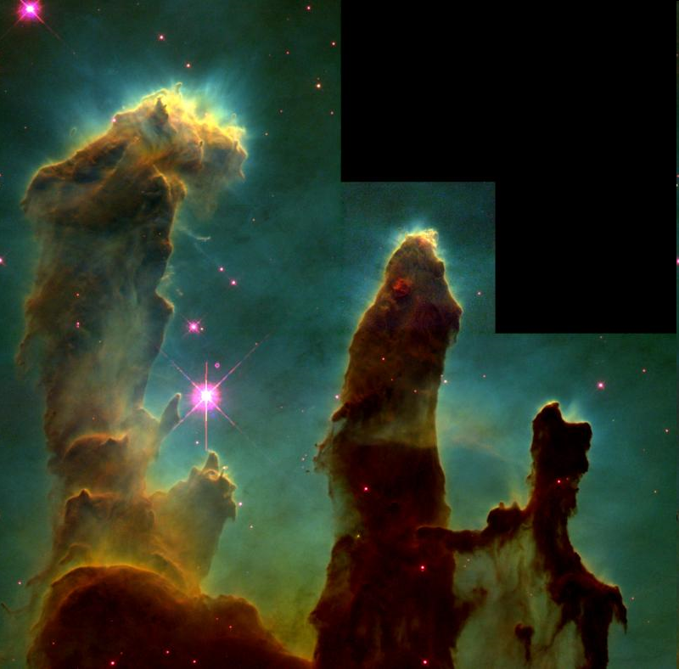
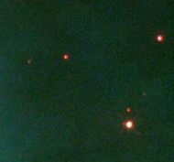
Astrobiology
The search for Life
Notes:
Introduce yourself. “Hi, my name is ____ and I’m from Institute for Earth and Space Exploration … etc.” I wanted to talk to you today about Astrobiology and the search for life in our universe.
Q: Can anyone tell me what Astrobiology is??

Slide 3
What is Astrobiology?
The study of Life in Space
Who are we?
Where do we come from?
Where are we headed?
Notes:
Biology is the study of life, and so Astrobiology is the study of life in space. It tries to answer big questions such as: Who are we? Where do we come from? And where are we headed?

Slide 4
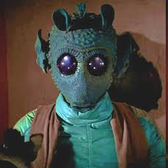
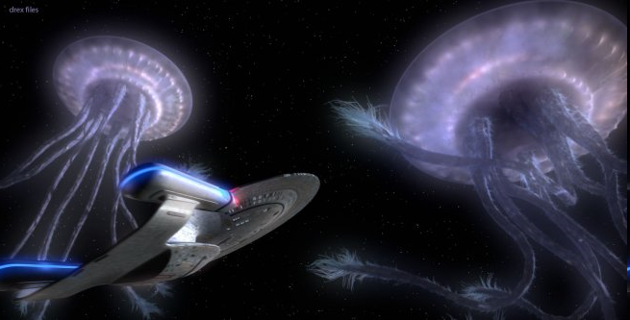
Astrobiology in Pop culture
Notes:
You may not realize it, but Astrobiology has a huge place in pop culture as well. For example, has anyone here seen Avatar?? They had scientists consult on making the movie. The organisms that you see there, the world that they created could be potentially real.
Q: Does anyone remember where Avatar was set? (ie. Try to get them to remember that it was on a moon circling a gas giant).

Slide 5
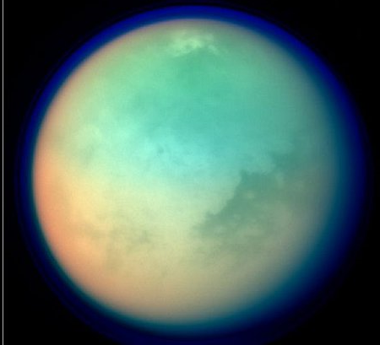
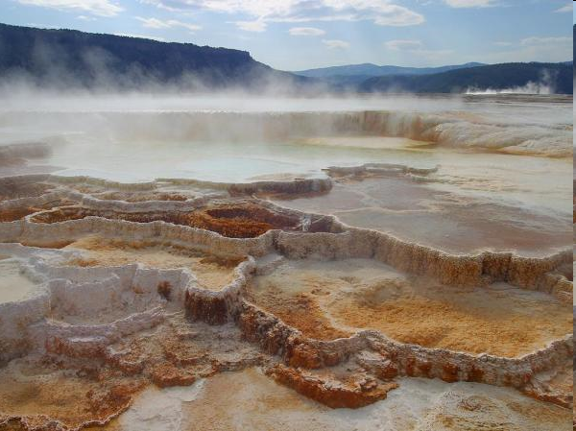
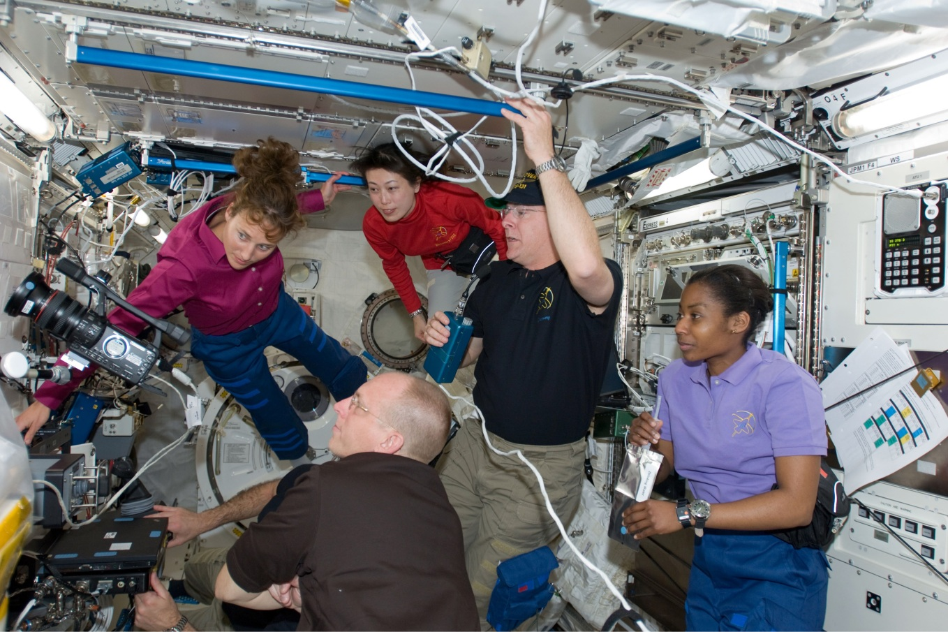
The study of life in extreme environments on Earth
The study of possible habitats for life on other planets
Notes:
Astrobiology encompasses four main fields of exploration:
-The study of life in extreme environments on Earth
-It’s the study of possible habitats for life on other planets

Slide 6
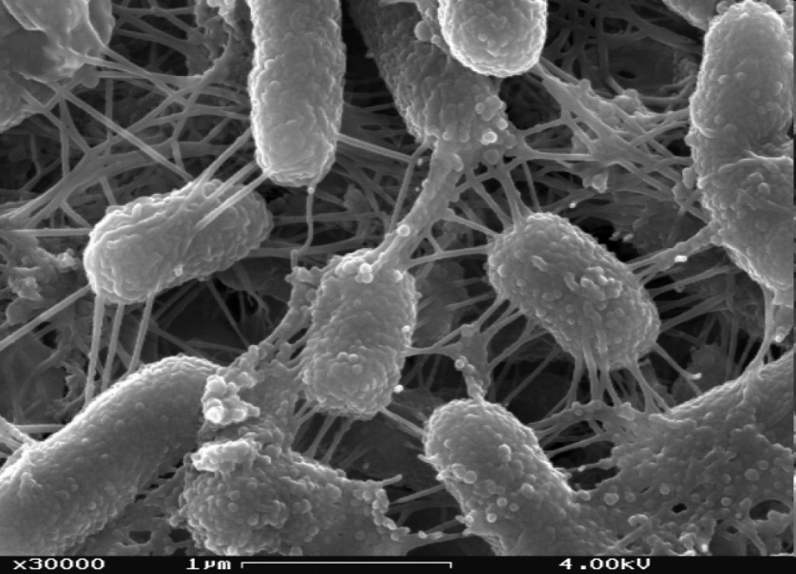
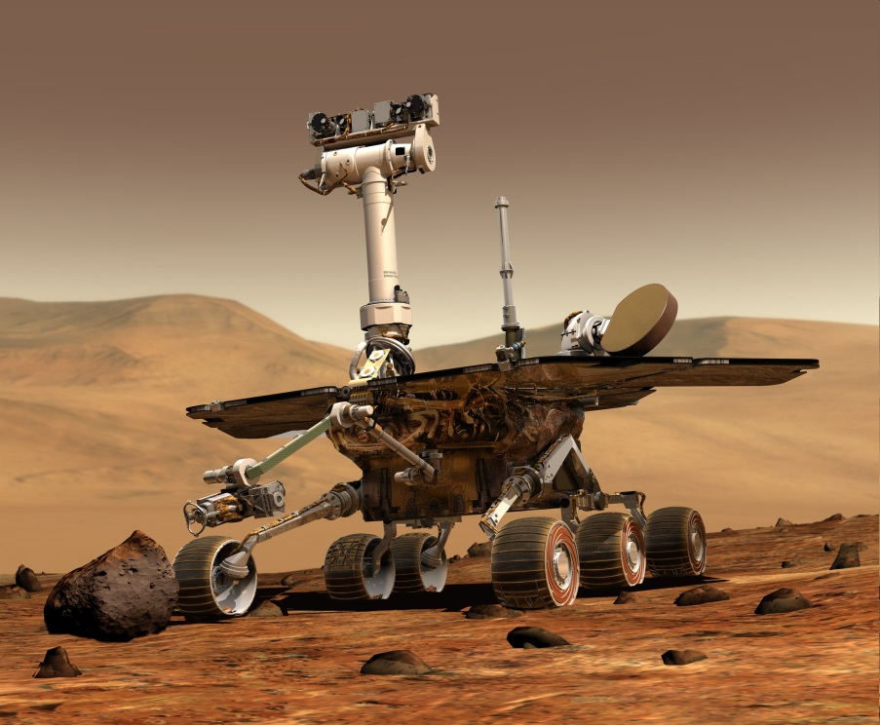
Designing instruments to detect this life
Studying the remnants of what life leaves behind
Notes:
-Studying the remnants of what life leaves behind. Even organism as tiny as bacteria can leave behind fossils for us to find.
-And it’s also the design and building of instruments to detect that life – for all you engineers out there.
Finally, and this is something that is going to be very big in your life times – it’s the study of how humans can adapt and operate in space. In the field of medicine, helping to counteract radiation, bone loss, muscle loss and isolation sickness are huge leaps we have yet to fully solve

Slide 7
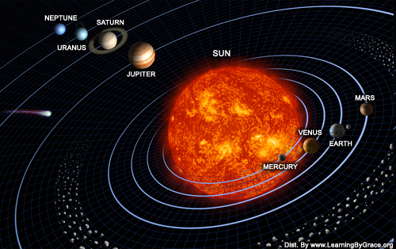
The Solar System
Notes:
So, now that you have a bit of an idea about what’s involved in Astrobiology, lets take another look at our solar system.
Q: What do we need for the existence of life (or at least, what do we “think” we need)?
A: Water, energy, light (to keep it simple).
Q: So, where would you look for life in our solar system, outside of the Earth?
A: The terrestrial planets, and maybe the moons of gas giants.
Q: Why would the moons of gas giants potentially be a problem?
A: They’re very far away from the Sun, and most are frozen. An important thing to understand, from looking at this picture, is the idea of something called a Habitable Zone. Each star, like our Sun, has a zone around it, where conditions are just right for the existence of liquid water. Think of it kind of like Goldilocks and the three bears. Your planet can’t be too close to the sun, but it can’t be too far away either.

Slide 8
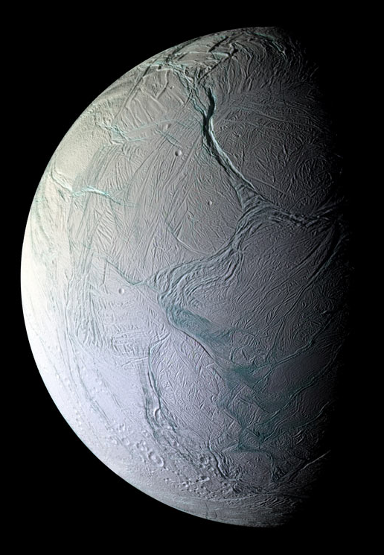
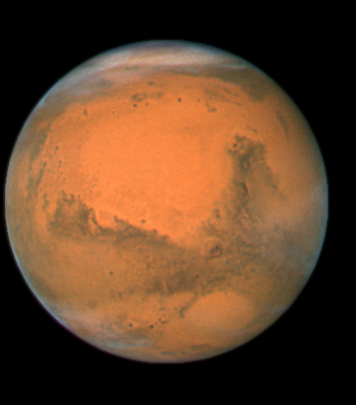
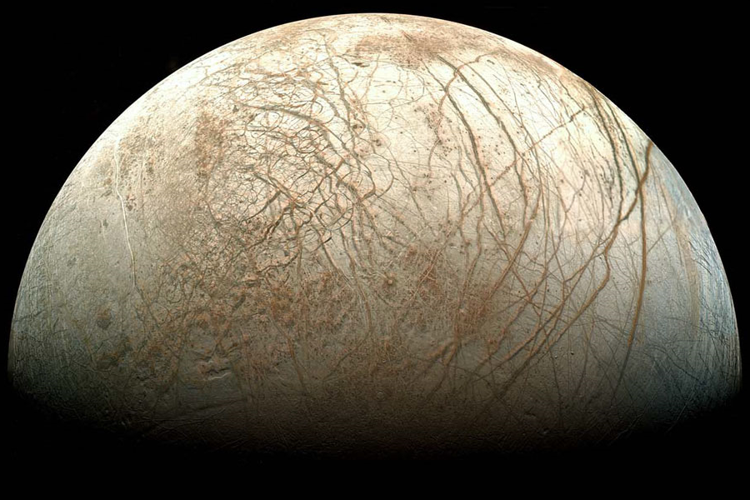
Habitable Bodies?
Mars
Europa
Titan
Enceladus
Notes:
So, you guys have covered most of these (hopefully they did). Scientists think that we could potentially find life on our nearest neighbour, Mars (far left pic). But the moons of gas giant planets are also of interest.
In this slide we can see:
Titan (in the very centre), which is a moon of Saturn. This moon is particularly interesting because it has a thick atmosphere with lots of gasses that could help support life. It also has large seas of methane, which is great, because there are organisms here on earth that lives off of methane.
Europa is at the bottom here, and we think this moon of Jupiter has a huge liquid ocean beneath the ice.
Finally we have Enceladus (top right), which in 2008 we found was actually shooting jets of WATER into space. This is the first hard evidence we’ve found of liquid water on another body in our solar system!!

Slide 9
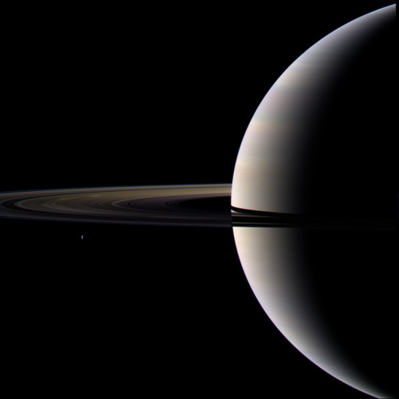
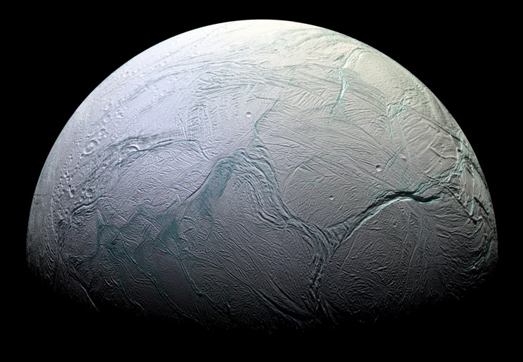
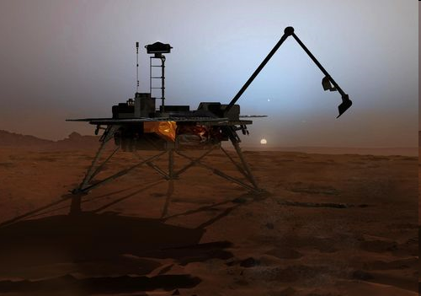
How do you study this?
Send missions to other planets:
Mars Rovers, Mars Reconnaissance Orbiter, Mars Science Laboratory
Cassini-Huygens - Jupiter, Saturn, Titan
Notes:
But how do we study these planets? How do we find out if there is life there? One of the ways is to send actual rover missions to other planets. So far we’ve sent several rovers to Mars, the most recent being the Mars Science Laboratory (a rover the size of a VW bug – which is huge!) to look for life. There was also a space probe called Cassini-Huygens that was sent to fly by Jupiter and Saturn, and finally landed on Titan to allow us our first glimpse of the shrouded moon.

Slide 10
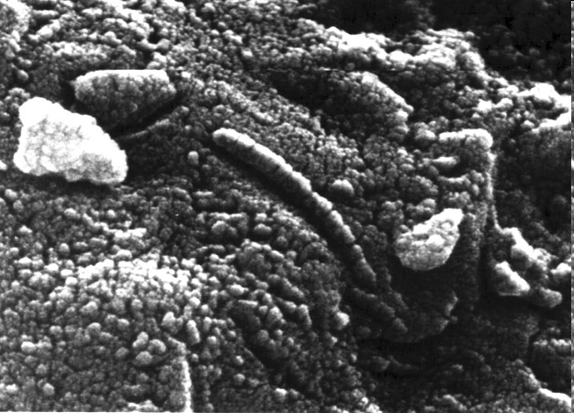
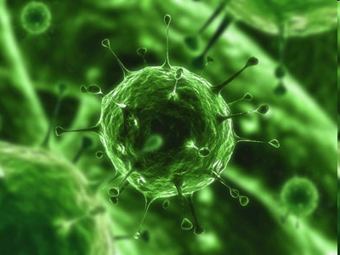
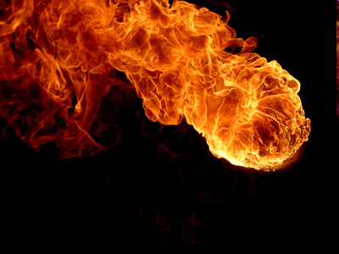
What to look for?
If you’re sending a robot mission to another planet, how do you know what to look for?
Is life on another planet going to be the same as here?
What is life?
Notes:
One of the biggest problems/questions a researcher has to answer when sending a rover to another planet is: what do you look for??
Q: Is life on another planet going to be the same as on this one? What do you think?
Q: Can anyone tell me “what is life?”
Q: Can anyone tell me out of these three pictures here what is alive? Ask them how they know?
A: Possibly none of them. From left to right: 1. An SEM picture of ALH84001 (Martian meteorite). This famous picture was thought to show a fossil of a bacterium, proving the existence of life outside of our own planet. It has since been dismissed. 2. A picture of a virus. Since viruses don’t have the machinery to replicate on their own, can they be considered living? 3. A picture of fire. Most people would say that obviously this is not alive – but how do you know? What makes it not “alive”?

Slide 11
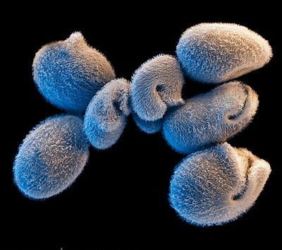
What is Life?
“Life is a self-sustained chemical system capable of undergoing Darwinian Evolution” – Joyce, 1998 (NASA)
BUT:
Computer programs can replicate
Fire can grow
Culture can evolve
Can anyone define water?
Notes:
Read out the types of definitions that we have so far. And then point out that none of them are great definitions. Click. Read.
To give you an idea of the enormity of the problem, I want you guys to answer a question for me:
As an example, ask the class to define water: Water is a molecule made up of 2 atoms of hydrogen and 1 atom of Oxygen.
Now ask them how they would define water if they didn’t know about atoms? … the problem with defining life may be quite similar.
Who can tell me the textbook definition of what water is? Think chemistry.
A: Water is H2O. Defining water using the chemical structure is the most accurate.
Now, ask them to forget that they know about atoms. Now, try to define what water is. The definitions of: it’s wet, it’s clear etc. can also describe other substances. You can’t do it.
There was a time in the 19th century, when scientists didn’t know about atoms, we didn’t know they existed, and thus it was difficult to accurately define things.
The definition of life, then, might be a similar issue, that we currently lack the knowledge/understanding to be able to define it.
Q: So, if we can’t necessarily define it, how do we know what to look for?

Slide 12
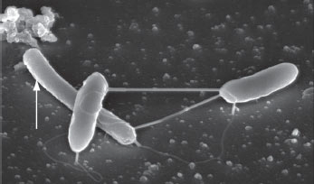
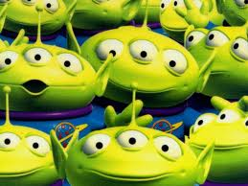
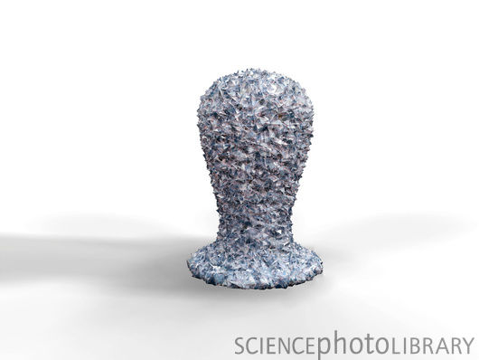
Would we recognize life?
Is all life made up of DNA?
Does all life use the same set of amino acids?
Does all life use carbon?
KNOW YOUR ASSUMPTIONS!!!!
Notes:
Would we even recognize life if we came upon it? Is all life going to be like what we know it to be? Is it going to use carbon, or maybe something different like silica? We use 22 amino acids, but there are more than 70 possible, is there life out there that uses a different set?
Does all life use carbon, sulfur, phosphorous, nitrogen, oxygen?
The answer is, we don’t know … the best we can do is to study life here on Earth that lives on the edge, in environments that we would deem to be “extreme”, so as to push our understanding of what life is capable of.

Slide 13
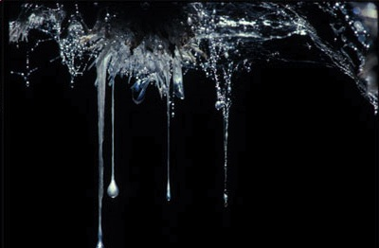
Extremophiles
Organisms that live in “extreme” environments:
Phile = Love
What are some examples?
Psychrophiles
Halophiles
Barophile
Acidophiles
– love of cold temperatures
– love of salty environments
– love of high pressure systems
– love of acidic environments
Notes:
These organisms that we look for, are called extremophiles Where phile = love.
These are some examples of types of extremophiles based on the environmental condition. So for example, pyschrophiles are organisms that love living in cold temperatures.
Q: Can anyone guess what the other ones are?
Also, sometimes organisms can be more than just one of these things. Sometimes, organisms are many of these things … Ex. Halomonus salaria – obligate barophile, halophilic. Obligate means that it has to live in that state. So for pressure, it has to live at high pressures, and the membrane of the organism is adapted to that. If you brought it up to our pressure (1 atm) the cell would explode.
Some of these organisms even create the “extreme” environment. Does anyone know what this is a picture of? (the top right picture). This is called a snotcicle. This is a goopy collection of bacteria that have formed a colony so large that it is dripping from the ceiling of this cave. These organisms eat sulfur and produce sulfuric acid (H2SO4).
Sometimes, organisms are many of these things …
Ex. Halomonus salaria – obligate barophile, halophilic
Now, it’s a bit costly to send missions to other planets, so one of the ways that we study “alien” environments, is through the study of what we call analogue sites.

Slide 14
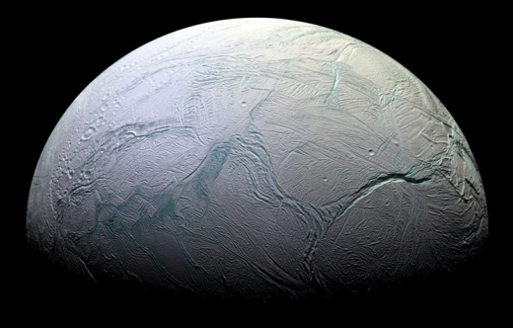
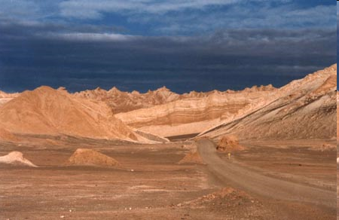
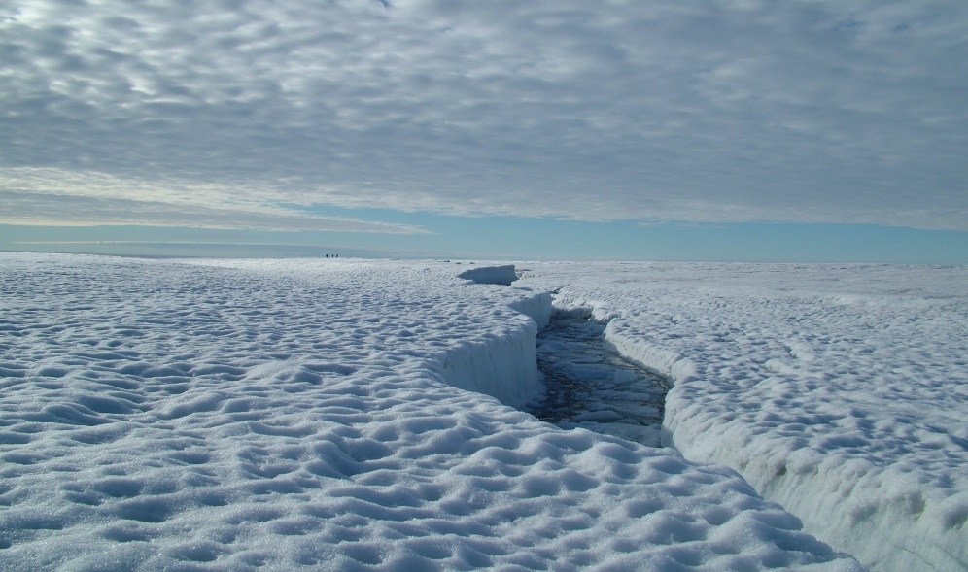
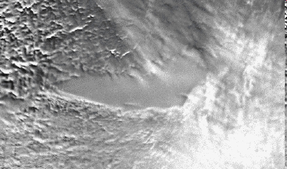
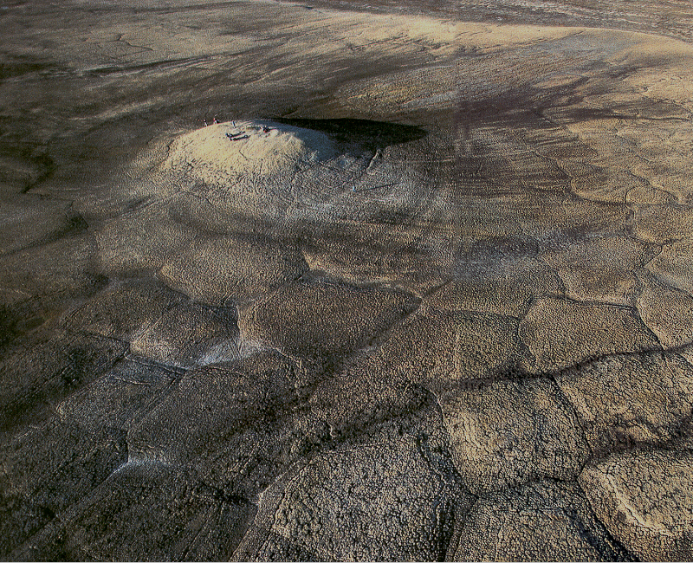
Analogue Sites
Atacama Desert, Chile
Ward Hunt Island, Canada
http://www.lukemastin.com/diary/gallery_atacama.html
Lake Vostok, Antarctica
Devon Island, Canada
Notes:
Now the places that we go to study these organisms, are called analogue environments: These are sites that serve as a close representation of other planets/moons in our solar system. And the organisms that we find living there, can act as good analogues for “alien” life.
So for example, many researchers go to the Atacama Desert in Chile, which is the driest place in the world to study how life survives with very little water. NASA also tests their rovers in this place to simulate Mars. Canada has some of the best analogue environment in the world in the high-Arctic. More and more space organisations are coming here to do analogue research.

Slide 15
Psychrophiles
What kinds of environments?
Cold deserts
Glaciers/Ice sheets
Ocean bottoms
What are the main problems?
Freezing
Have to make your membranes really fluid
Ice crystals are very, very SHARP
Water availability
All the water is either in the atmosphere, or is not accessible, ex. Ice.

Slide 16
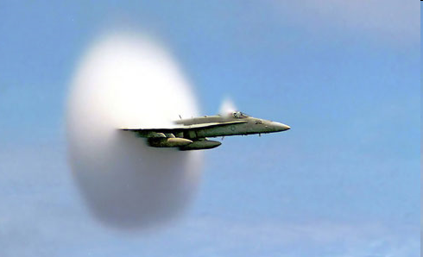
How does ICE form?
Ice needs a disturbance to form, this disturbance is called a nucleator
Having a nucleation site means that the energy needed to form a crystal is lowered
Ex. Water freezes at 0ºC, but a sample of pure water actually freezes at -42ºC

Slide 17
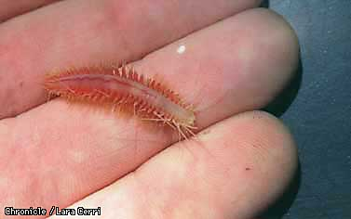
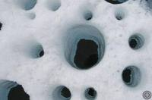
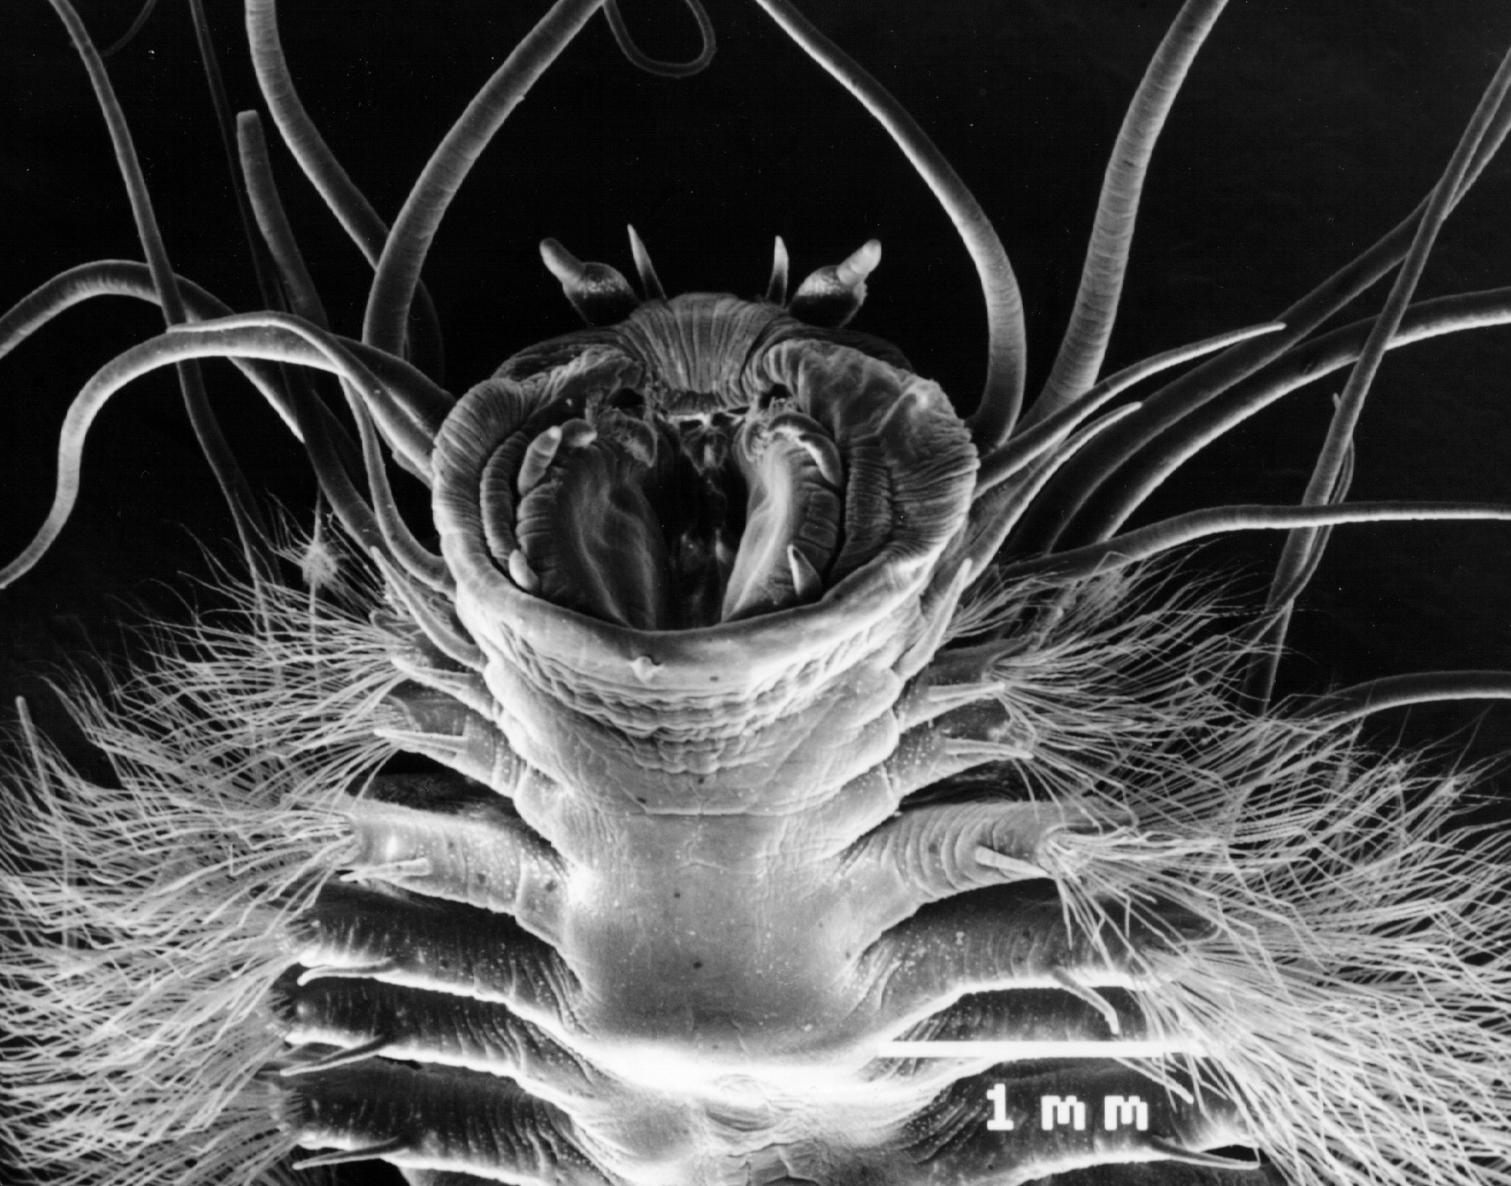
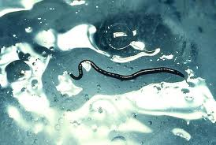
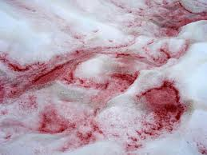

Slide 18
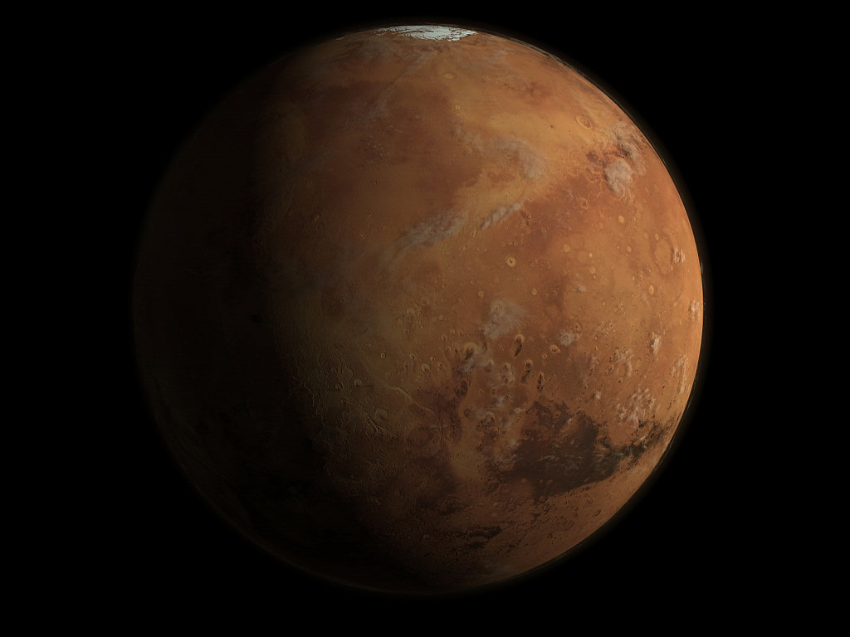

Slide 19
Thermophiles
What kinds of environments?
Hot deserts
Hydrothermal vents
Volcanoes
What are the main problems?
Extreme heat
Have to make your membranes really solid
Hard to keep things like DNA, RNA and proteins together
Water availability
If you’re in the desert, where is your water coming from?

Slide 20
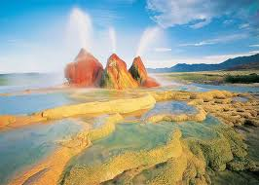
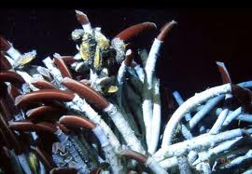
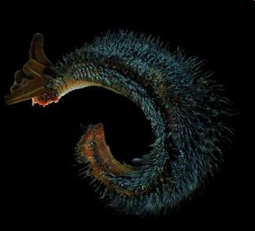
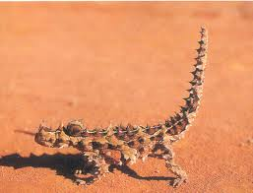
Notes:
Bacteria
Pompei worm
Tubers
Gecko, stores water in sacks on it’s back (see arrow).

Slide 21
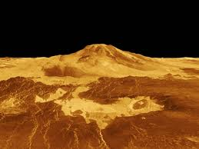

Slide 22
Halophiles
What kinds of environments?
Saline lakes ex. The Dead Sea
Brine veins in ice sheets (cold and salty!)
The ocean
What are the main problems?
Hypertonic solutions
The surroundings are so salty that they pull water from the cells, which shrivel up and die.
Water availability
All of the water you can drink is very salty, how do you fix this?

Slide 23
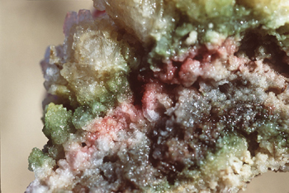
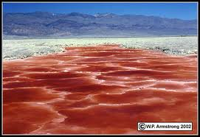
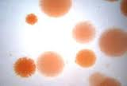
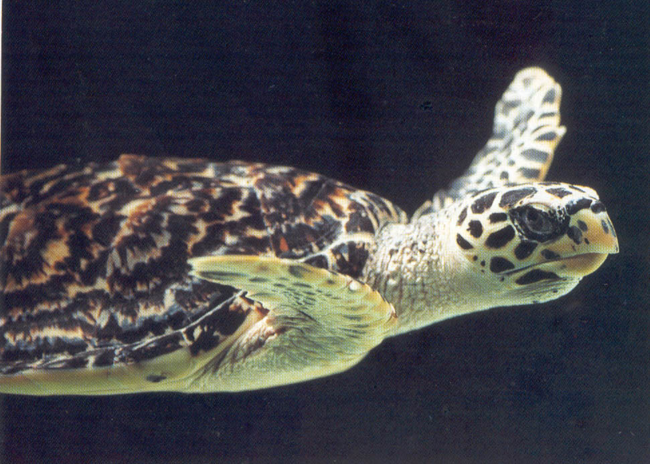
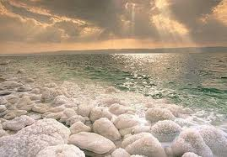
Notes:
Different halophiles, inhabiting rock, saline lakes.
Turtles can also be considered halophiles, have to deal with salt water. Have glands near their eyes that help secrete salt and keep the levels low in their body.

Slide 25
Barophiles
What kinds of environments?
Deep oceans
What are the main problems?
Pressure
Makes the membrane really waxy and does not allow in nutrients.
Light?
Because these organisms live so far down, there is no light, they use other chemicals to make food.

Slide 26
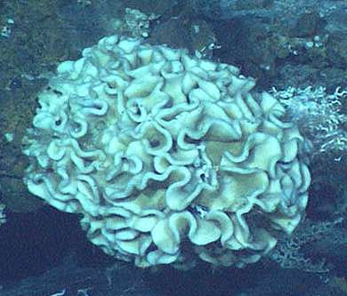
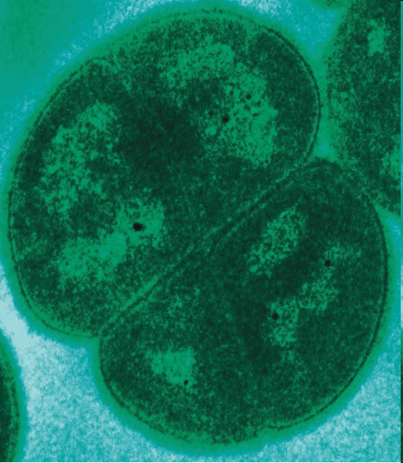
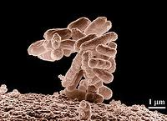
Notes:
Halomonas solaria needs to grow at 1000atm, 3 deg C and likes to grow between 10-25% salinity. The ocean is at 5%.
Deinococcus radiodurans: in the Guinness Book of World Records – can withstand cold, vacuum, radiation and acid!!

Slide 27
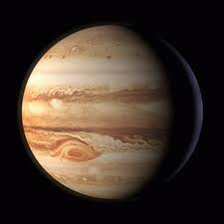

Slide 29
Local Examples

Slide 30
Tardigrades
FACTS:
Tardigrade means “slow walker”
Also called Water Bears
Multicellular organisms, only 500 µm in size!

Slide 31
Tardigrades
Studies have shown that these organisms are capable of withstanding:
Extreme desiccation and salinity
500,000 rads of x-ray radiation
Vacuum conditions
Temperature extremes (151°C to -272°C)
Over 600 atm of pressure (Rothschild and Mancinelli, 2001)
How do they do this??
Notes:
Tardigrades are some of the most “extreme” organisms on Earth!!!

Slide 32
Cryptobiosis
Crypto = uncertain or mysterious
Biosis = way of life
Tardigrades form a tun and in this cryptobiotic state can withstand harsh environments.

Slide 33
Tardigrades
Facts
The longest surviving tardigrade was 120 years old!
In 2008 these organisms were sent up to the International Space Station!!

Slide 34
Where can you find them?
Can be found all around the world in many different environments:
Marine and Freshwater
On land (water films in moss and leaf litter in your own backyard!)

Slide 35
Nematodes
Not as complex as tardigrades, but are capable of withstanding a lot of extreme environments
Adapted to live in nearly every ecosystem (marine/fresh water, soil, polar regions, tropics, high/low elevations, deserts, oceanic trenches)
90% of all life forms on the ocean floor!
Normally < 2.5mm long

Slide 36
Rotifers
Not as extreme, but can sustain many extreme environments if dehydrated
Found mostly in fresh water environments and moist soil
Used in fish tanks to help clean the water
0.1-0.5mm long

Slide 37
Dehydration
The key to these organisms living in extreme environments is dehydration
Experiment with different techniques:
Heat
Cold
Salt
Sunlight
Other ideas?

Slide 39
How do I become an Astrobiologist?
Little bit about me:
Went to McMaster University
Honours Bachelors in Biology with a Minor in Geology
Senior Thesis on extremophilic bacteria in the Canadian Arctic – field work on Ward Hunt Island
Masters in Biology (Origin’s Institute)
Studying Tardigrades on the Ward Hunt Ice Shelf
University of Western Ontario
PhD Candidate in Planetary Science
Studying bacteria living in rocks that have been hit by meteorites – Mars Analog Site on Devon Island

Slide 40
Thank you!
Questions?

