Slide 2
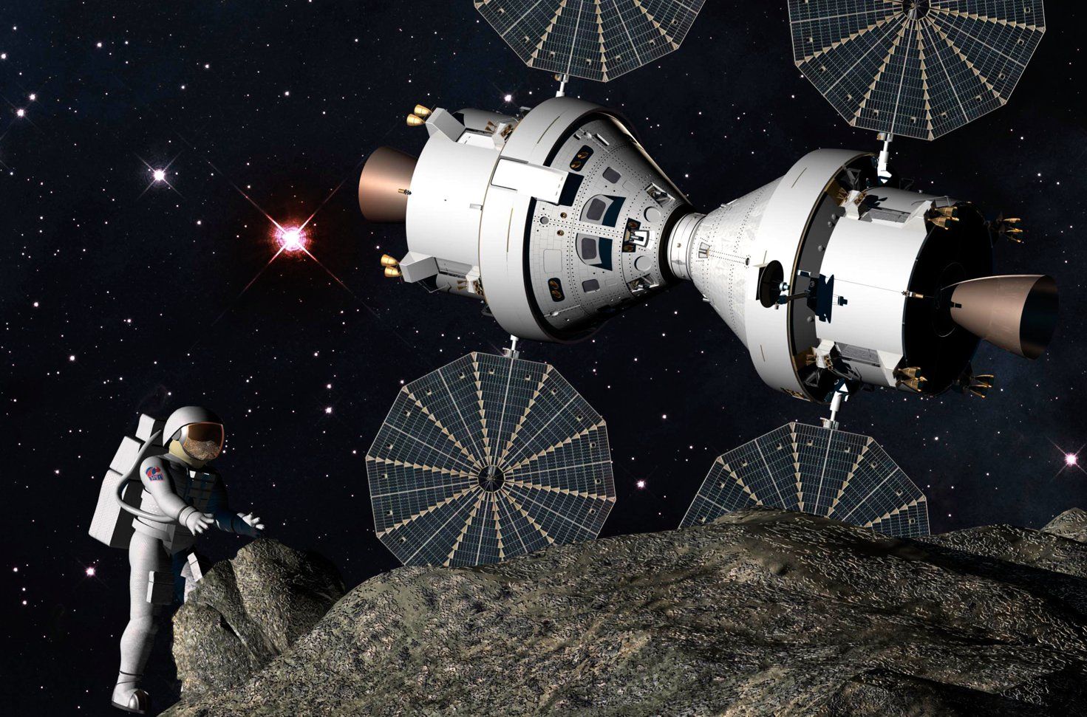
Mission Meteorite
Prepared by: Parshati Patel

Slide 3
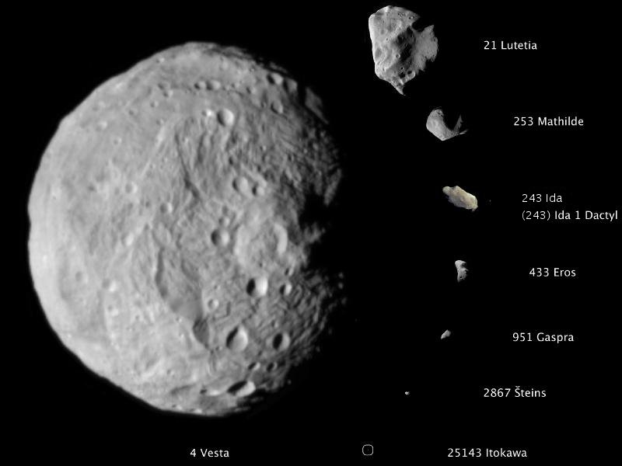
What are asteroids?
Rocky and/or metallic objects that orbit the Sun but are too small to be considered planets
Called “minor planets”
First discovered in 1801
Notes:
Asteroids shown to relative scale in image.
The first asteroid to be discovered, Ceres, was found in 1801 by Giuseppe Piazzi, and was originally considered to be a new planet.

Slide 4
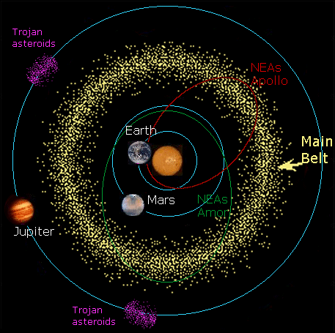
Where Are They?
Notes:
Talk about where you find asteroids, and the risk of asteroids hitting Earth (meteorites)
Trojan asteroids occupy the same orbit as a planet but do not collide w/it (Jupiter, Earth, Mars & Saturn all have known Trojan asteroids)
Main belt lies between Jupiter & Mars; orbital disturbances by Jupiter can launch asteroids from the belt toward the inner solar system, posing Earth hazard

Slide 5
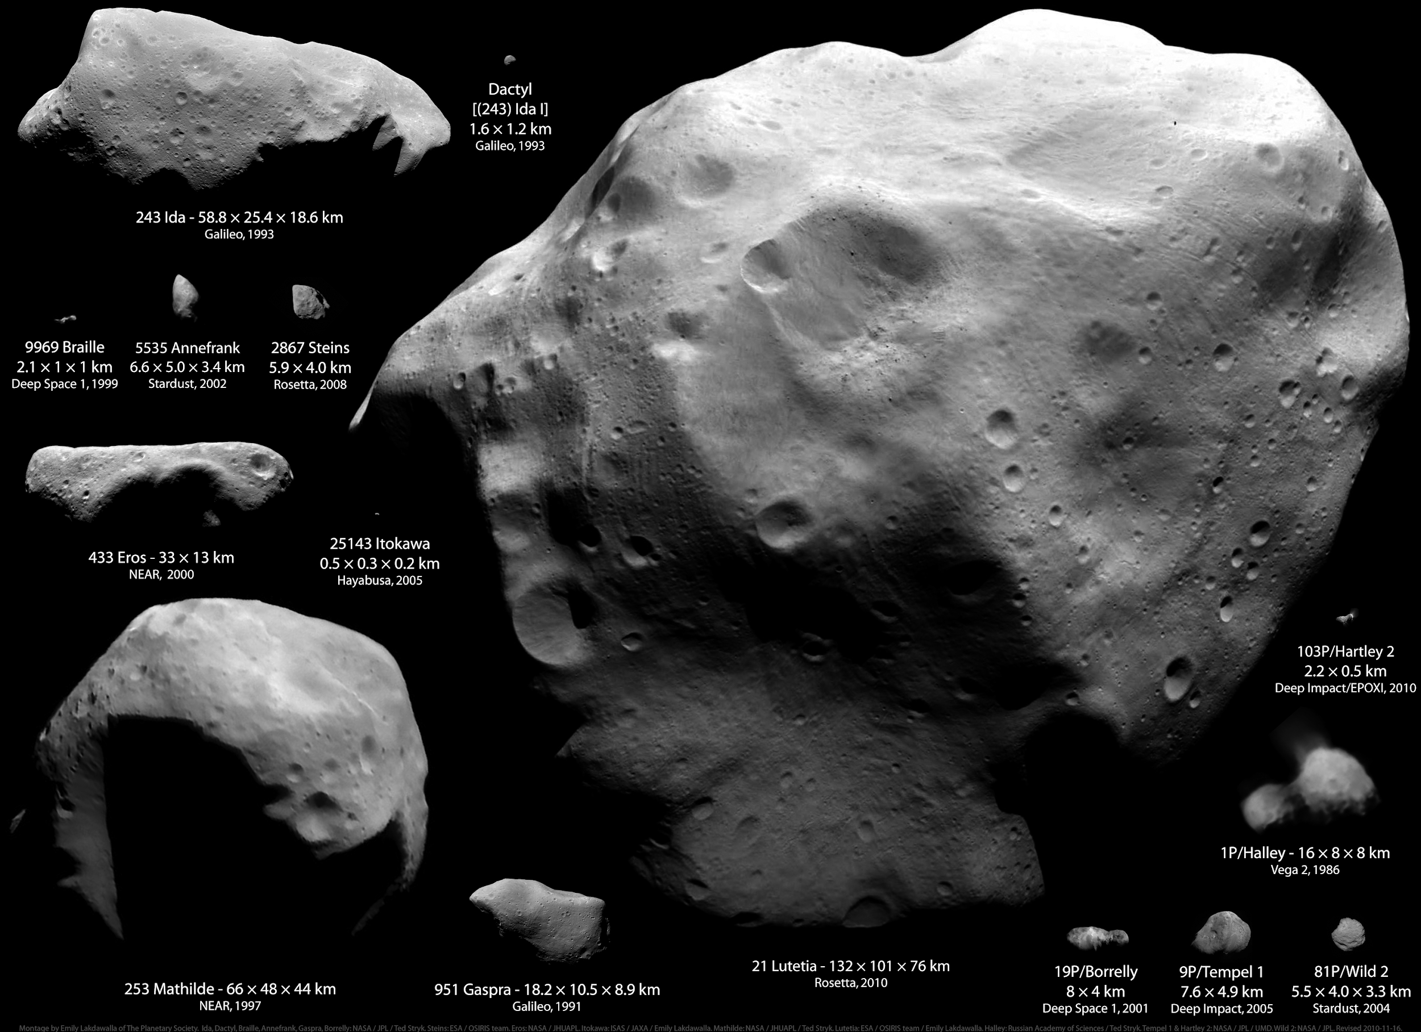
Notes:
Photo of all asteroids visited by spacecraft (& comets in lower right corner), shown to relative scale

Slide 6
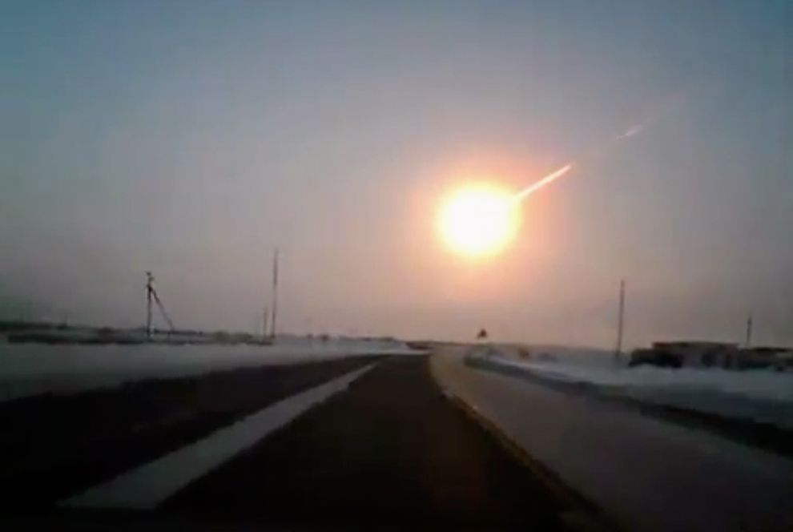
When an asteroid enters the atmosphere, it is then called a “meteor”
Chelyabinsk fireball over Russia

Slide 8
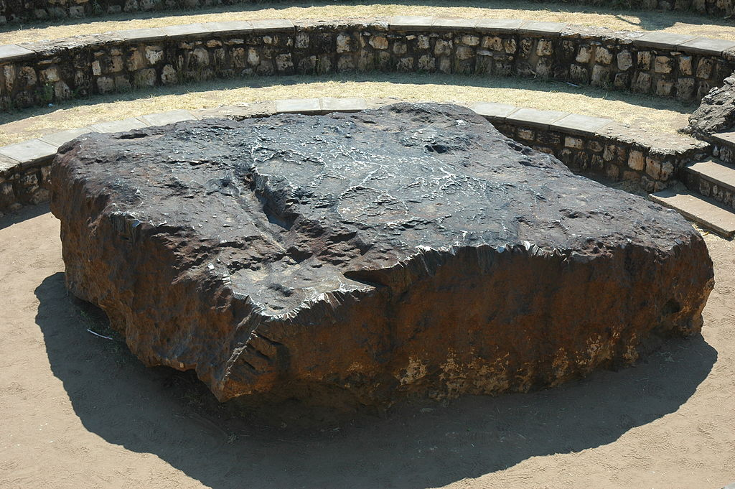
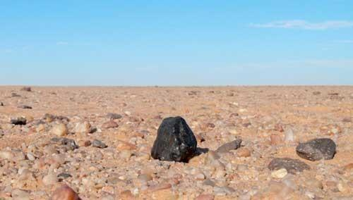
If the asteroid survives the flight and lands on Earth (or any solid surface), it is called a “meteorite”

Slide 9
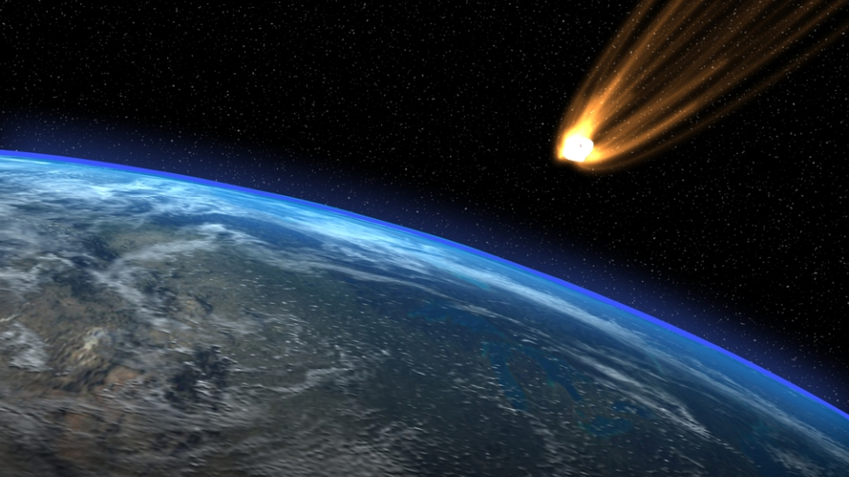
Types of Meteorites
Stony:
Chondrites
Achondrites
Stony-Iron
Iron

Slide 10
“stony iron”
Notes:
Shows undifferentiated (left) to fully differentiated (right) bodies
Talk about core formation

Slide 11
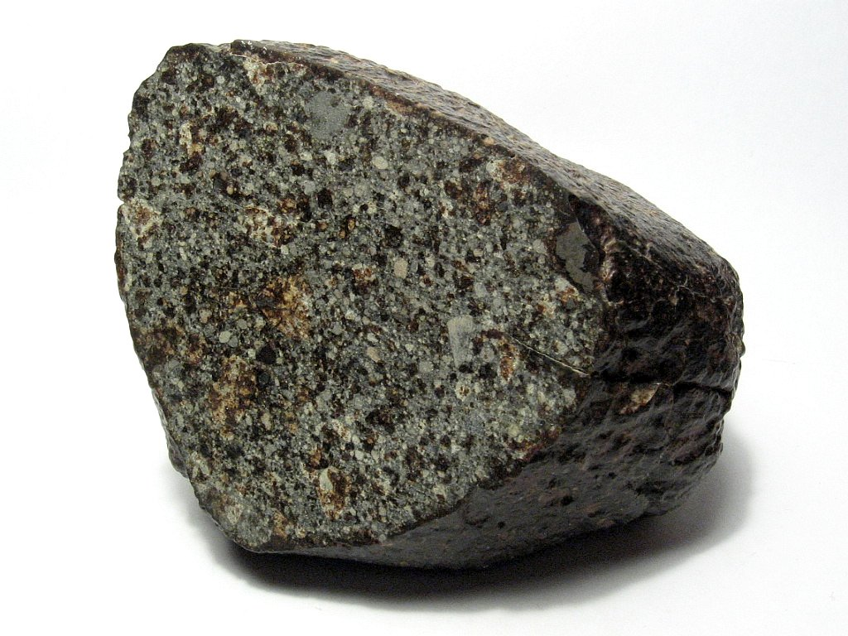
Chondrites
Stony
Most common type
Low metal content
Parent bodies never melted 🡪 no differentiation
Contain “chondrules”
Notes:
Chondrites contain dust—embedded in this dust are presolar grains, which predate the formation of our solar system and originated elsewhere in the galaxy. These meteorites help us understand how the solar system formed.
Prominent among the components present in chondrites are the enigmatic chondrules, millimetre-sized spherical objects that originated as freely floating, molten or partially molten droplets in space; most chondrules are rich in the silicate minerals olivine and pyroxene.
POINT OUT FUSION CRUST IN PHOTO!
Chondrites are stony (non-metallic) meteorites that have not been modified due to melting or differentiation of the parent body.^{[1][2]} They are formed when various types of dust and small grains that were present in the early solar system accreted to form primitive asteroids. They are the most common type of meteorite that falls to Earth with estimates for the proportion of the total fall that they represent varying between 85.7%^{[3]} and 86.2%.^{[4]}

Slide 12
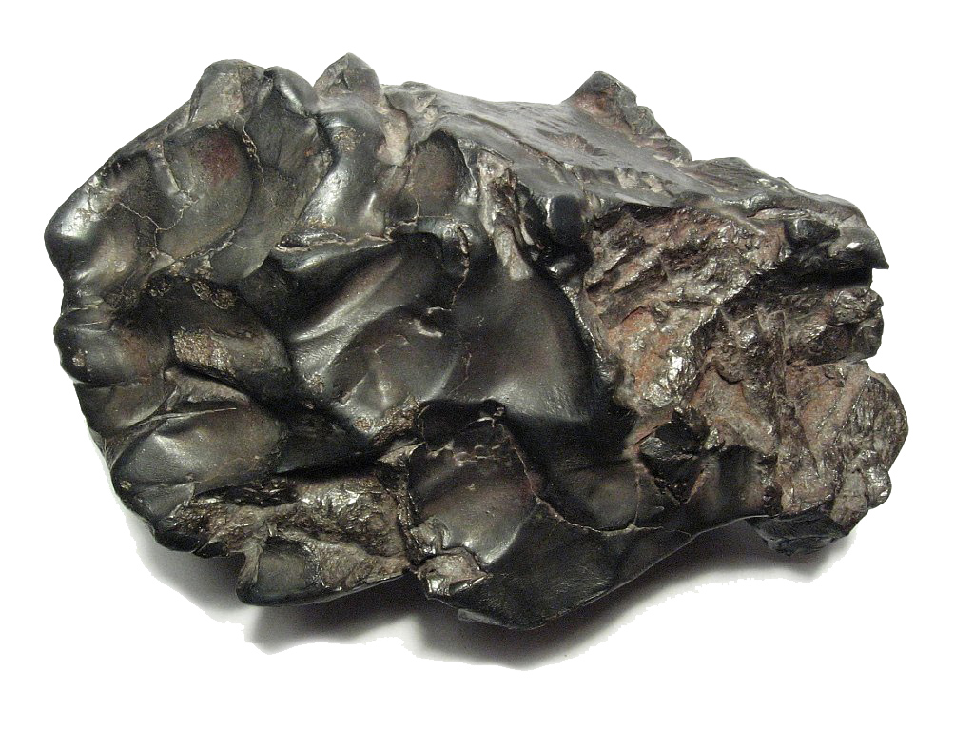
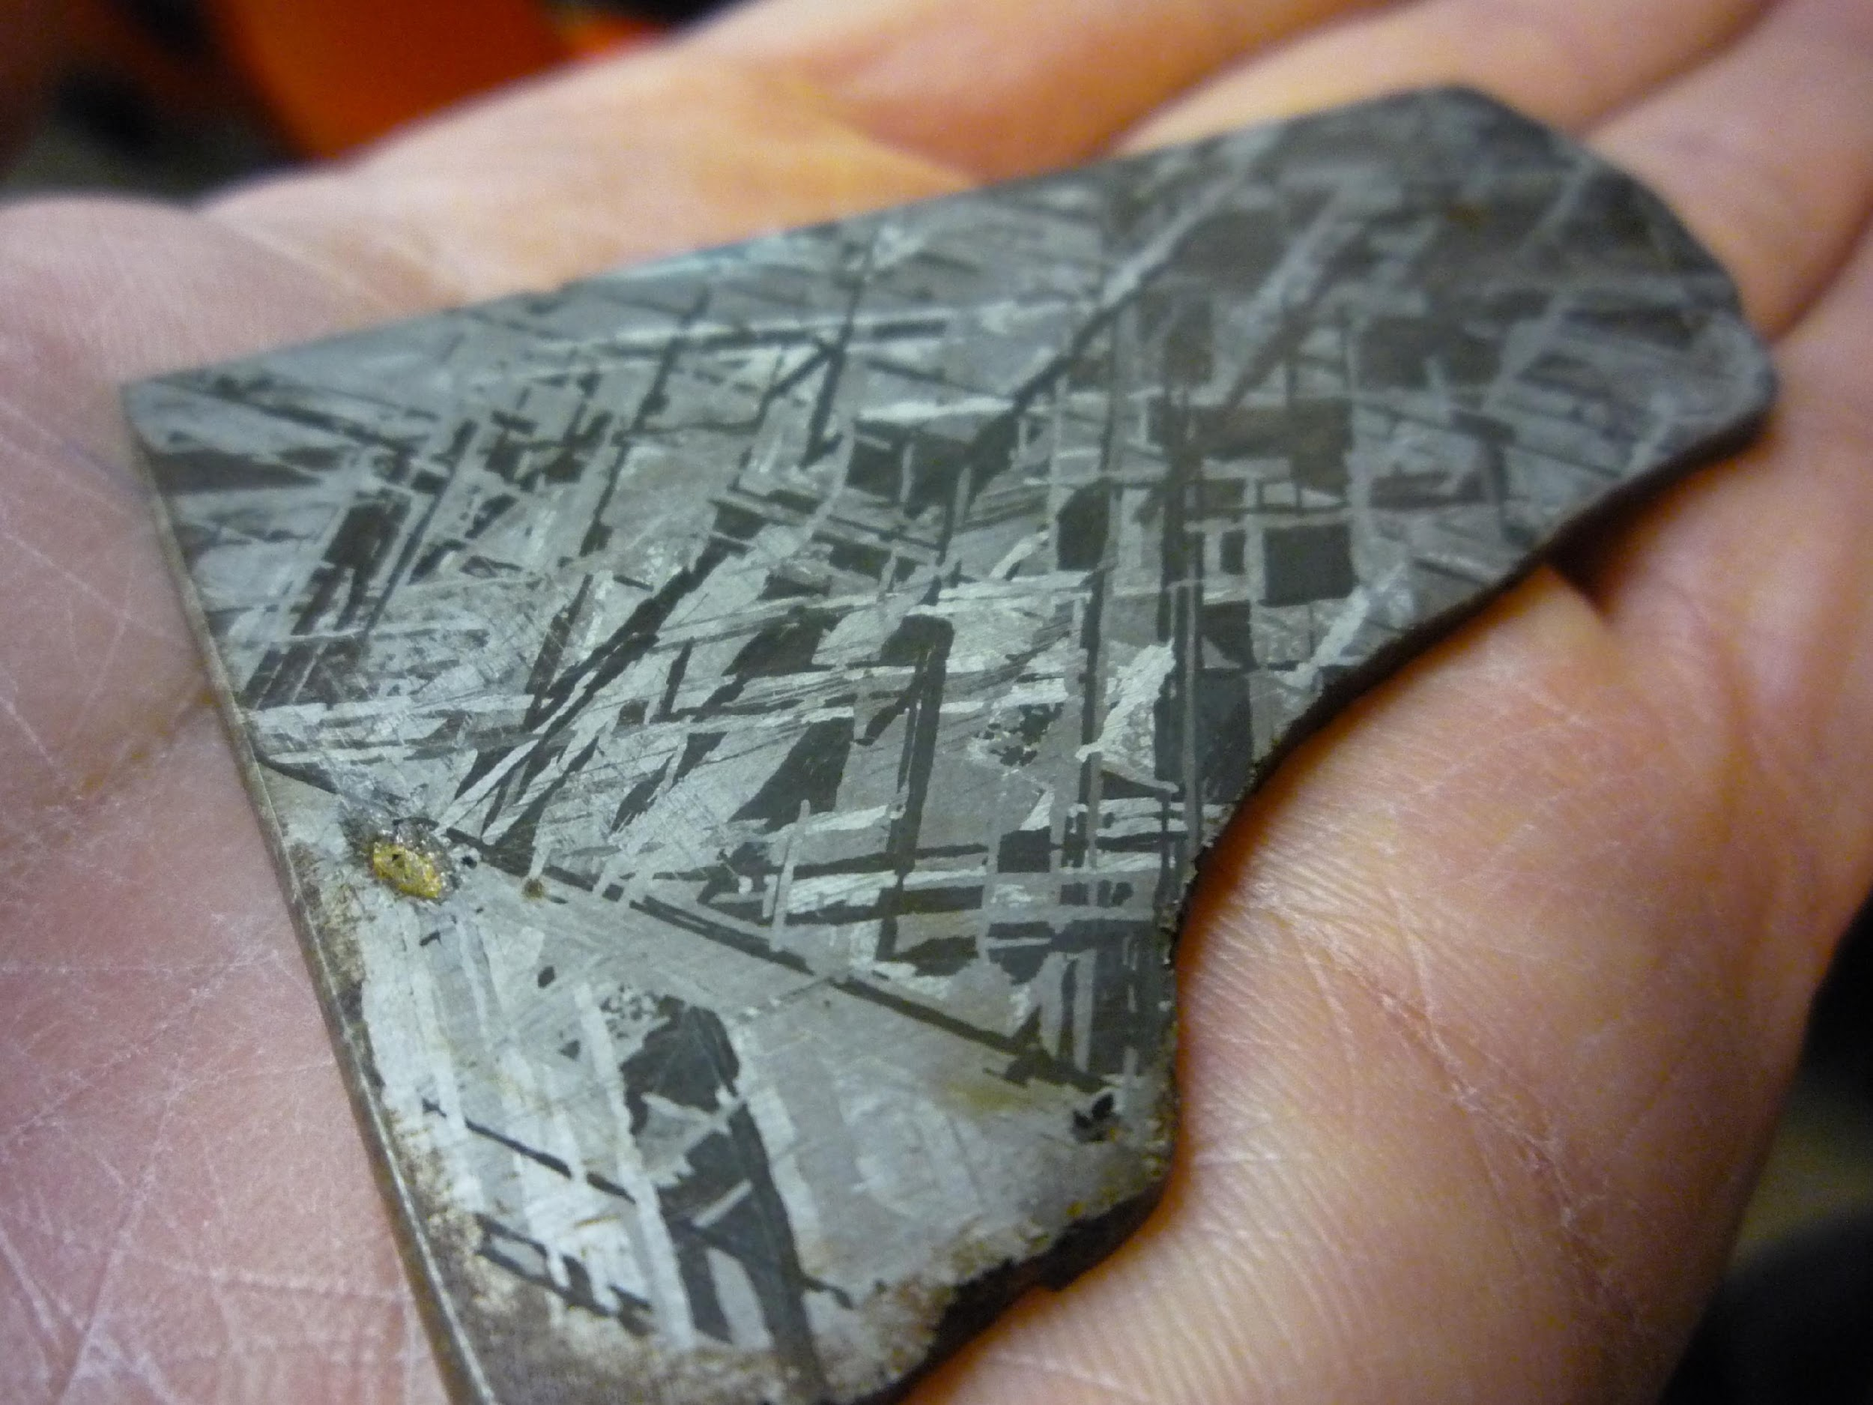
Iron
Iron
From core of differentiated body
Composed of iron & nickel
Widmanstätten pattern when polished
Notes:
Widmanstätten pattern is the outlines of giant individual iron and nickel crystals; can’t get single crystals of them that large on Earth, which is how we know they’re from space
very slow cooling, about 100 to 10,000 °C/Myr, with total cooling times of 10 Myr or less.^{[9]} This explains why this structure cannot be reproduced in the laboratory.
The crystalline patterns become visible when the meteorites are cut, polished, and acid etched,

Slide 13
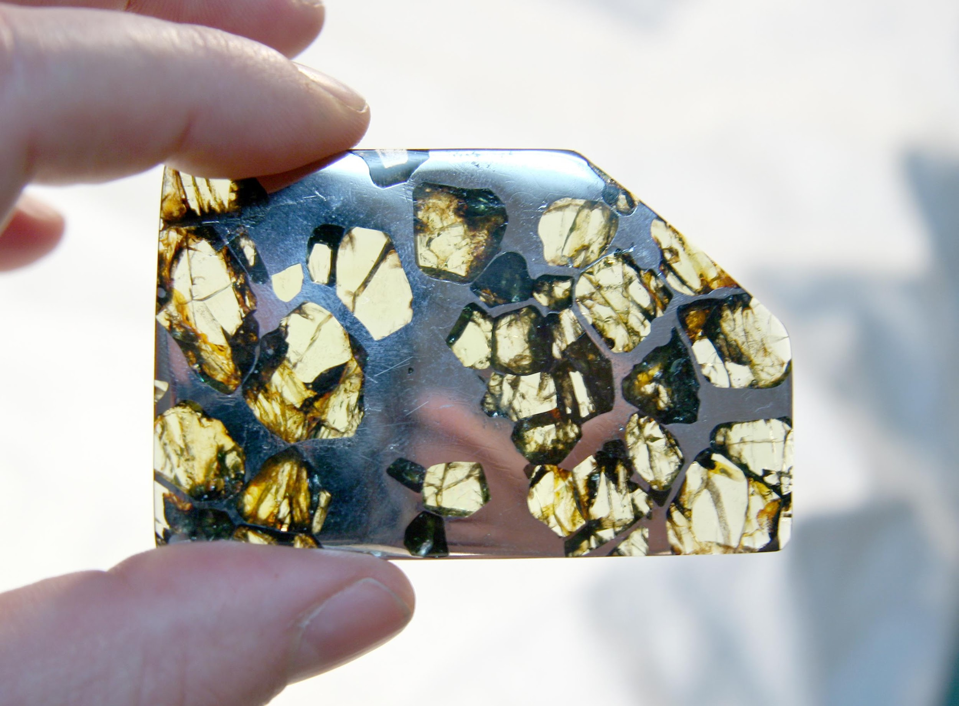
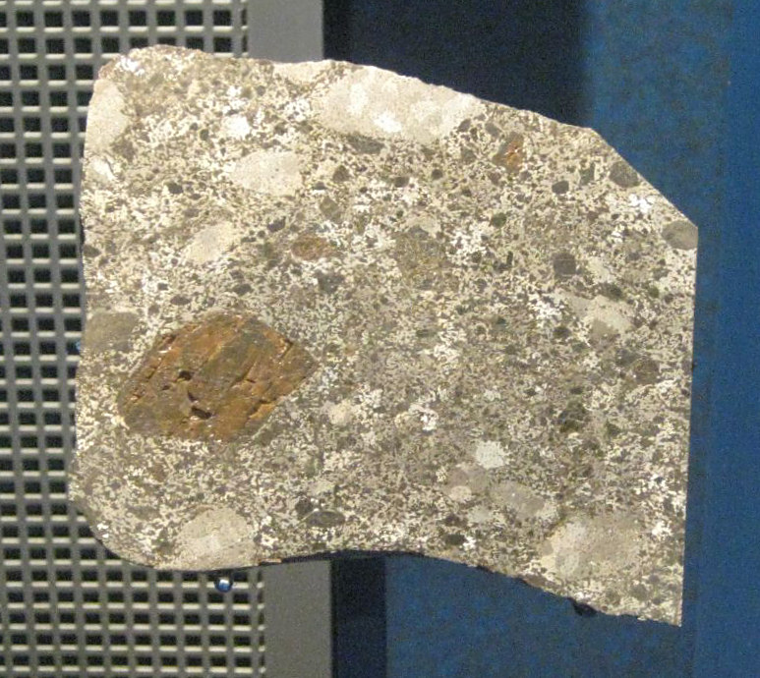
Stony-Iron
Nearly equal parts iron & silicates (stony)
From mantle of differentiated body
Pallasites
Mesosiderites
Notes:
Pallasites have a matrix of iron w/embedded silicates (usually olivine)
Mesosiderites are rare; breccias w/signs of metamorphism
Meso-side-rites

Slide 14
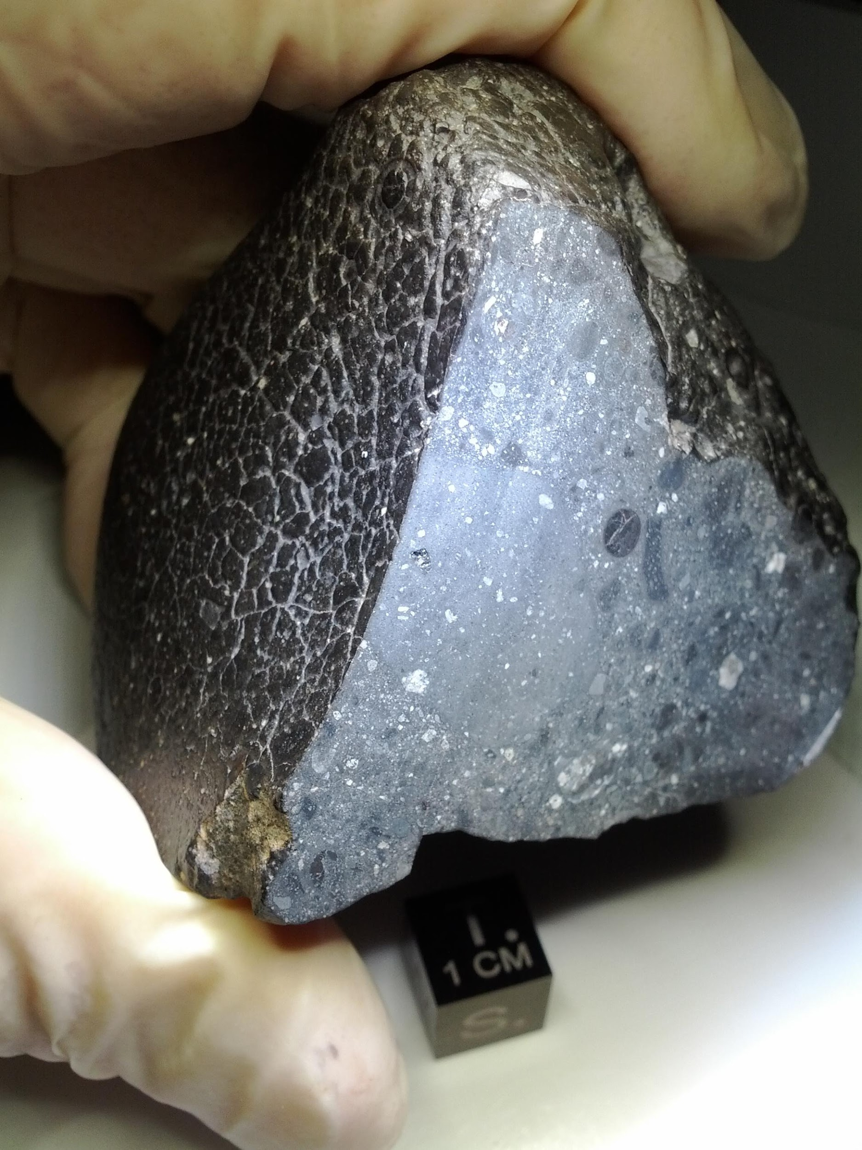
Achondrites
Stony
No chondrules
Similar to basalt on Earth
From crust of differentiated body
Includes lunar & martian meteorites
Notes:
Photo: “Black Beauty” (martian shergottite)
An achondrite is a stony meteorite that does not contain chondrules. It consists of material similar to terrestrial basalts or plutonic rocks and has been differentiated and reprocessed to a lesser or greater degree due to melting and recrystallization on or within meteorite parent bodies. As a result, achondrites have distinct textures and mineralogies indicative of igneous processes.

Slide 15
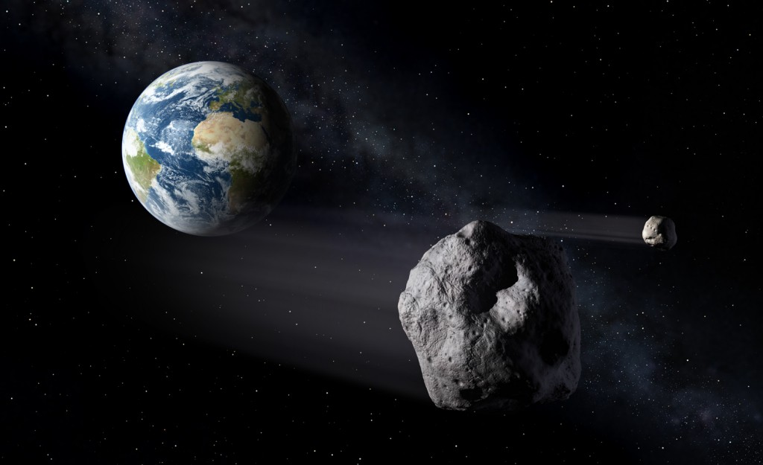
Why are we interested in asteroids?
Impact hazards
Study origin of the Solar System
Asteroid mining
Notes:
Impact hazards: Mention dinosaur extinction, Chelyabinsk shockwave damage
Origin of solar system: As mentioned on chondrites slide, chondrules tell us about composition of pre-solar nebula
Asteroid mining: Precious metals = valuable

Slide 16
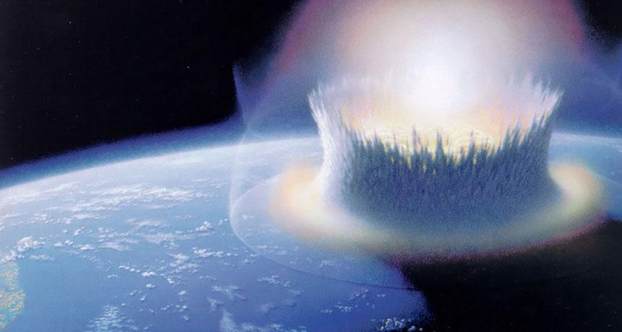
Meteorite impacts and craters
When an object such as an asteroid or comet collides with a moon or solid planet, it forms a crater.

Slide 17
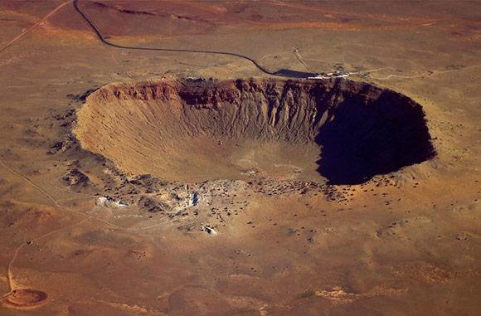
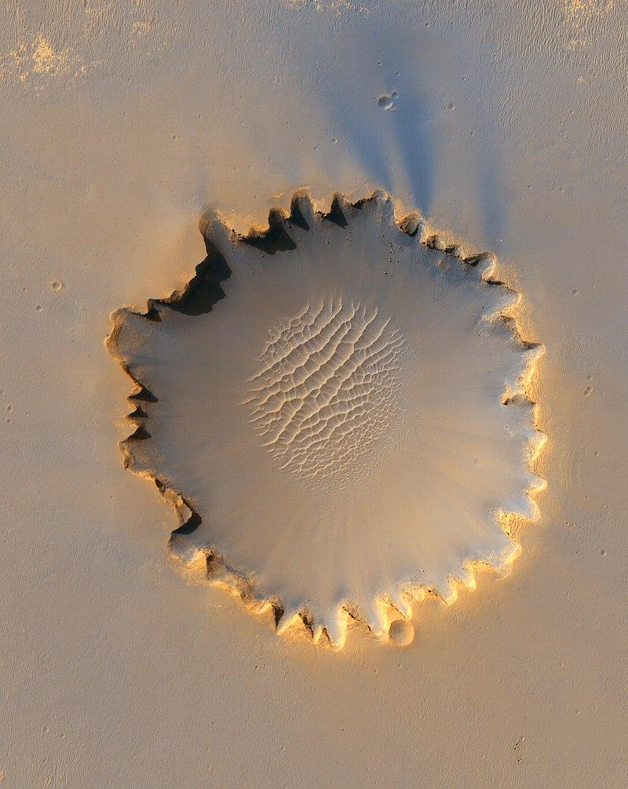
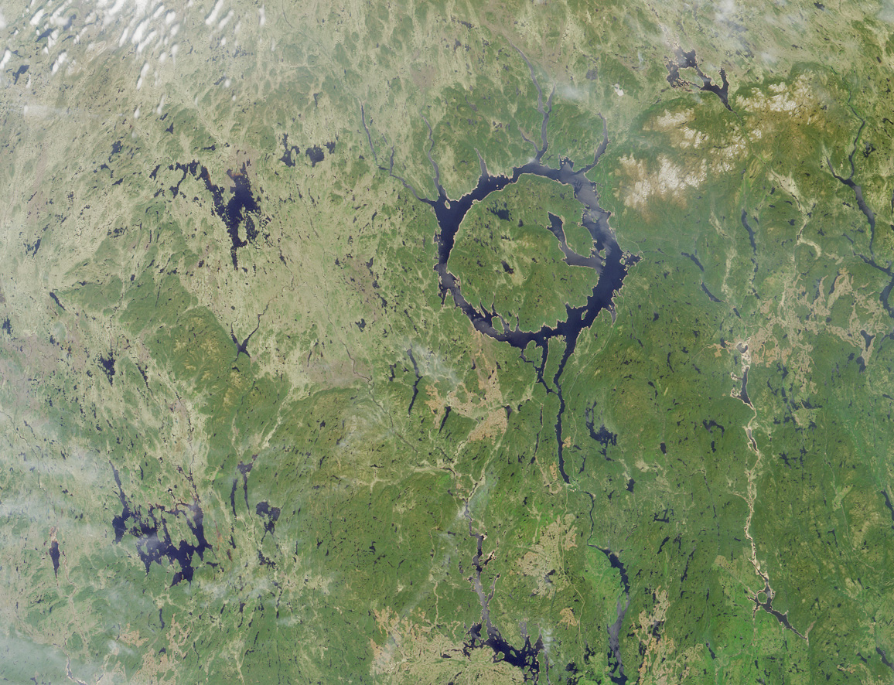
Meteorite impacts and craters
Meteor Crater, Arizona
Victoria Crater, Mars
Manicouagan Crater, Quebec

Slide 18
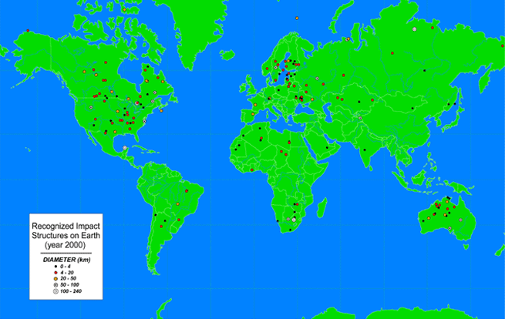
183 known impact craters on Earth
Google Maps Viewer
Notes:
183 known craters
Where don’t we see craters?
Oceans, Greenland, Russia, Alaska.
Ask them to think about why this might be as we look at our nearest neighbor, the Moon.
Image credit: http://www.lpi.usra.edu/publications/slidesets/craters/slide_2.html

Slide 19
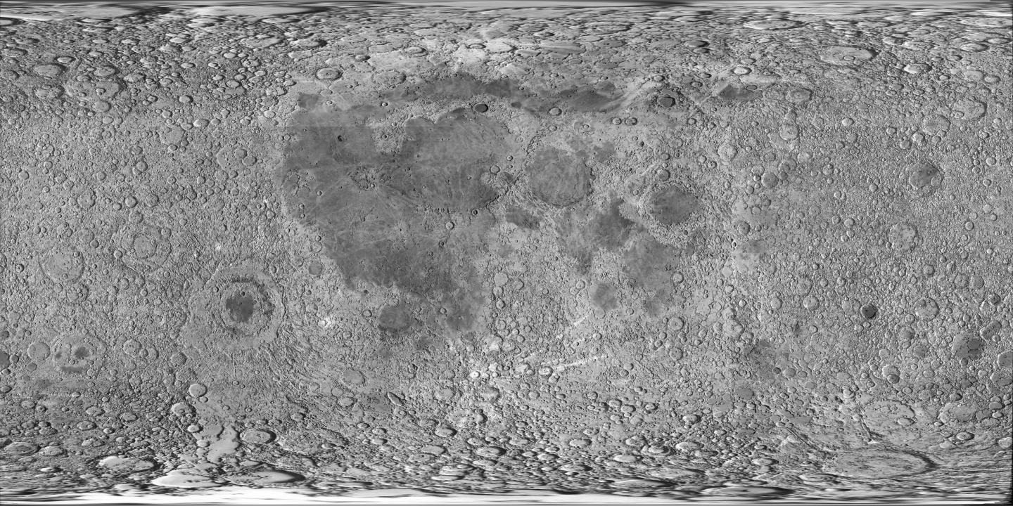
How many craters on the Moon?
More than 30,000!
Notes:
How many craters are in this photo of the moon? (this is the entire moon, front and back).
We can see about 30,000 craters on the moon by looking through a small telescope in your backyard. Can see millions of craters if look in more detail using larger telescopes and cameras on satellites orbiting the Moon.
Image credit: NASA

Slide 20
When impact occurs, a shock wave spreads through the Earth.
Notes:
When the meteoroid strikes the Earth, a shockwave is sent through the ground.
Diagram from NASA Lunar Science Institute Cratering Lab:
http://www.lpi.usra.edu/nlsi/education/hsResearch/crateringLab/lab/part1/background/

Slide 21
Most often, the impactor is completely destroyed.
Some material will be thrown into the air and then fall back to the surface.
Notes:
This shockwave is so powerful that it actually melts the rock and it acts like a liquid! The explosion and excavation of materials at the impacted site created piles of rock (called ejecta) around the circular hole as well as bright streaks of target material (called rays) thrown for great distances. The meteoroid itself is mostly vaporized.
Diagram from NASA Lunar Science Institute Cratering Lab:
http://www.lpi.usra.edu/nlsi/education/hsResearch/crateringLab/lab/part1/background/

Slide 22
Ejected material is called ejecta, and forms an ejecta blanket.
Notes:
This is what some impact craters will look like, and this process can take a few seconds to several hours to complete, depending on the size of impact. In the bowl of the crater is a mix of melt-rich material and breccia (looks like concrete), and fractured rock beneath that. There is an uplifted rim, and ejecta outside the bowl of the crater. Sometimes there is a central uplift or peak in the middle, and rings around the rim of the crater --- these occur in larger craters.
Diagram from NASA Lunar Science Institute Cratering Lab:
http://www.lpi.usra.edu/nlsi/education/hsResearch/crateringLab/lab/part1/background/

Slide 23
Mission Meteorite Activity
Station-based activity, ~20 mins at each station
Class will be split into three groups
Station 1: Stony (meteorites + thin section of a meteorite)
Station 2: Stony-iron & Irons (plus Lunar and Martian)

Slide 24
Mission Meteorite Activity
Rules:
Do not touch the meteorite with bare hands
Use gloves
Impactites: Okay to touch them with bare hands
Please be careful when handling meteorites
Do not take the meteorite out of the box (if in a box)
Put the meteorites on the white paper only
Do not handle the meteorites unless instructed

Slide 25
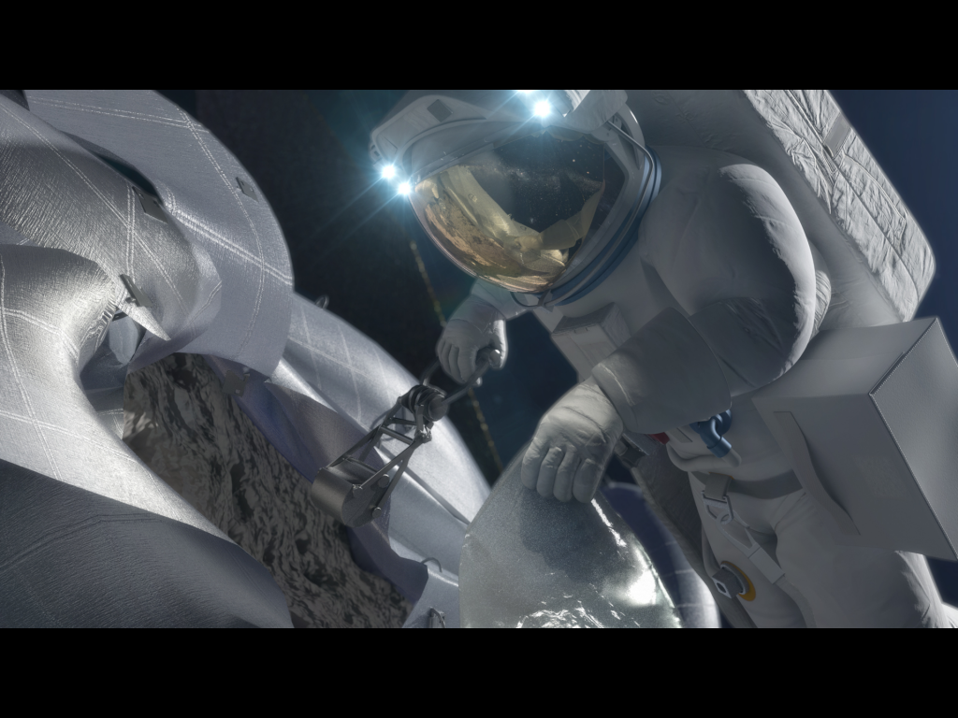
Welcome to Mission Control!
Your mission goals today are:
Learn about asteroids & meteorites
Identify different types of meteorites
Asteroid mining

Slide 26
Notes:
Vesta vs Ceres vs Moon

Slide 27
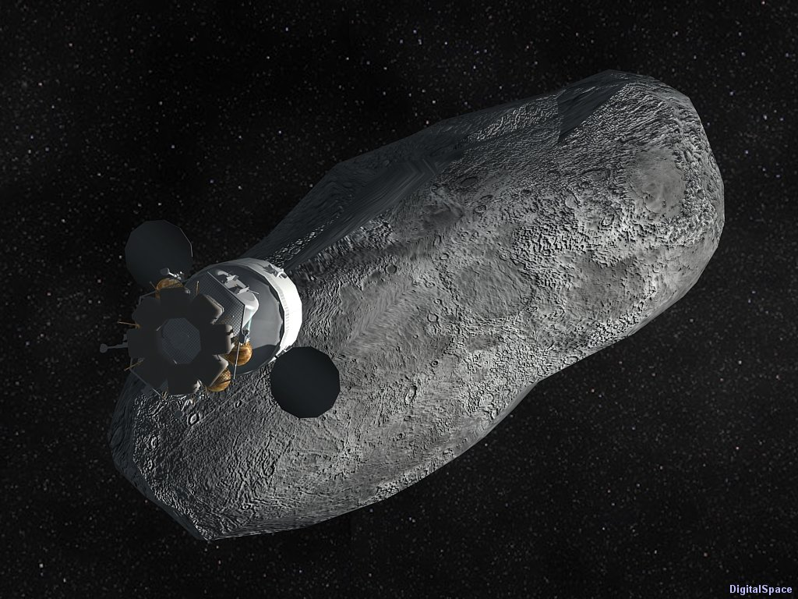
Ready to Launch!

Slide 28
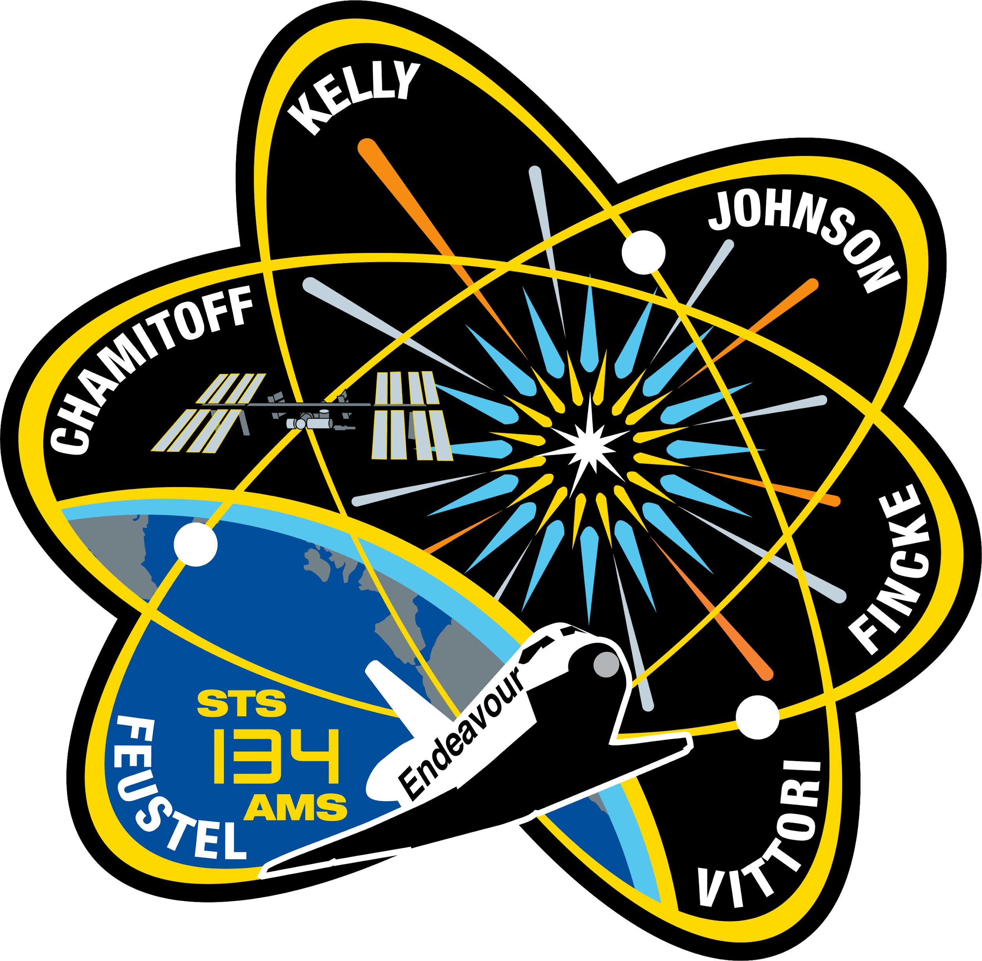
Split into your teams…
Design your mission patch!
Notes:
Give ~5 minutes for patch design

Slide 29
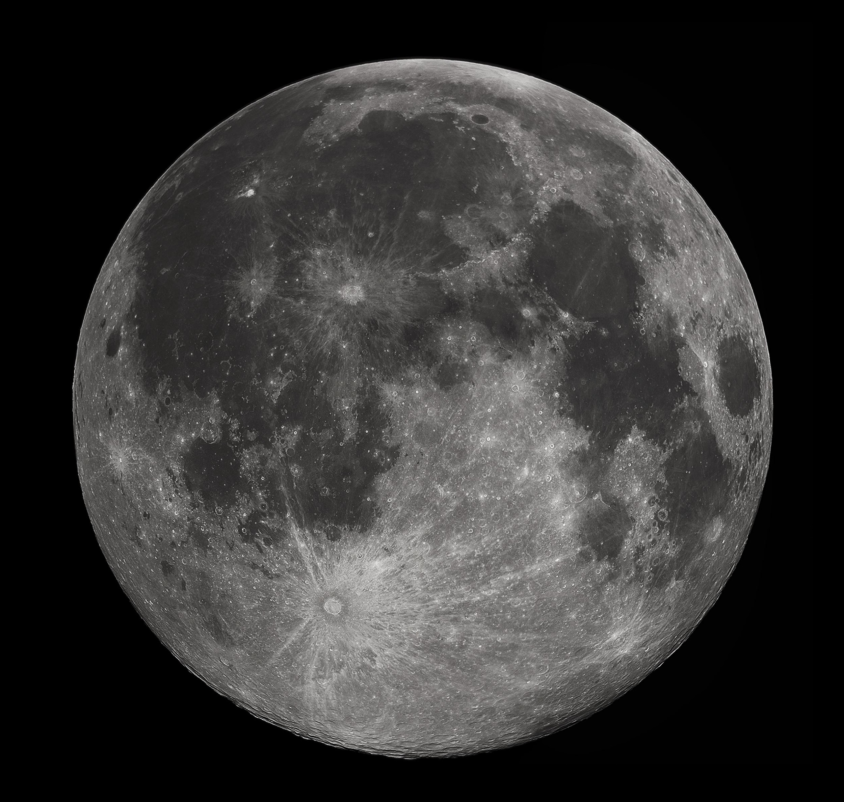
Notes:
Moon is covered with craters, explain why Earth has so few
http://files.abovetopsecret.com/files/img/np54577b5d.jpg

Slide 30
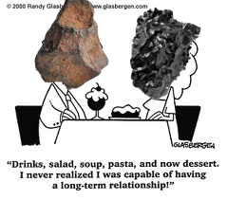
Meteorite Dating Techniques

Slide 31
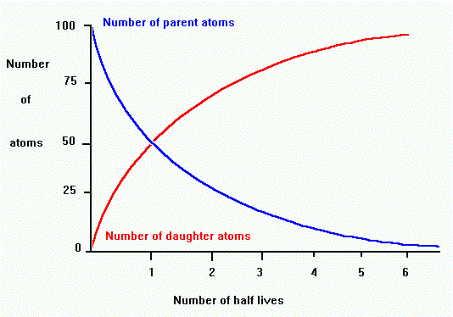
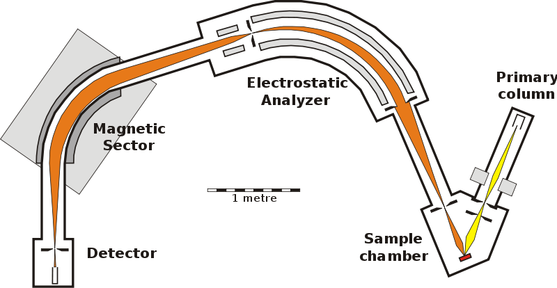
Meteorite Dating Techniques
Radiometric Dating
Compares amounts of Parent and Daughter Isotopes
Uses known decay rate to date rock sample
SHRIMP
Sensitive High Resolution Ion Microprobe Instrument

Slide 32
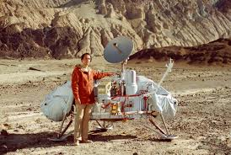
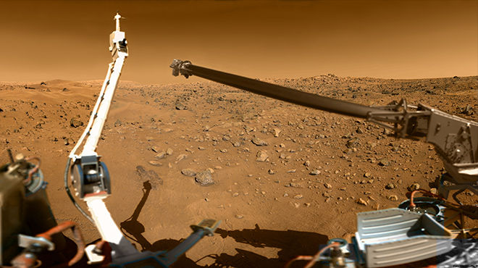
Voyager to Viking
The Viking program grew from NASA's earlier, even more ambitious, Voyager Mars program, which was not related to the successful Voyager deep space probes of the late 1970s
The isotopic composition of the Martian atmosphere measured by the two viking landers (Viking 1 and Viking 2) corresponds to the isotopic composition of trapped air bubbles within SNC meteorites (inferred to be Martian meteorites).
Notes:
Picture 1: Carl Sagan standing next to a model of the Viking lander in Death Valley, California
Picture 2: A view of Mars taken by the Viking 2 lander

Slide 33
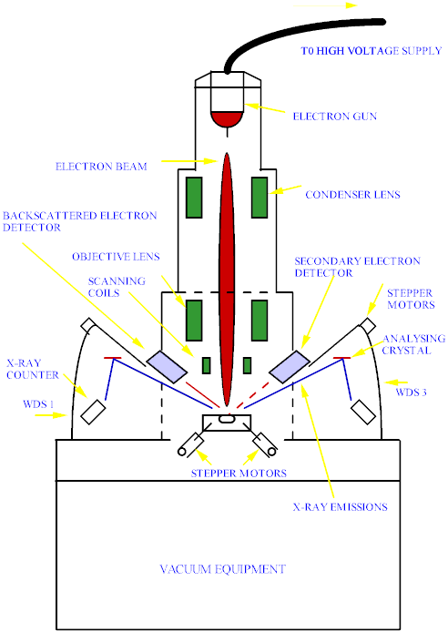
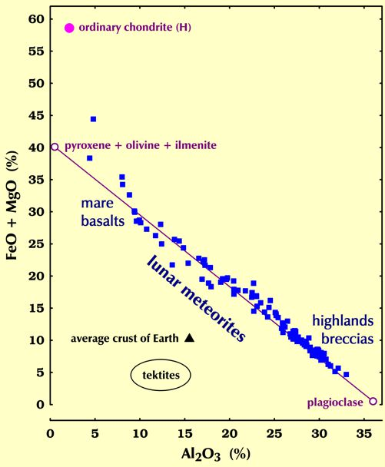
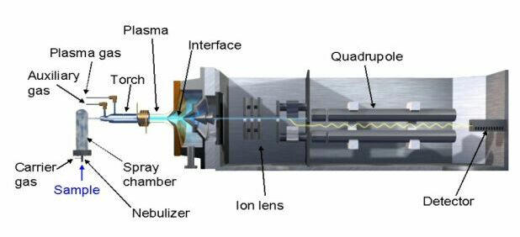
Lunar Meteorite Identification
Apollo Samples and Lunar Meteorites have similar:
Mineralogy and Textures
Optical Mineralogy (lack or abundance of minerals)
Chemical Composition
Electron microprobe
Inductively coupled plasma mass spectrometry
Source: http://meteorites.wustl.edu/lunar/howdoweknow.htm
Source: http://www.geotrack.com.au/emp-op.htm
Source: http://eecelabs.seas.wustl.edu/ICP-MS.aspx

Slide 34
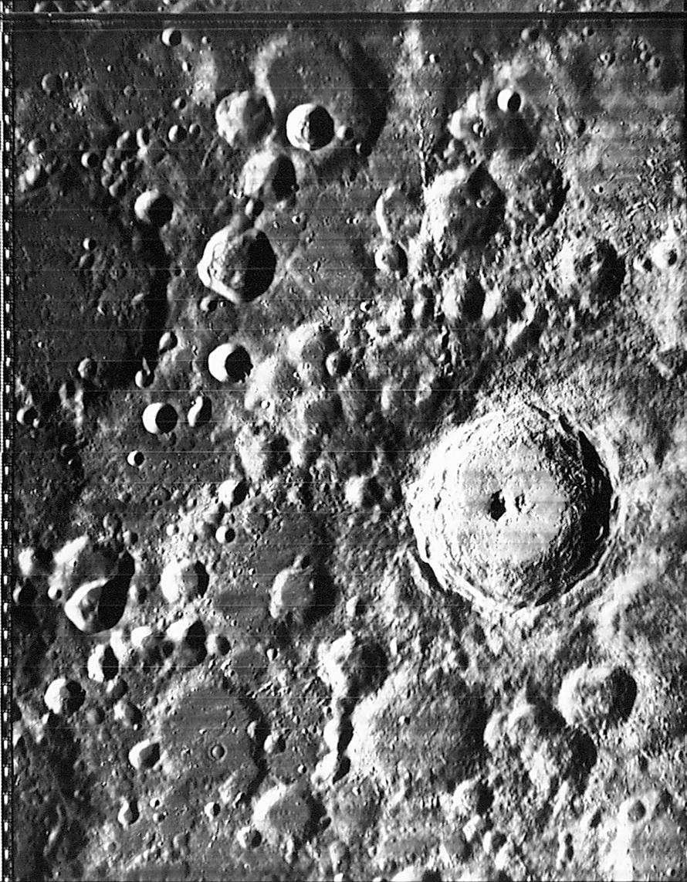
Notes:
http://www.lpi.usra.edu/research/lunar_orbiter/img/4-124H2.jpg
http://www.lpi.usra.edu/htbin/lunar_orbiter/lo.pl?info1257
Photo Number IV-124-H2
Feature Name: Tycho
Feature Latitude: 43.4°S
Feature Longitude: 11.1°W
Size: 102 km
Sun Angle: 70.1°
Spacecraft Altitude: 2994.47 km
Medium Photo Center Latitude: 43°S
Medium Photo Center Longitude: 14.08°W
Add crater close up chart

Slide 35
Notes:
Barringer Crater, Arizona

Slide 36
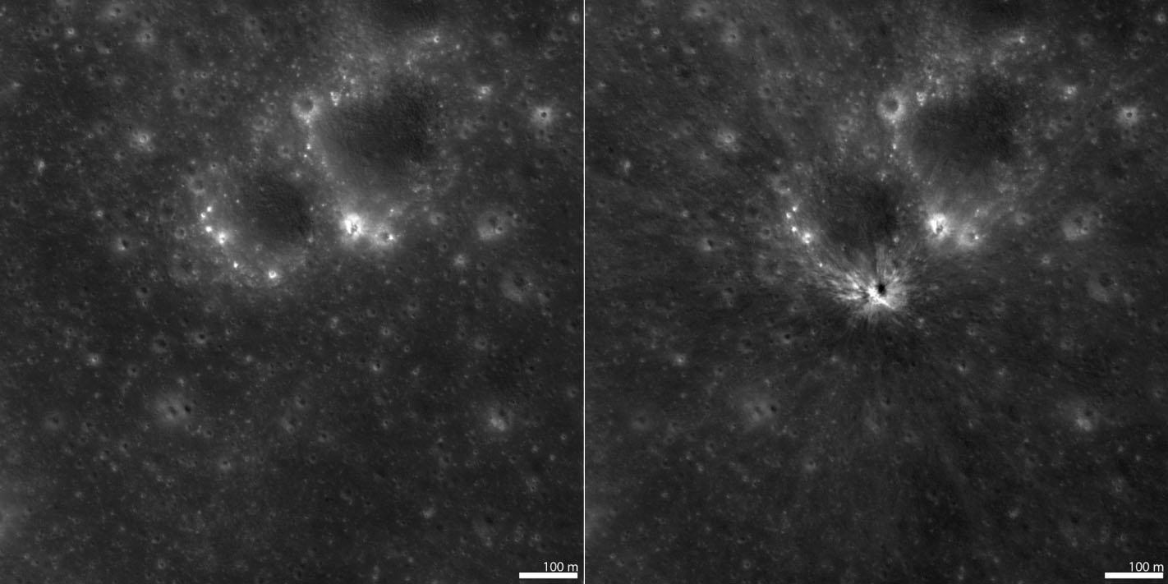
New Crater on the Moon!
Formed 11 September 2013
Notes:
On 11 September 2013 the "Moon Impacts Detection and Analysis System" (MIDAS) camera captured a bright 8-second long flash on the central nearside of the Moon. This was the brightest event captured so far by the MIDAS team, and they estimated that the crater should be between 46 and 56 meters in diameter. The LROC team targeted the reported coordinates (17.2°S, 339.5°E) of the flash and acquired several images over a few months until the crater was found in images acquired on 16 March 2014 and 13 April 2014!
(We’ve also seen new craters form on Mars with Mars Global Surveyor & Mars Reconnaissance Orbiter)
http://lroc.sese.asu.edu/posts/810

Slide 37
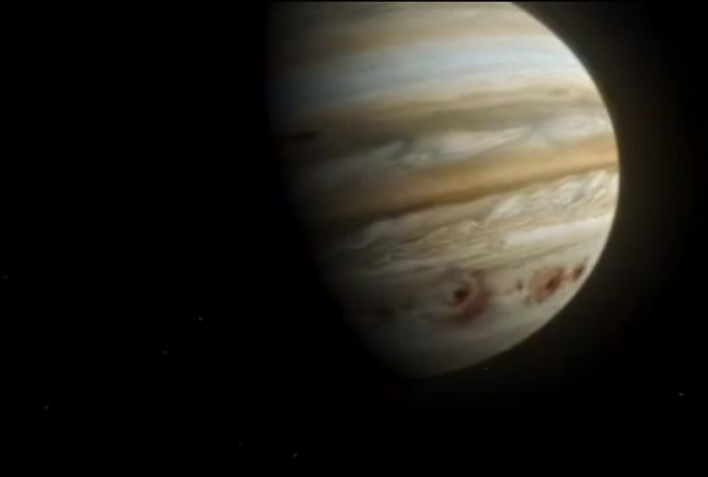
Jupiter vs. Comet Shoemaker-Levy 9
Notes:
http://nssdc.gsfc.nasa.gov/planetary/sl9/image/sl9juppre_hst.gif
http://nssdc.gsfc.nasa.gov/planetary/sl9/html/preimpact_images.html
PHOTO RELEASE NO.: STScI-PR94-26a FOR RELEASE: July 7, 1994
PHOTO ILLUSTRATION OF COMET P/SHOEMAKER-LEVY 9 & PLANET JUPITER
This is a composite photo, assembled from separate images of Jupiter and comet
P/Shoemaker-Levy 9, as imaged by the Wide Field & Planetary Camera-2
(WFPC-2), aboard NASA's Hubble Space Telescope (HST).
Jupiter was imaged on May 18, 1994, when the giant planet was at a distance of
420 million miles (670 million km) from Earth. This "true-color" picture was
assembled from separate HST exposures in red, blue, and green light. Jupiter's
rotation between exposures creates the blue and red fringe on either side of
the disk. HST can resolve details in Jupiter's magnificent cloud belts and
zones as small as 200 miles (320 km) across (wide field mode). This detailed
view is only surpassed by images from spacecraft that have traveled to Jupiter.
The dark spot on the disk of Jupiter is the shadow of the inner moon Io. This
volcanic moon appears as an orange and yellow disk just to the upper right of
the shadow. Though Io is approximately the size of Earth's Moon (but 2,000
times farther away), HST can resolve surface details.
When the comet was observed on May 17, its train of 21 icy fragments
stretched across 710 thousand miles (1.1 million km) of space, or 3 times the
distance between Earth and the Moon. This required six WFPC exposures along
the comet train to include all the nuclei. The image was taken in red light.
The apparent angular size of Jupiter relative to the comet, and its angular
separation from the comet when the images were taken, have been modified for
illustration purposes.
Credit: H.A. Weaver, T.E. Smith (Space Telescope
Science Institute) and J.T. Trauger, R.W. Evans
(Jet Propulsion Laboratory), and NASA

Slide 38
ENGAGE MISSION!

Slide 39
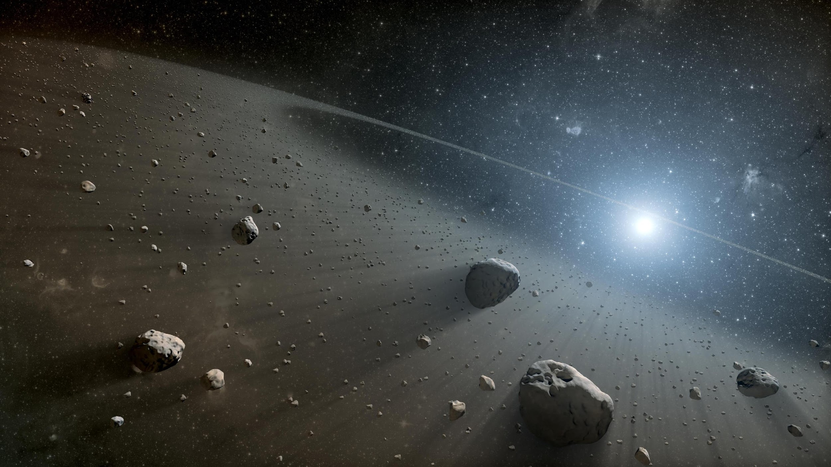
What did you learn?
Notes:
Asteroids contain large amounts of precious metals that are valuable on Earth, hence the interest in asteroid mining
Private companies like Planetary Resources, as well as NASA proposing concept human missions to asteroids or bringing asteroids to Earth orbit for mining

Slide 40
Mission Meteorite Activity
Station-based activity, ~15 mins at each station. Class will be split into three groups
Station 1: Stony (meteorite + thin section of a meteorite)
Station 2: Stony-iron & Irons (plus lunar and martian)
Station 3: Impactites

Slide 41
Asteroid Mining Activity
ASTEROID
MINING
Notes:
Asteroids contain large amounts of precious metals that are valuable on Earth, hence the interest in asteroid mining
Private companies like Planetary Resources, as well as NASA proposing concept human missions to asteroids or bringing asteroids to Earth orbit for mining

Slide 42
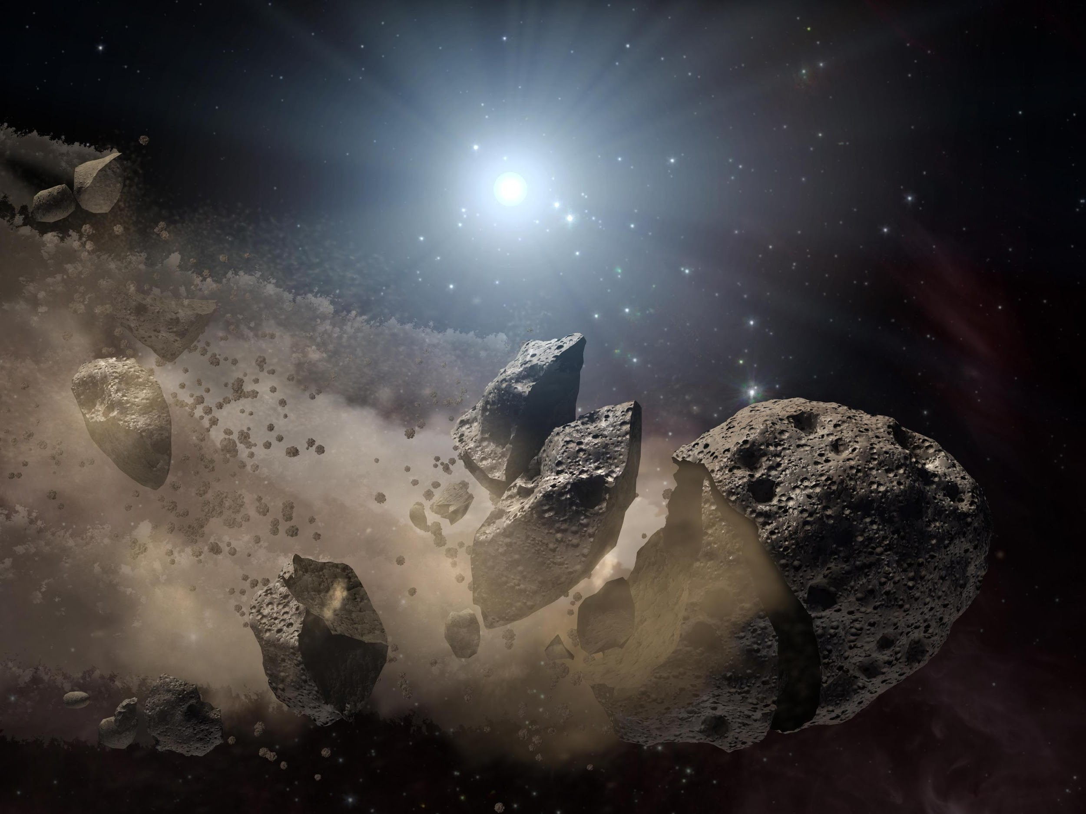
Cookie Mining Activity
Use only the tools provided—no hands!
“Mine” the chocolate chips
10 points per clean whole chip
5 points per dirty or broken chip
Team with the most points wins!

Slide 43
Thank you!
Questions?

