Slide 2
Mapping Planetary Landscapes
Prepared by: Laura Thomson
Updated by: Tanya Harrison
Notes:
First, introduce yourself, your studies and interests.
Highlight CPSX and Western – Canada’s largest planetary sciences program is in London!
“Today we’re going to talk about Mars and specifically the features on the surface of Mars and how we know what we know today about the planet.”

Slide 3
Outline
Introduction to mapping
How we see Mars, past and present
What we see on a global scale
Features on Mars
Mapping activity
Notes:
“First I’m going to explain how we’ve progressed in our understanding of what the surface of Mars is like. Then, I’m going to give you a tour of the entire planet and point out some key features that make Mars unique from, as well as similar to, Earth. Then you are going to work together to develop a map of Mars, similar to what we planetary scientists at CPSX do!”

Slide 4
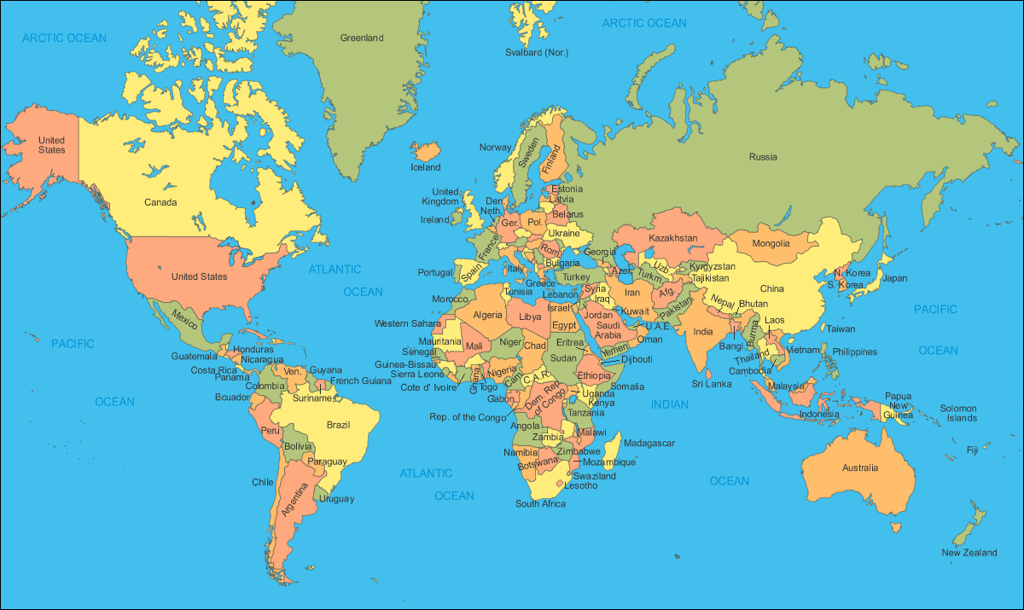
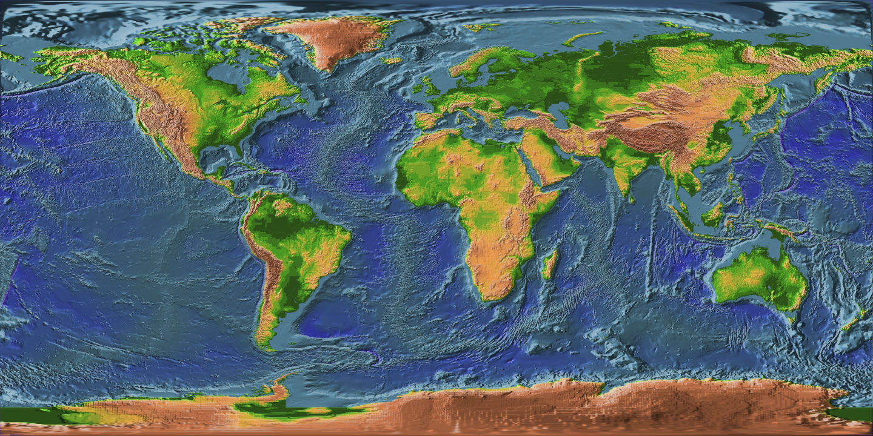
Maps of Earth
Notes:
Q: Has anyone drawn a map before? If so, what kind of map?
A: political map (coloring), treasure map, road map
ST: There are many kinds of maps. Here are just a few examples of maps of our Earth. The one of the left is a political map, where all the countries are a different color. The one on the right is a geological map, which tells us how high and low (elevation) areas are (topographical map).

Slide 5
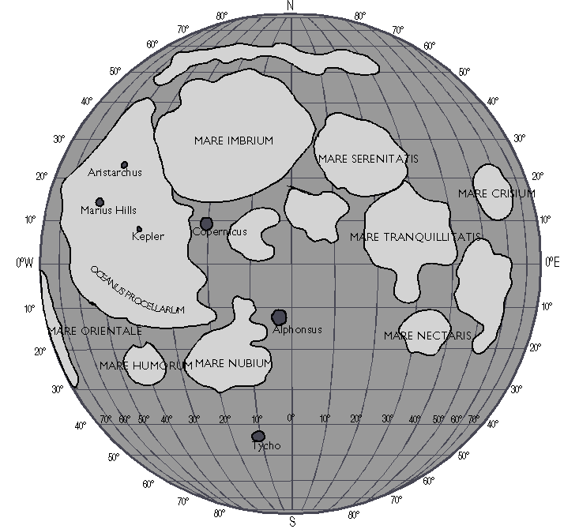
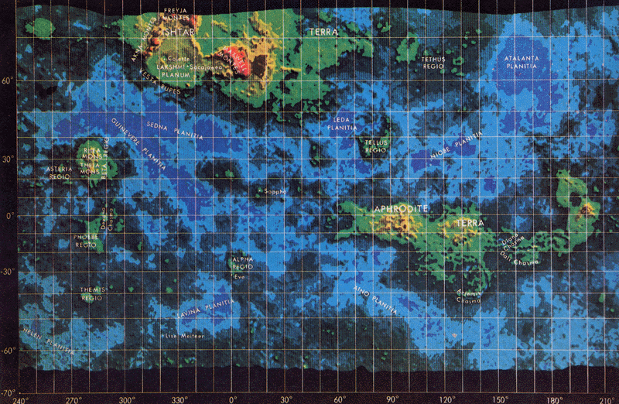
Maps of Other Planets
Simple map of the Moon
Topographical map of Venus
Notes:
Planetary scientists make maps of other planets. They choose different things to map (smooth/rough, light/dark, high/low elevation, etc.), then they can make interpretations of how that surface came about. These are two examples of very different maps. The one on the left is a very simple map of the Moon, showing the large mare and craters. The one on the right is more complex, and shows the topography of Venus.
We make maps for three reasons:
We often can’t go to a planet or moon to make observations, so this is the best way to see the differences on the surface.
Once we have these observations, we can figure out what might have happened on the planet to create those features.
If we want to send robots or humans to a moon or planet, we will know where we want to land, what will be there when we get there, and what we want to look at.
This presentation will talk about mapping Mars specifically. We’ll go through a number of images, figuring out what differences (units) to map and then try to interpret what might have happened on the surface to create those features.
Q: Before I get started, what do you know already about Mars? (If needed, prompt further with “What does Mars look like?)
AR: Mars is red, it’s near the asteroid belt, farther from the sun than Earth, smaller than Earth, etc.
Q: And how do we know this? How have we gained this information?
AR: Satellites, rovers, landers, etc.

Slide 6
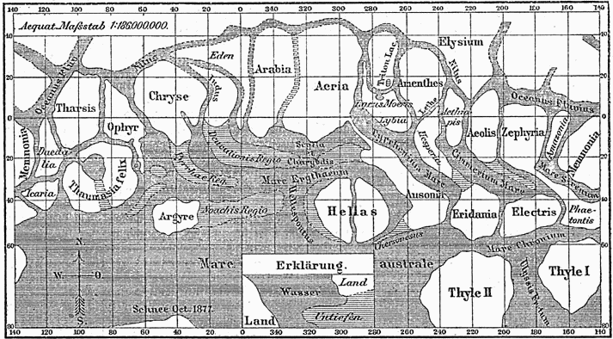
Mapping Mars: Old School
Notes:
ST: That’s right. But, we didn’t always have the modern technology you mentioned to study Mars. This image here is one of the first maps of Mars, made in 1888 (over 100 years ago) by Giovanni Schiaparelli (“Schip-a-relly”), well before we had sent satellites to Mars.
Q: How, then, do you think Schiaparelli could have made this map?
AR: A telescope!
ST: That’s right, Schiaparelli created this map of the surface of Mars using a telescope. He called the darker areas “mare” (meaning “oceans”) and the sinuous lines “canali” (Italian for channels). However, some thought these “canali” were artificial canals created by intelligent life on Mars. These theories were especially encouraged by Percival Lowell, who went on to write a book titled “Mars as the Abode of Life.”
PS: Meyers Konversations-Lexikon (German encyclopaedia), 1888.

Slide 7
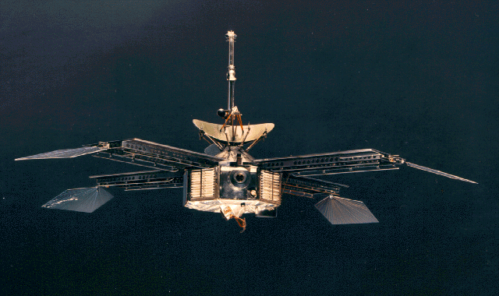
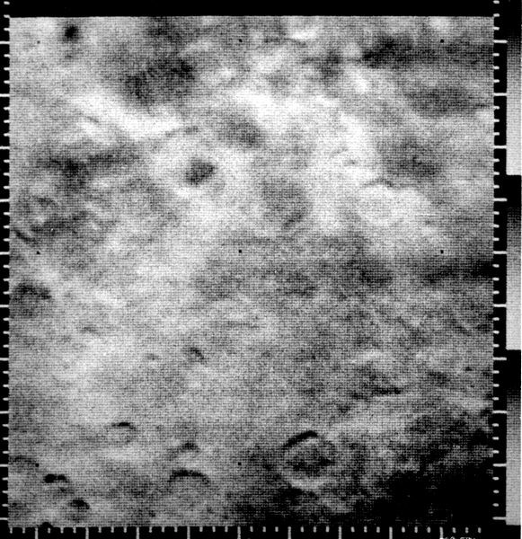
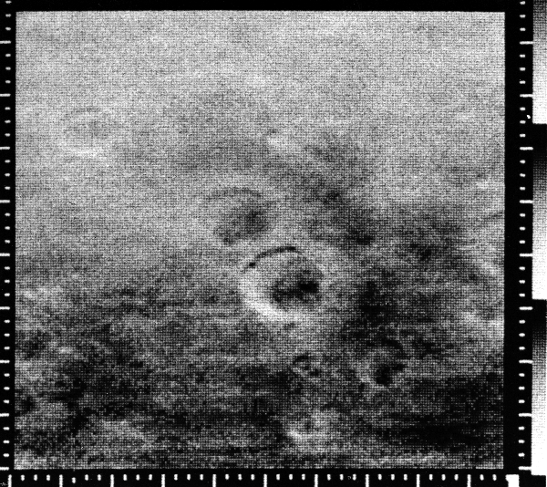
The Mariner Missions: Our First Pictures of Mars
Mariner 4 – NASA flyby mission (1964–1967)
Notes:
ST: For nearly 100 years, telescopes were the only tool we had to observe Mars—but in the 1960s, everything changed. The space race was happening between Russia and the United States. In just a few years the human race had developed rockets, sent satellites into space, sent a man into orbit, and eventually put people on the moon. At the same time, we were sending missions to Mars. The first satellite to reach Mars was Mariner 4, which sent back our first close-up images of the planet! The 22 images collected by Mariner covered 1% of the planet, providing the information necessary to start compiling a map of the planet.
Q: These are some of the first images of Mars’ surface, how would you interpret them? What do you see?
AR: Craters!
ST: That’s right, these features are similar to the craters that we see on the Moon, and also on Earth in some places—including many right here in Canada! In fact, the second largest impact crater on Earth is in Sudbury, Ontario!
PS: Mariner 4 images courtesy of NASA NSSDE Image Catalog: http://nssdc.gsfc.nasa.gov/imgcat/html/mission_page/MR_Mariner_4_page3.html

Slide 8
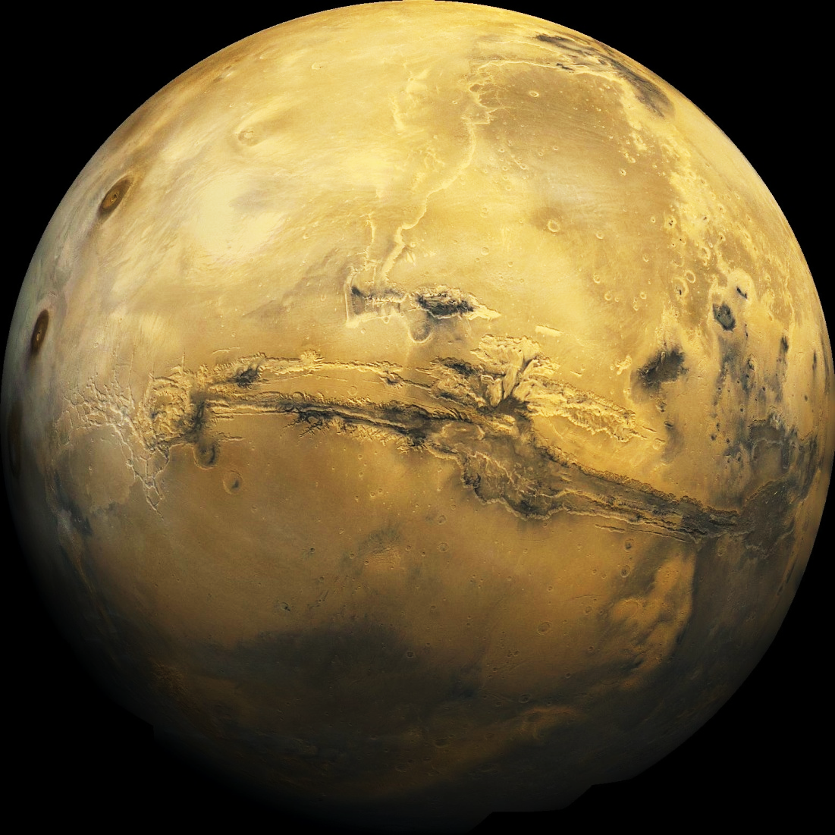
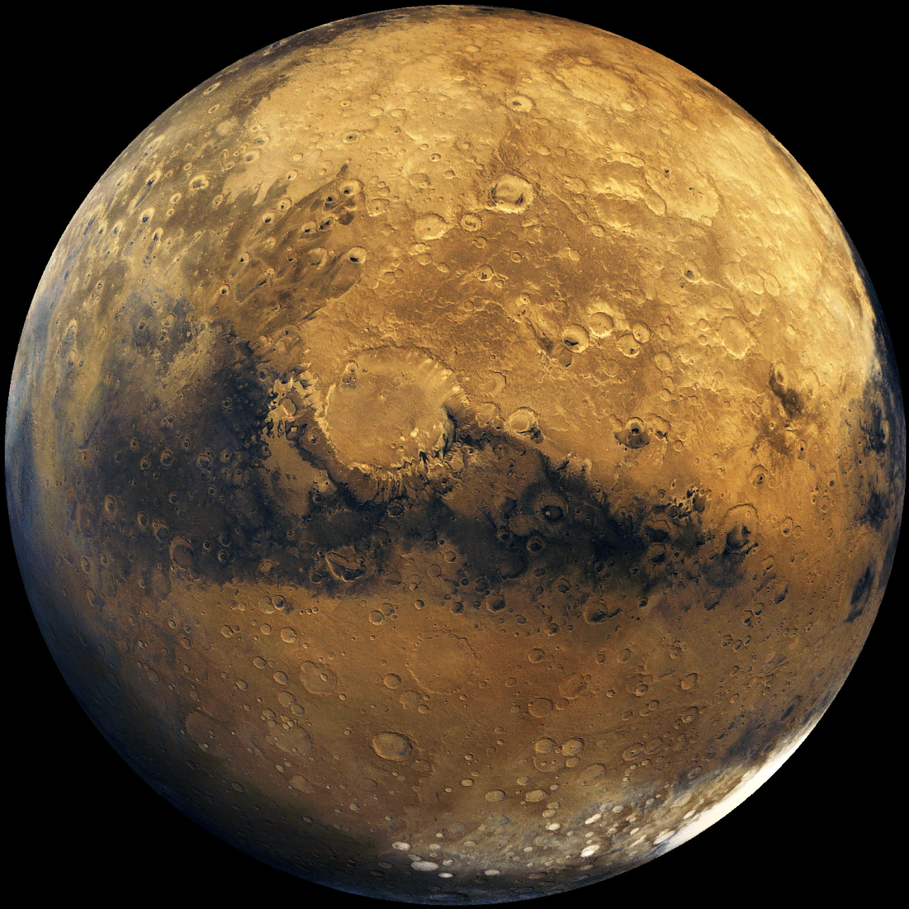
Our View of Mars Today
Notes:
ST: Today our views of Mars are impressive! Not only do our images cover the entire planet, but we can see many features with very high resolution (can see small things) and at different wavelengths.*
Q: I’d like to hear some descriptions of what we can recognize in these two hemispherical views of Mars. It’s ok if you don’t know the proper term for the feature, just describe it.
AR: Long line across middle of left image, dark circles at top left (left image), bright northern area (left), craters (right image), dark smudge (right), ice at bottom (right)
*CS: Different wavelengths: in addition to visible light which covers the range of wavelengths that give us different colours, there are also microwaves (smaller wavelength) and radio waves (larger). You could think of these as colours that our eyes can’t see, but special satellite instruments can see.
PS: Mosaic of Viking Orbiter images. Courtesy of NASA.

Slide 9
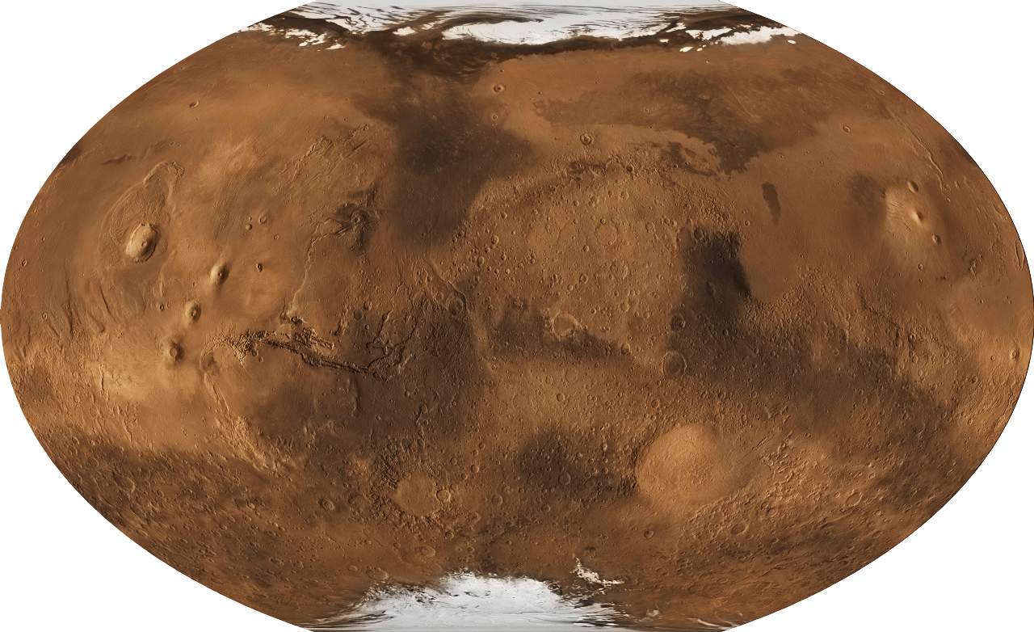
Our View of Mars Today
Notes:
ST: Similar to global maps of Earth, we can do the same for Mars.
Q: Do you recognize anything else with this image?
AR: We see ice in the northern AND southern polar areas (like Earth!)
Q: Are there differences between the northern and southern hemispheres?
AR: The north is smoother, whereas the south has more craters.
ACT: Let’s take a survey, how many students knew there were volcanoes on Mars?
Ice?
Craters?
Valleys?
ST: Now let’s talk about some of these features in detail!

Slide 10
Martian Landforms
Volcanoes
Valleys
Wind features
Water features
Impact craters
Landslides
Layered rock

Slide 11
Martian Volcanoes
Notes:
ST: First, let’s talk about volcanoes. This is a topographic map – it shows changes in elevation so that the cool blue-coloured regions are low, and the red areas are higher, with the brown and white areas showing the tops of peaks. This is the Tharsis region of Mars which has four large volcanoes (indicate on screen). Now there is something special I’m hoping you guys can recognize here. There something unique about the region around the volcanoes. There are certain features that we don’t see around the volcanoes but that we do in the two bottom corners (indicate two regions).
Q: Can anyone tell me what’s missing from the volcano region? (If taking a while, indicate specific craters in the south and smooth areas around volcanoes).
AR: Craters!
ST: That’s right.
Q: Any idea why we don’t see craters around the volcanoes?
AR: (They likely don’t know, but give them the time to think about it…)
ST: Well, volcanoes produce lava! They completely change their surroundings because as lava flows out, it covers the ground around it and buries any old features in the area leaving a smooth, crater-free surface behind.
[Indicate Olympus Mons on the map—volcano farthest west]
ST: This volcano here is Olympus Mons—the largest volcano in the solar system!

Slide 12
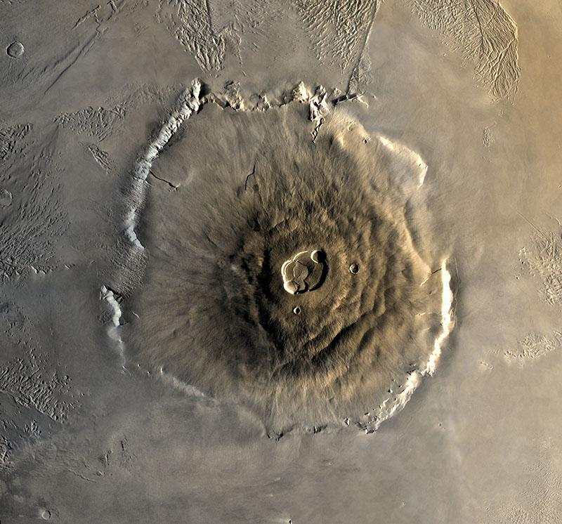
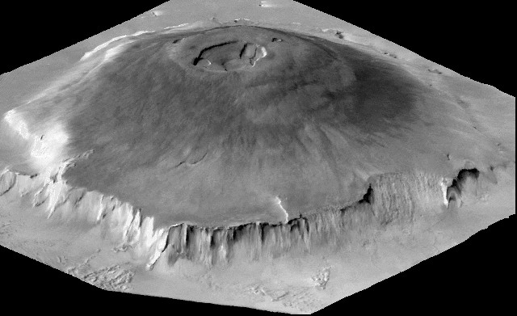
Martian Volcanoes: Olympus Mons
Olympus Mons is 25 km tall and 550 km across!
Notes:
ST: Olympus Mons is the largest known volcano in our solar system! It is 25 km tall. For perspective, if we look at the right image and imagine our own Mount Everest (8 km tall) sitting on this smooth plain at the bottom (indicate), its peak would just barely peek over this plateau here (indicate). This volcano is huge! This feature at the top is called the caldera (indicate). It looks like a crater, but a good way to tell the difference between a caldera and a crater is to see whether there are many other craters around it. If the surface around it is quite smooth, then it has likely been covered with lava flowing from the crater.
Extra information: We have never seen this volcano erupt, but we believe some of the lava flows were emplaced as early as two million years ago, which is not that old in geological time!

Slide 13
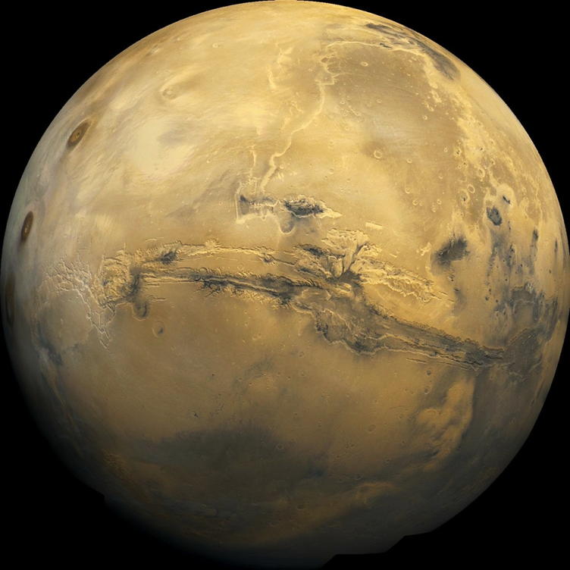
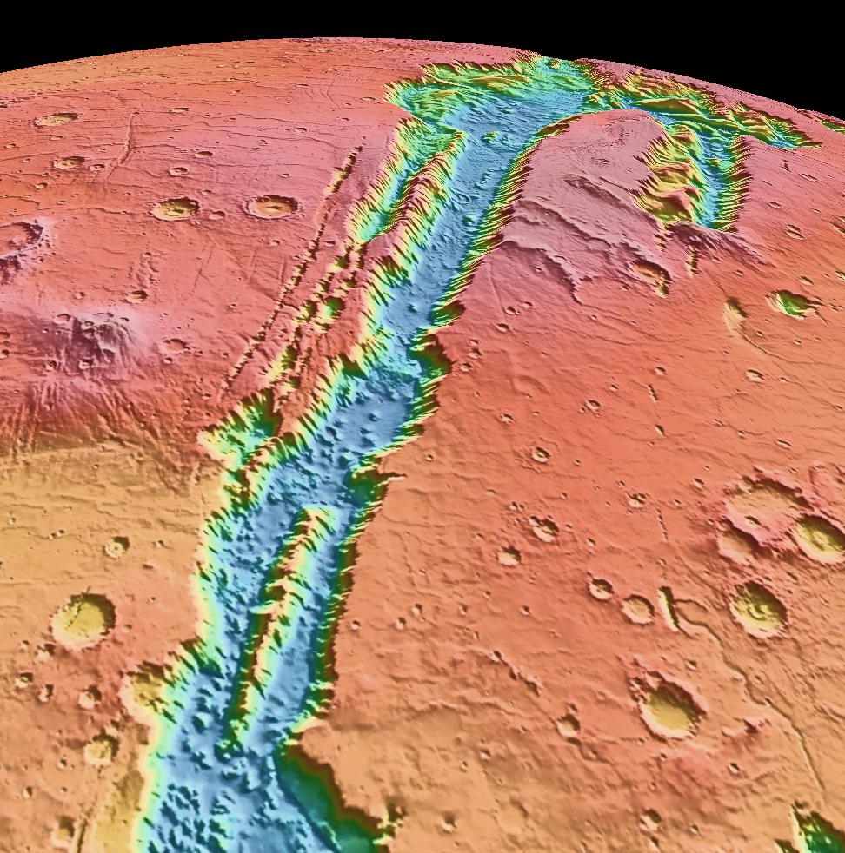
Martian Valleys
Valles Marineris is 4,000 km long, 200 km wide and up to 7 km deep—the largest valley in our solar system!

Slide 14
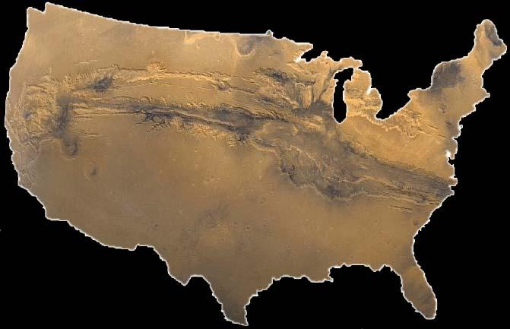
Valles Marineris is as long as the U.S. is wide!
Notes:
CHANGE TO VM OVER MAP OF CANADA
Shows the scale of Valles Marineris compared to the U.S.—easier to visualize than numbers like “4000 km long.”
Image courtesy of ASU.

Slide 15
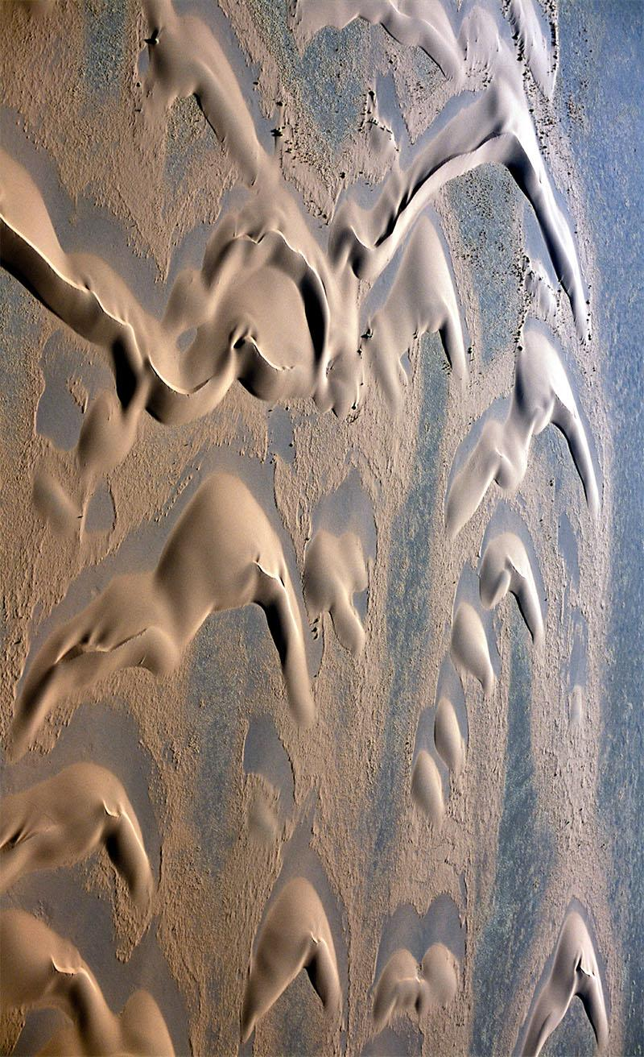
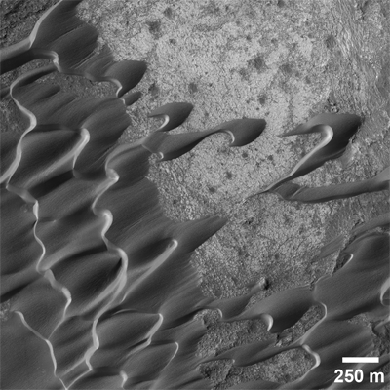
Wind Features: Sand Dunes
Mars
Earth
Notes:
ST: Sand dunes on Earth are often found in deserts or coastal areas—places where sand is abundant. Wind causes sand to collect and build up in different shapes based on the dominant wind direction(s) in the region. These images show “barchan dunes,” just one of many types of sand dunes found on Earth and Mars. These dunes form in places where the wind mainly blows in a single direction, with the small arms of the dune indicating the wind direction. In the image from Mars, the wind blew from upper right to lower left. In the Earth dunes example, in the Sahara Desert, the wind blew from top to bottom of the image. Dunes on Mars typically appear dark in orbital images due to their composition, and appear smooth as they are relatively youthful.
Image credits: Left—HiRISE image of barchan dunes in the caldera of Nili Patera, a volcano on Mars (NASA/JPL-Caltech/UA). Right—Barchan dunes of the Great Western Erg in the Sahara Desert on Earth (photo by Karol Olszewski).

Slide 16
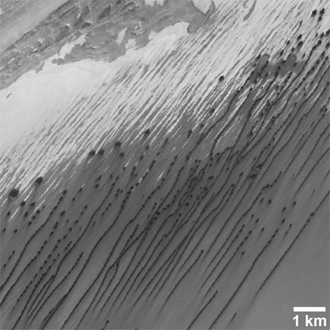
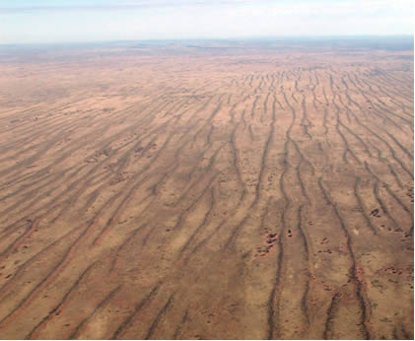
Wind Features: Sand Dunes
Mars
Earth
Notes:
ST: This is another type of sand dune called a “linear dune.” These dunes form in areas of bidirectional winds—that is, where the winds blow mainly in two directions. In the Martian example, the winds blow diagonally across the image. Linear dunes can be over 100 km long. The white areas in the image from Mars are ice—part of the north polar cap.
Image credits: Left—Mars Reconnaissance Orbiter Context Camera (CTX) image of linear dunes near Mars’ north polar cap (NASA/JPL-Caltech/MSSS). Right—Linear dunes in Australia (Smithsonian Institute: http://airandspace.si.edu/research/project/simpson-desert-detail)

Slide 17
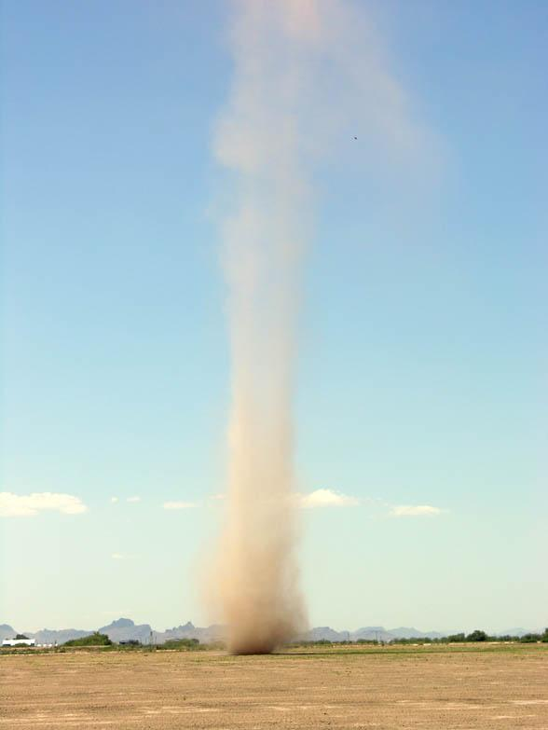
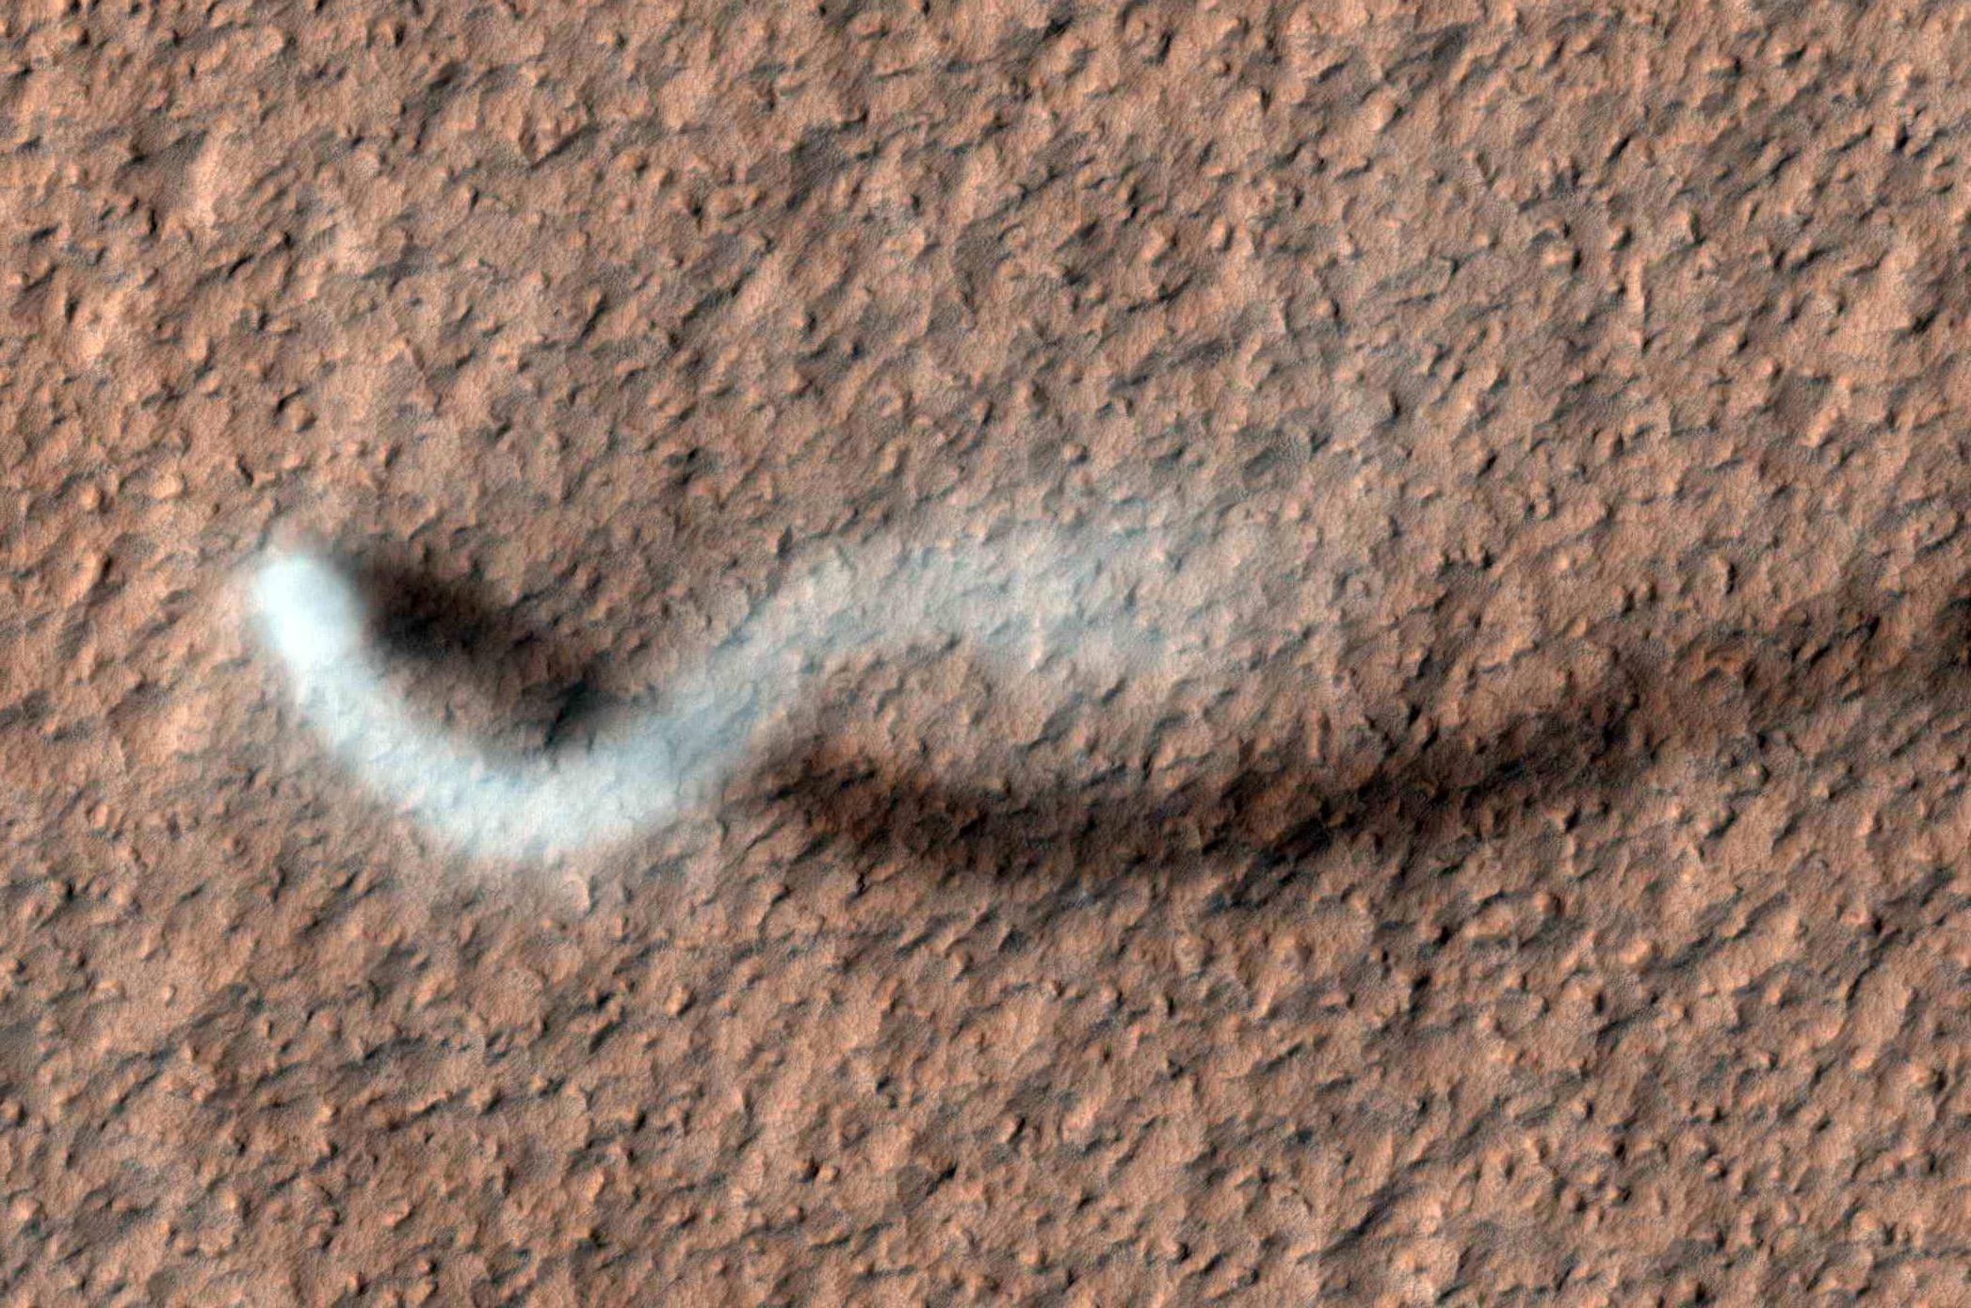
Wind Features: Dust Devil Tracks
Mars
Earth
Notes:
ST: Dust devils on Mars are like small tornadoes on Earth. They are whirlwinds that pick up dust off the surface of the planet during sunny, fair weather conditions.* Here we see a dust devil on Mars 800 metres tall and 30 metres wide, compared to a dust devil in the Arizona desert. As dust devils travel across a planet’s surface, they leave trails behind them called dust devil tracks.
*More detailed dust devil information: Dust devils form when hot air rises quickly through a small pocket of cooler, low-pressure air above it. If the conditions are right, the air may begin to rotate. As the air rapidly rises (remember, hot air rises, cool air sinks), the column of hot air stretches vertically, moving mass closer to the axis of rotation and intensifying the spinning effect by conservation of angular momentum, like an ice skater pulling in their arms to spin faster. The dust devil will persist until it begins to incorporate cooler air as it moves, which causes the dust devil to dissipate in a matter of seconds. Dust devils tend to form in flat areas during clear/partly cloudy skies with light or no wind and cool atmospheric temperatures.
Image credits: Left—HiRISE image, NASA/JPL-Caltech/UA; Right—Dust devil in Arizona, NASA

Slide 18
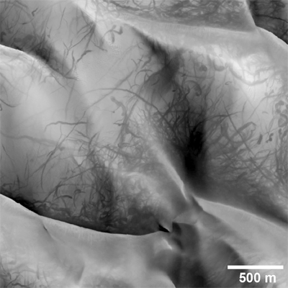
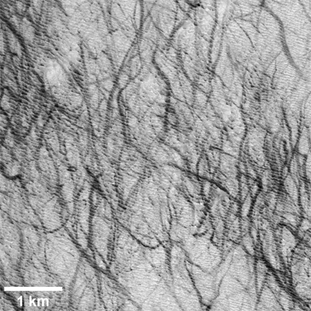
Wind Features: Dust Devil Tracks
Notes:
ST: These are some examples of dust devil tracks. In grayscale (black and white) images of Mars, the dusty surface of the planet appears as light gray. Underneath this dust however, the surface of Mars is very dark. Dust devils remove this fine layer of dust, revealing the darker surface below.
Image credits: Left—Dust devil tracks on sand dunes within a crater. Right—Dust devil tracks on a southern hemisphere plain. Both images from the CTX instrument aboard the Mars Reconnaissance Orbiter (NASA/JPL-Caltech/MSSS).

Slide 19
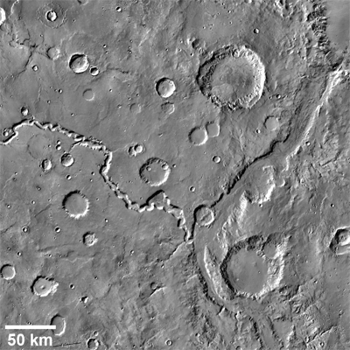
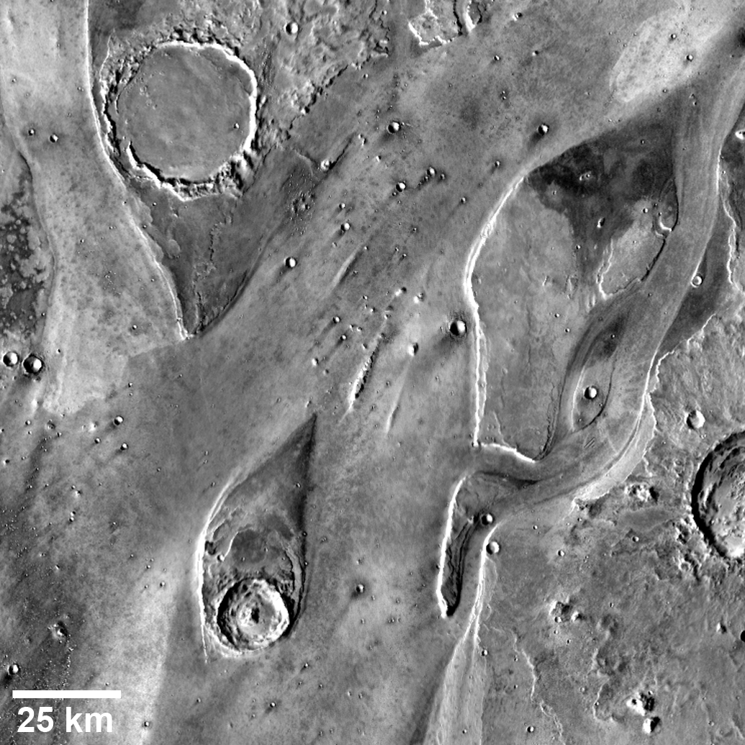
Water Features: Channels
Notes:
ST: Mars has channels carved by water, just like Earth (indicated by orange arrows on the left image). In Mars’ case however, the water is long gone. All we have left are the channel beds and diagnostic features to tell us how the water flowed to carve the channels. One of these diagnostic features is called a “streamlined island”. These islands are teardrop-shaped, with the smaller end pointing in the direction of the flow of the water (indicated by blue arrows on the right figure).
Image credit: Mars Odyssey Thermal Infrared Imaging System (THEMIS) images of Nirgal Vallis and Ladon Vallis (left) and streamlined islands within Tiu Valles (right); NASA/JPL-Caltech/ASU.

Slide 20
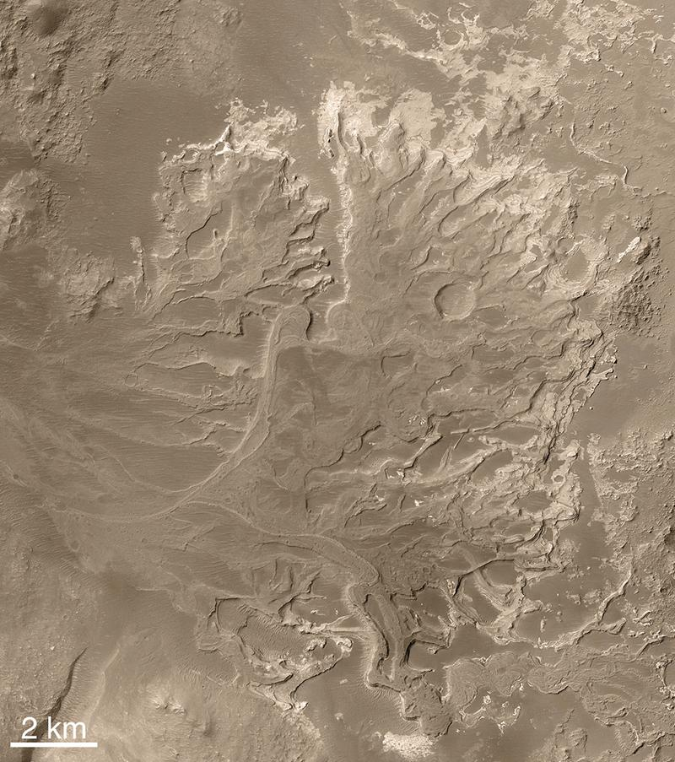
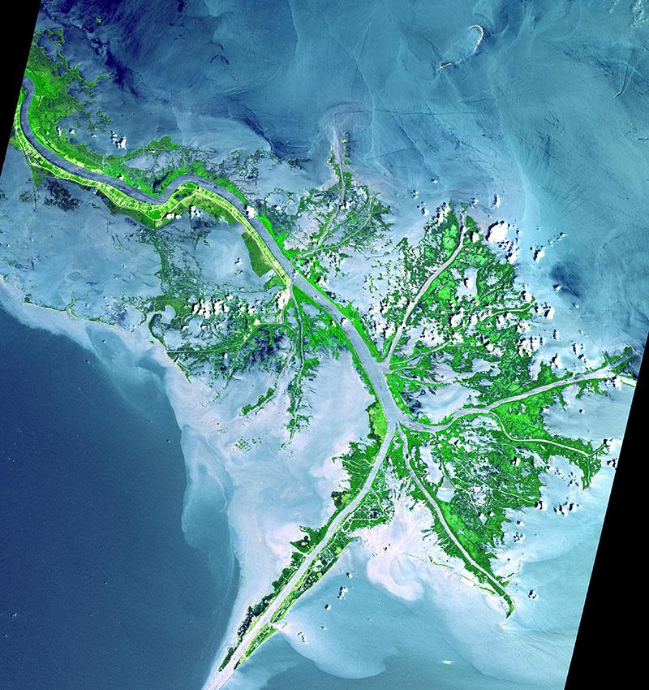
Water Features: Deltas
Mars
Earth
Notes:
ST: On Earth, deltas form at the mouths of rivers where they empty into larger bodies of water, such as a sea or the ocean. This (indicate right image) is the Mississippi River delta, where it empties into the Gulf of Mexico in Louisiana. This (indicate left image) is a delta in Eberswalde (“Eh-bers-val-deh”) Crater on Mars. The discovery of this delta was HUGE because deltas require a river that flows for a long time in order to form! We have discovered other deltas on Mars as well.
Image credits: Left—The Eberswalde Delta on Mars, imaged by the Mars Global Surveyor Mars Orbiter Camera (MOC), NASA/JPL-Caltech/MSSS. Right—The Mississippi Delta, imaged in May 2001 by the Advanced Spaceborne Thermal Emission and Reflection Radiometer (ASTER) on NASA’s Terra satellite; NASA/GSFC/METI/ERSDAC/JAROS, & U.S./Japan ASTER Science Team.

Slide 21
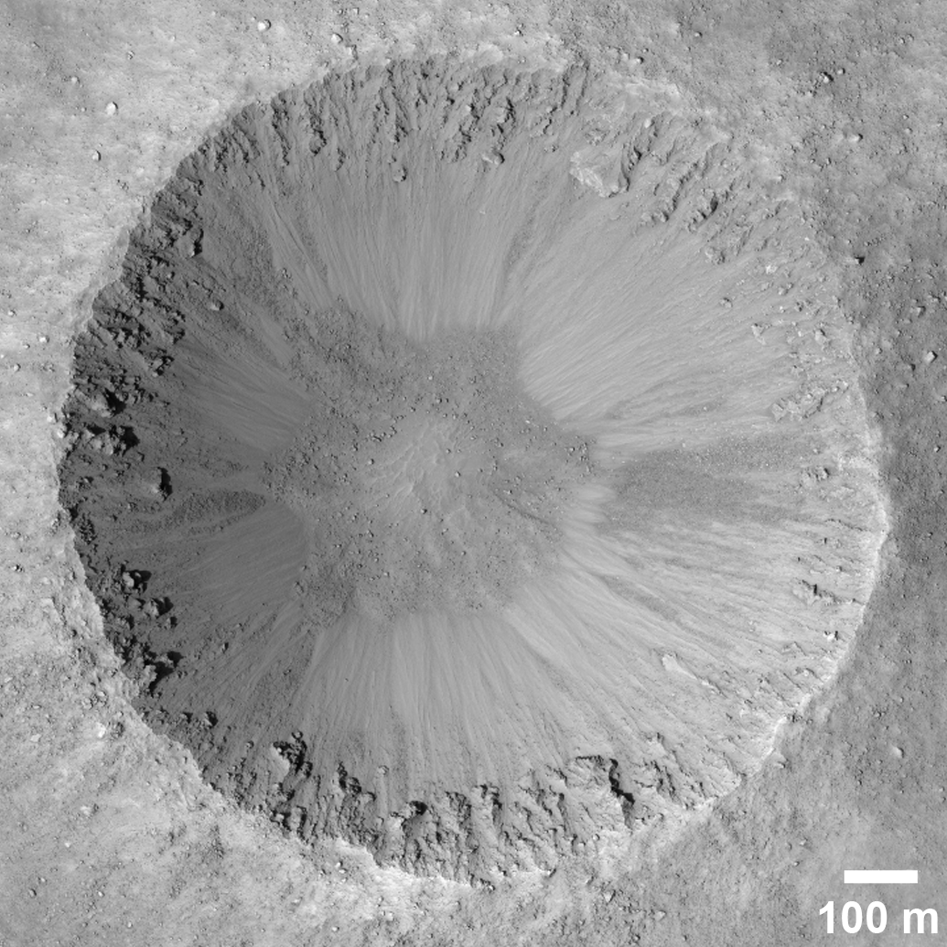
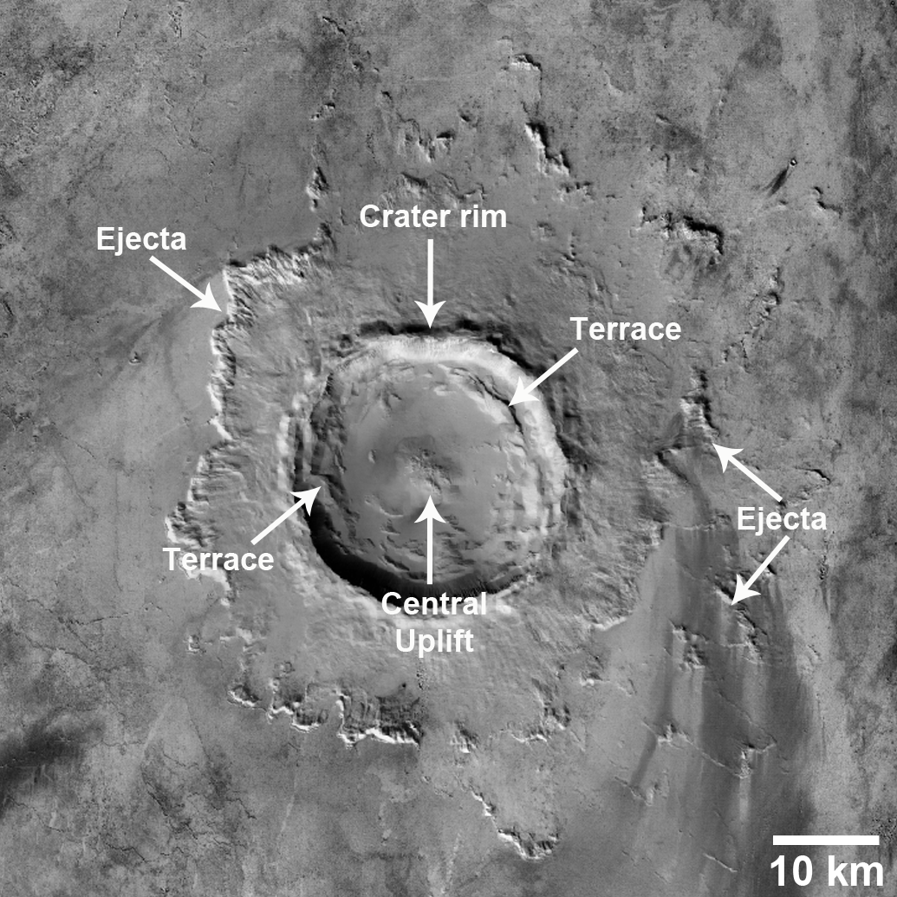
Impact Craters
Simple Crater
Complex Crater
Notes:
INCLUDE IMAGE OF SIMPLE & COMPLEX CRATERS AT SAME SCALE
ST: Remember how you pointed out that Mars is covered with craters formed from asteroids or comets hitting the planet’s surface? Well, there are two types of impact craters: Simple and complex. Simple craters are small—generally less than 7 km in diameter—and bowl-shaped. Complex impact craters are larger and have a central “peak” or “uplift.” They also often have terraces along their walls, where gravity has caused them to slump or collapse inward during the formation of the crater. Both simple and complex impact craters have ejecta blankets—material ejected from the impact event and deposited around the crater, sometimes great distances away from the crater (tens of crater radii distant)! However, over time these ejecta blankets erode away. On Mars, this erosion is mostly by wind, but on Earth water (i.e., rain) plays a big role. The majority of craters on Earth have had their entire ejecta blankets stripped away.
ST: Craters can tell us a lot about a planet’s surface. Early on in the solar system, the planets were heavily bombarded by asteroids, forming lots of craters. The impact rate has decreased significantly over time, but Mars is still struck dozens of times per year. So, in general, the older an area is on a planet, the more craters it has. Remember earlier the global map of Mars, where the southern hemisphere is much more heavily cratered than the northern hemisphere? This tells us that the surface in the north is much younger. What happened to “resurface” this area though is still a mystery to scientists. Some think there was an ocean there. Others think lava flows covered the area, forming smooth plains.
Image credits: Left—HiRISE image of a crater in Acidalia Planitia; NASA/JPL-Caltech/UA. Right—Mars Express HRSC image of a complex impact crater in Amazonis Planitia; ESA/DLR/EU Berlin (G. Neukum).

Slide 22
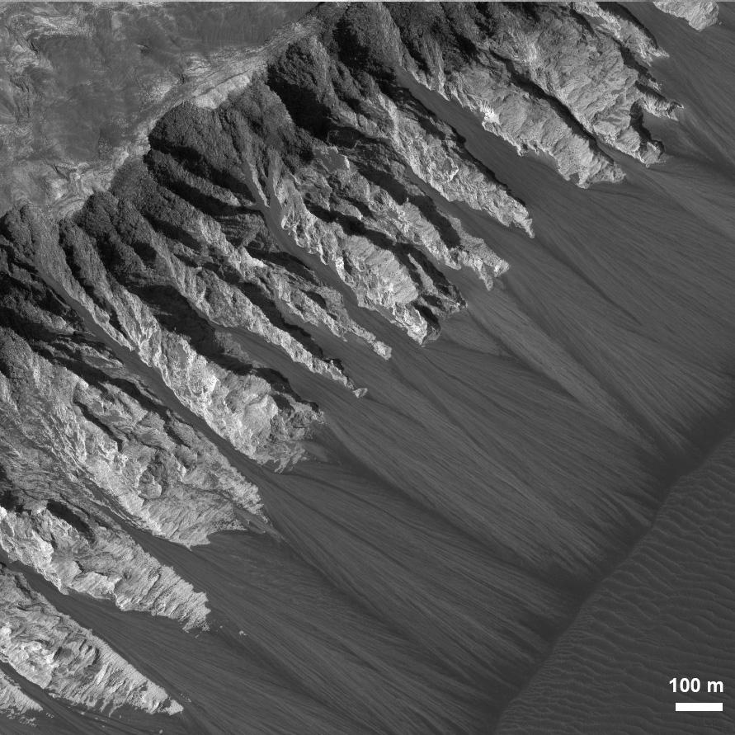
Landslides
Dry
Wet
Notes:
ST: Have you guys ever seen a landslide? Maybe in person, or on the news? (wait for show of hands) Can anyone describe what a landslide is?
ST: The basics of landslides are pretty simple: They form from material falling downhill, forming an “alcove” where the material fell from, and an “apron” where the material is deposited (stops falling). The shape of the landslide tells us about how they were triggered and how they flowed downhill. Landslides that didn’t have any water involved stop at the base of the hill, like these ones here (indicate left image). They consist of an alcove and a “fan”, “apron”, or “talus cone” of material at their base. Landslides carved by water on the other hand often host channels—like small-scale river channels—in addition to alcoves and aprons. An example of this type of landslide found on Mars and Earth is a “gully” (indicate right image). Gullies on Earth are usually carved by rain, but on Mars the source of water is still under debate. Hypotheses include melting snow or ground ice.
Image credits: Left—HiRISE image of granular landslides on light-toned material within Valles Marineris (NASA/JPL-Caltech/UA). Right—HiRISE false colour image of gullies in a crater in Mars’ southern mid-latitudes (NASA/JPL-Caltech/UA).

Slide 23
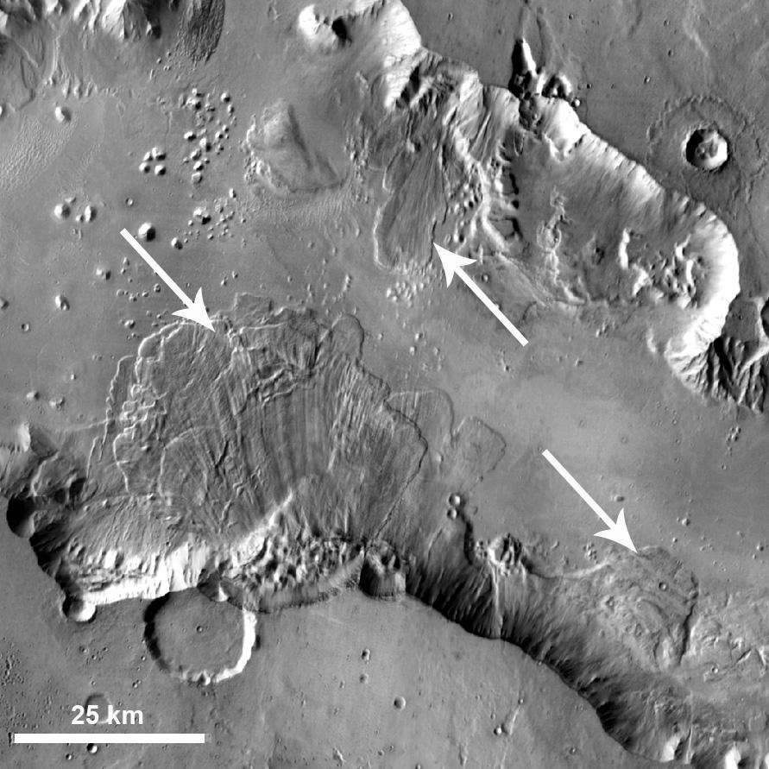
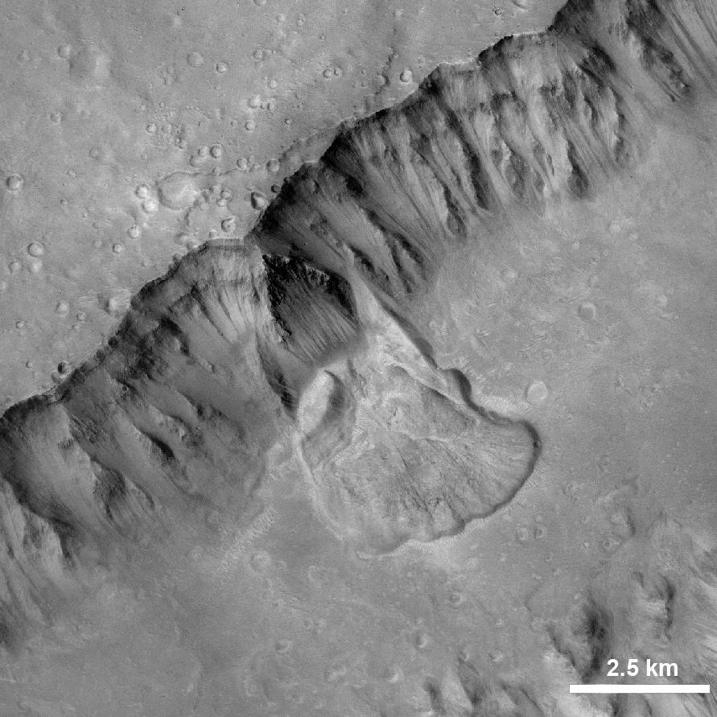
Landslides
Notes:
ST: Landslides can occur on massive scales. Look at the scale bars on these images—one of the landslides in the image on the left is over 25 km wide!* Both of these images show landslides in parts of Valles Marineris. The valley has widened over time from these recurring landslides. While these were probably dry landslides, they do not stop at the base of the slope, but rather flow out onto the valley floor. This is observed with massive landslides on the Earth as well, but how these landslides manage to travel so far is still a mystery to scientists. One hypothesis is that they travel upon a layer of air that allows them to behave like a fluid.
*For a local comparison, that’s nearly the distance from London to St. Thomas.
Image credits: Left—Mars Odyssey THEMIS image of landslides in Ganges Chasma, part of Valles Marineris (NASA/JPL-Caltech/ASU). Right—Mars Reconnaissance Orbiter Context Camera (CTX) image of a landslide in Shalbatana Vallis, north of Valles Marineris (NASA/JPL-Caltech/MSSS).

Slide 24
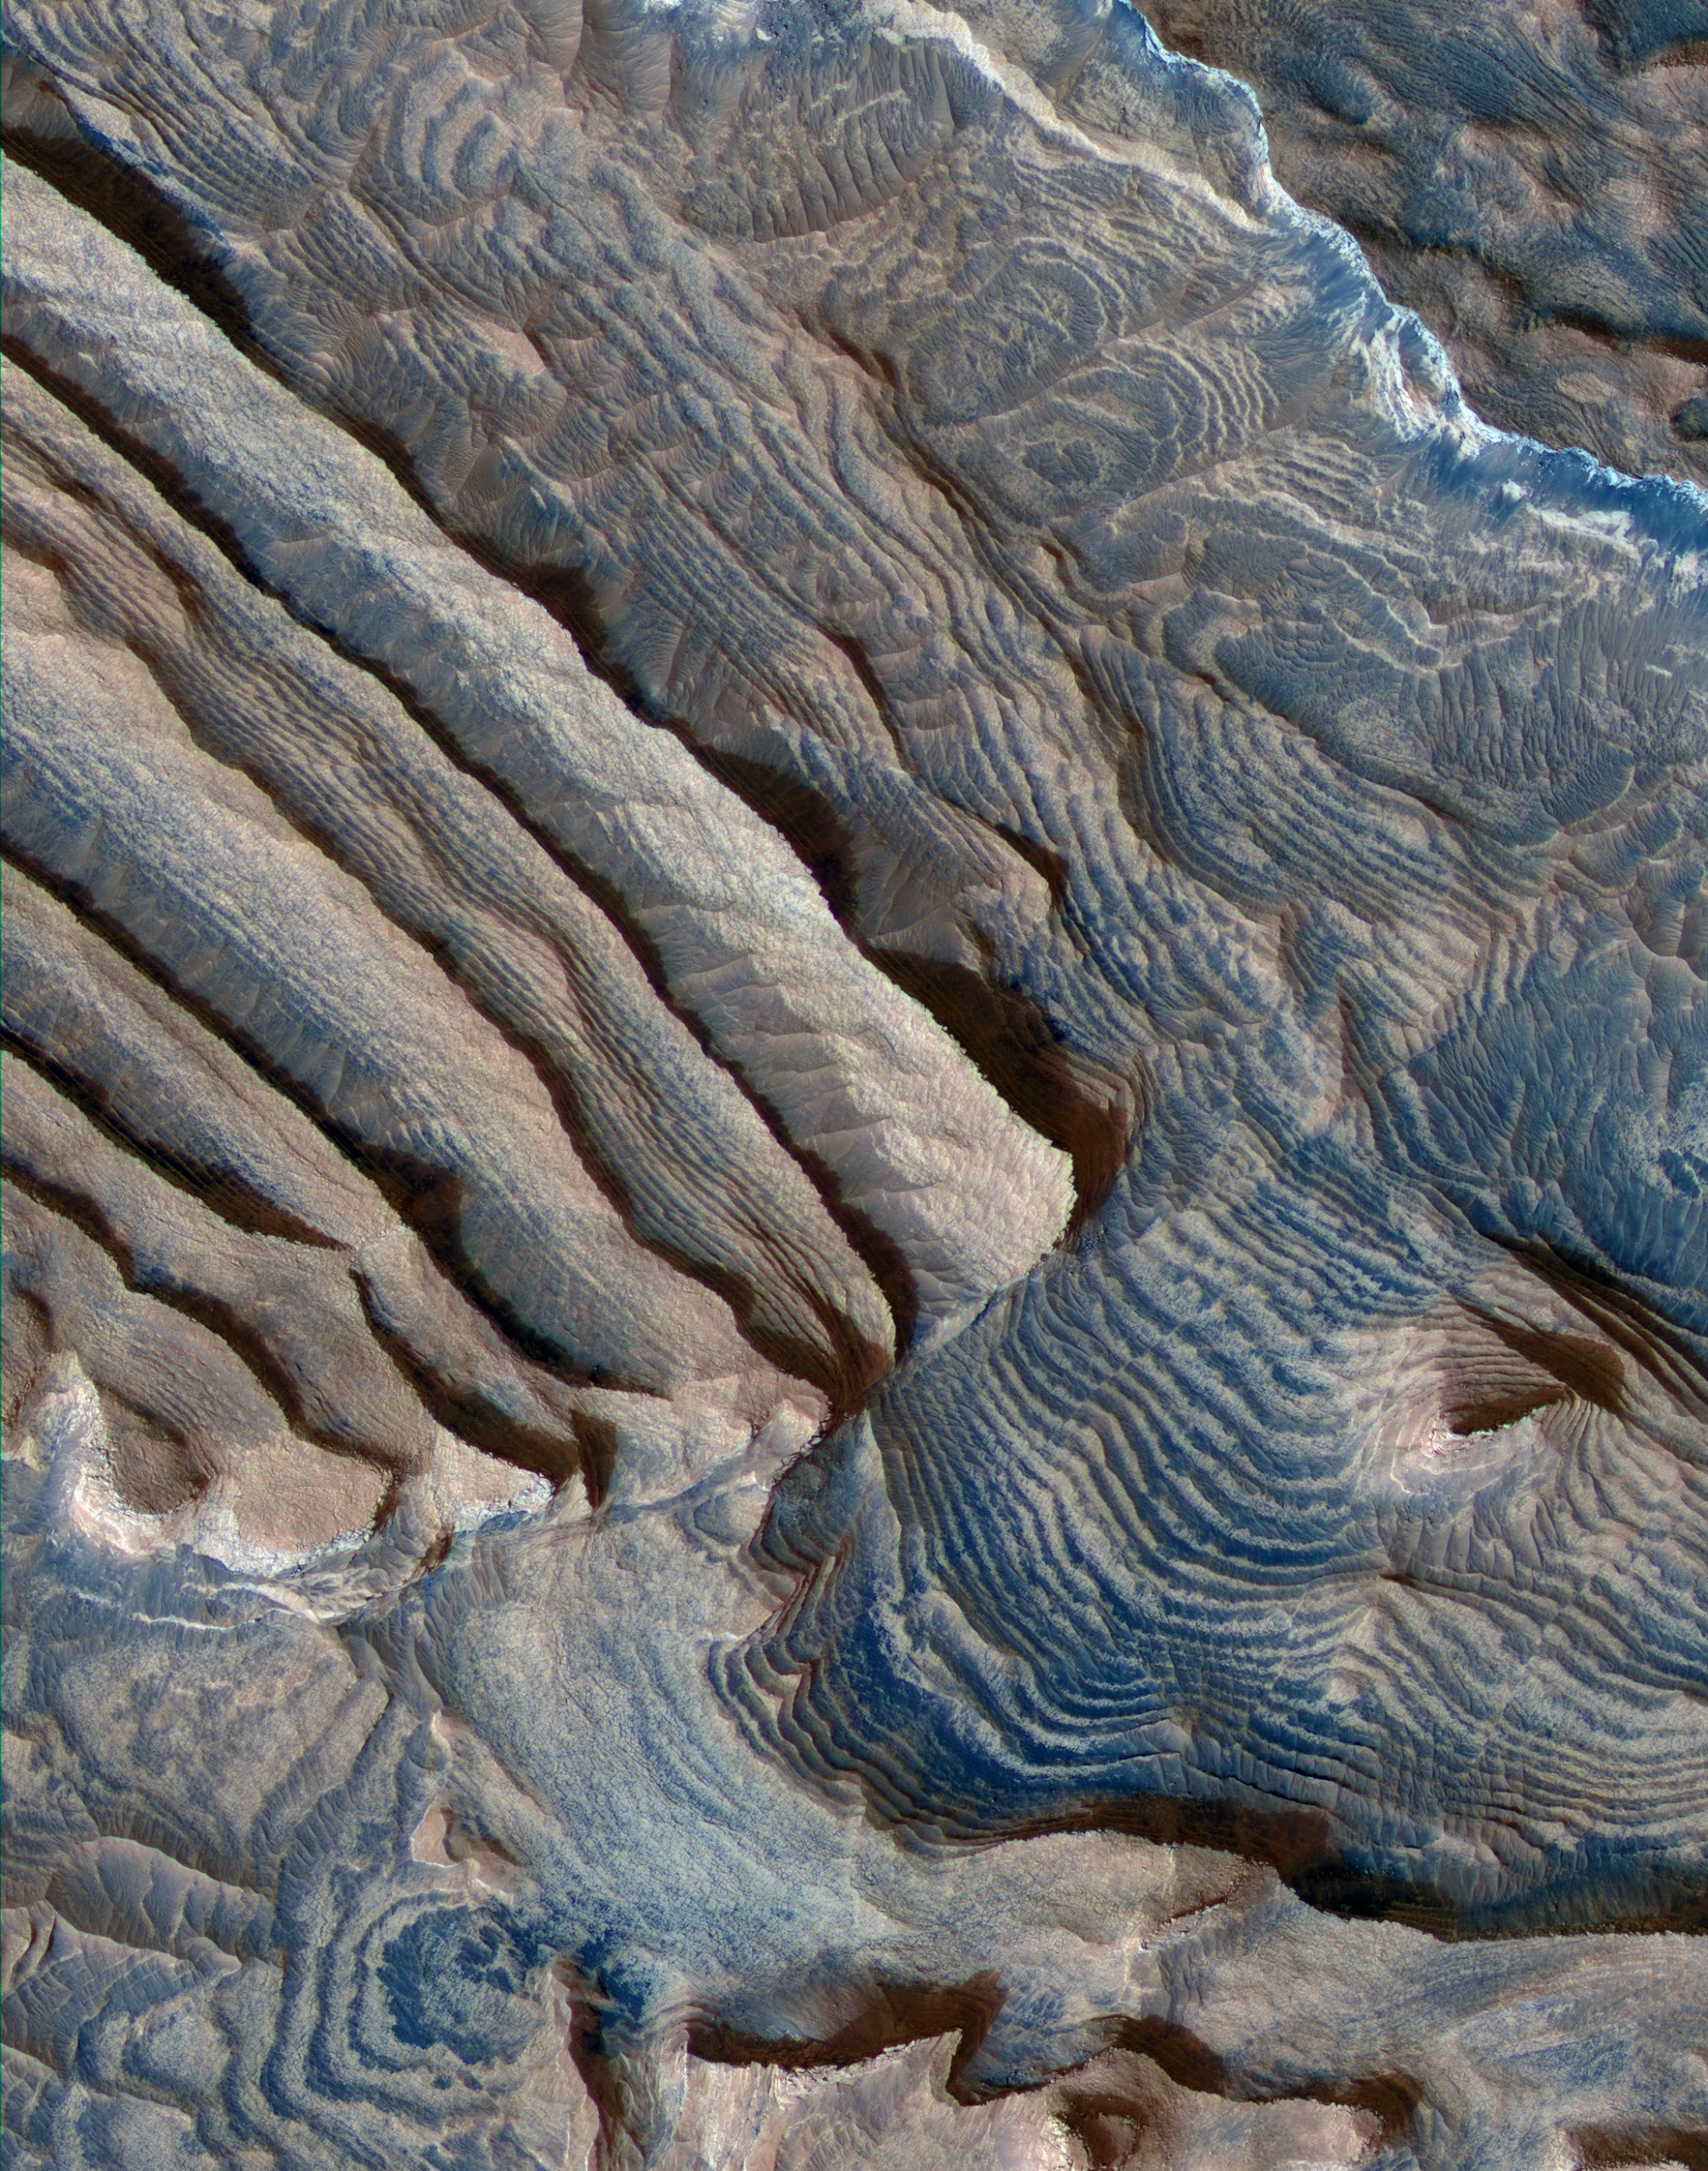
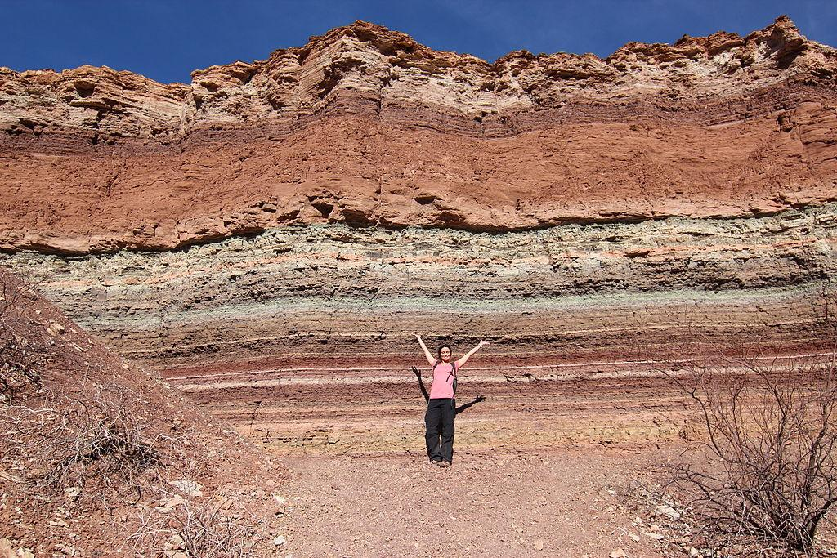
Layered Rock
Mars
Earth
Notes:
ST: Have any of you been to the Grand Canyon? Or the Painted Desert? Or Niagara? (wait for show of hands) These are all places where layered rocks are common, or what scientists call “sedimentary rocks.” These rocks are formed from material such as sand or mud that has collected due to wind (i.e. sand dunes) or precipitating out of water (i.e. salt deposits). The different layers can tell us about changes in the conditions under which they were deposited relative to the layers around them. Layered rocks are very common on Mars, some probably formed in settings like evaporating lakes, while others are likely collections of wind-deposited material. The layers on the left here are part of a mound in a crater called Becquerel (“BECK-er-rel”) on Mars, while the layers on the right are in the desert of Argentina. You can see layering nearby in Ontario as well, if you go to any of the waterfalls in the Niagara Escarpment!
Image credits: Left—From the HiRISE camera (NASA/JPL-Caltech/UA); Right—Rock layers in Quebrada de Cafayate, Salta, Argentina. Photo by travelwayoflife on Flickr, used under a Creative Commons Attribution-ShareAlike 2.0 Generic License.

Slide 25
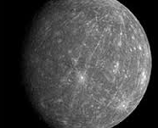
Mercurian Landforms
Volcanic features
Pits
Wrinkle ridges
Channels
Impact cratering
Tectonic features
Scarps
Troughs

Slide 26
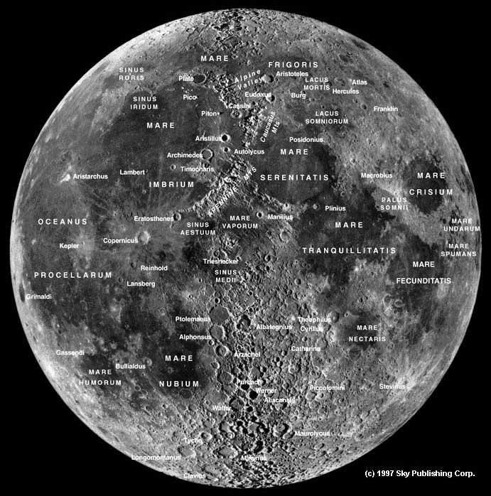
Mapping the Moon
Craters
Mountains
Valleys
Frozen water at poles??
Notes:
An overview of the lunar surface – we can see craters, mountains that are actually crater rims. Many craters have large valleys near them.
After recent discoveries from multiple orbiters, there is high likelihood that frozen water exist near the poles (inside shadowed craters – i.e. these craters never see any sunlight).
Features are named after famous scientists, scholars, artists and explorers
By observing these surface features, they give us more clues about the lunar history and about the planet’s interior.

Slide 27
Mapping Activity
Notes:
ST: So before we get started on our activity, are there any questions about the features we’ve seen?
Answer
Note: Any general questions about Mars/Space/Quantum-Physics/Aliens will be answered at the end of the visit
ST: Alright, with questions out of the way, what we are going to do right now is a mapping activity. Each of you will be given a different picture of a region on Mars.

Slide 28
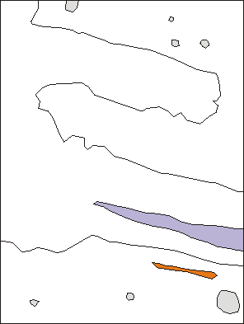
Mapping Activity
Legend
Craters
Trough
Cracks
Ridge
Plateau P
Valley floor VF
P
VF
Notes:
ST: What I would like you to do is to take your image of Mars and on your worksheet make a very simple map of what you see. I would like you to identify different regions, such as smooth plains, rough plains, cliffs, ridges, craters, pits, valleys, etc. And form a map like you see here on the screen. I’m going to give you about 10 minutes to work on these. Remember, a lot of mapping is based on the mapper’s interpretation, so if you don’t know what the proper name it is, feel free to be descriptive. After a few minutes I’ll put up a slide with images that should help with naming.
Q: Questions before we get started?

Slide 29
Mapping Activity
Legend
Craters
Trough
Cracks
Ridge
Plateau P
Valley floor VF
P
VF
Notes:
Pits interpreted as volcanic source vents (lower left).
Channels formed by lava erosion (lower right).

Slide 30
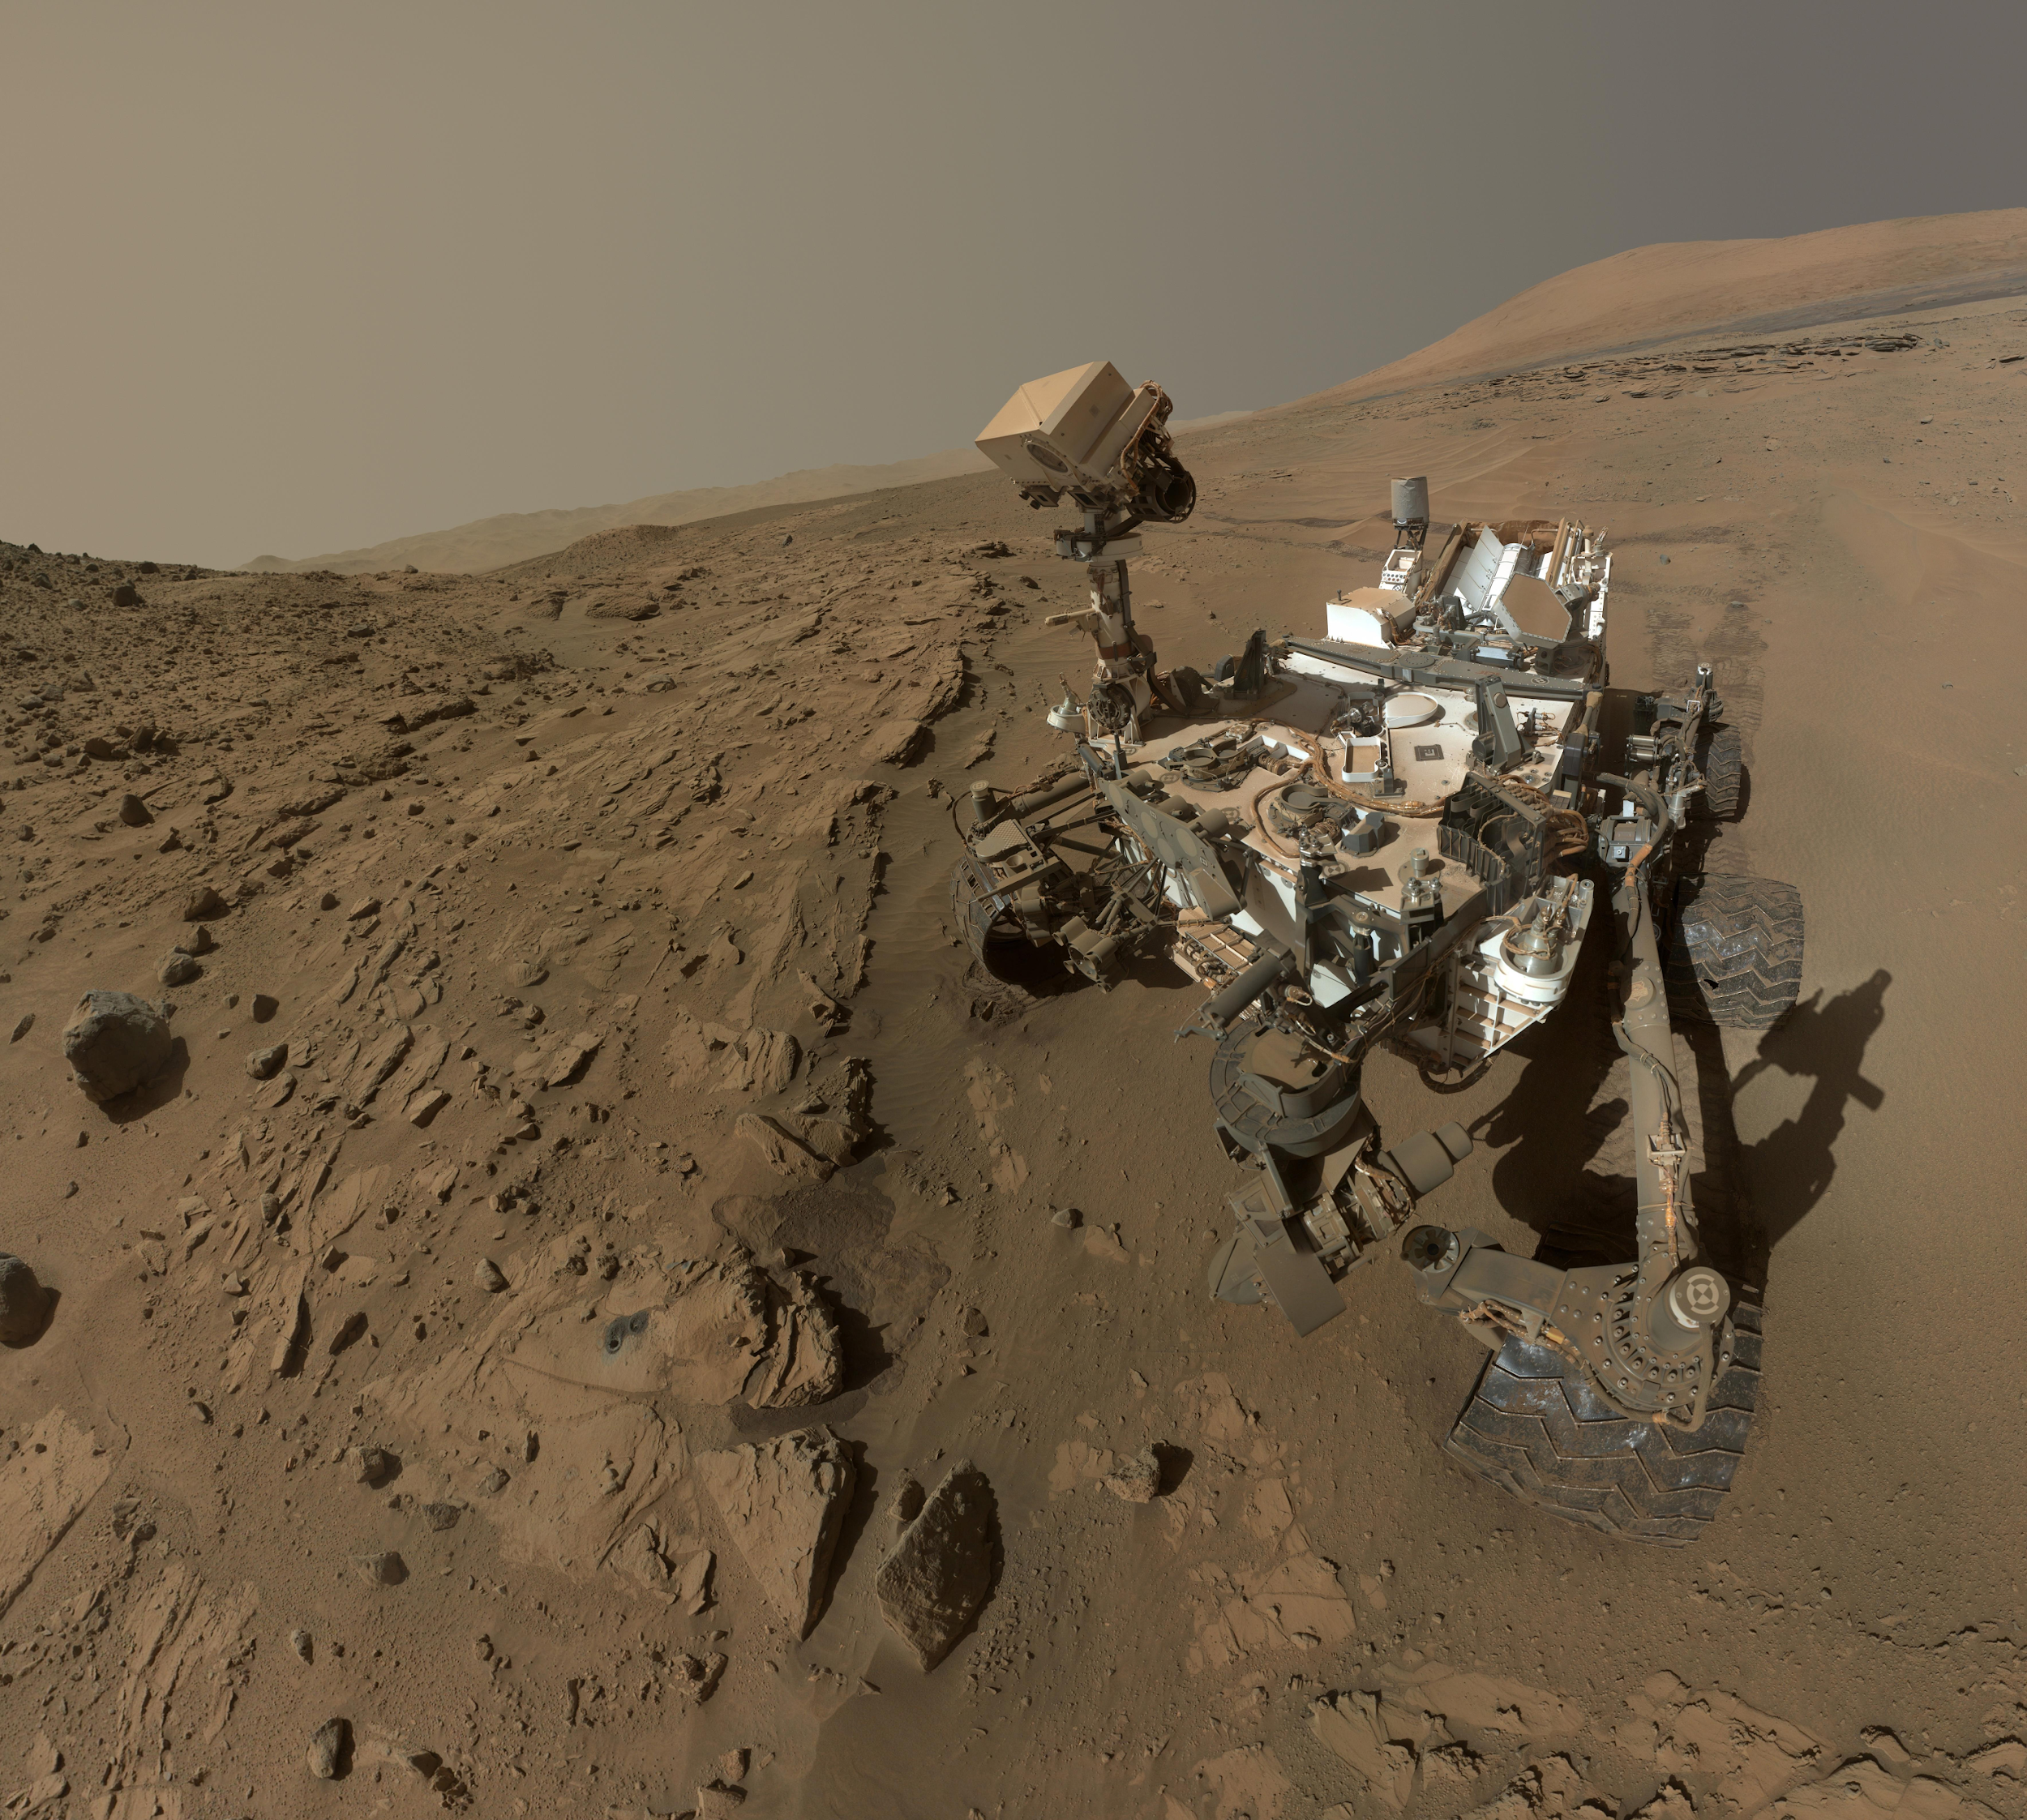
Curiosity Rover in Gale Crater
Notes:
ST: The Curiosity rover landed on Mars in August of 2010, after an 8-month journey from Earth. This picture was taken on Mars by the rover itself! It held out its robotic arm and took a series of images with its Mars Hand Lens Imager (MAHLI) camera that were then mosaicked together to create this composite image—essentially, the rover took a selfie! This is just one of a few “selfies” the rover has taken.
Image credit: NASA/JPL-Caltech/MSSS

Slide 31
Landing Site: Gale Crater
Notes:
ST: This is a map of Mars with major place names marked. The yellow circle marks the context for where Curiosity landed—near Mars’ equator.
Additional info: “MER-B” is the Opportunity rover; can ask if the students have heard of it. Can also point out Olympus Mons since it was discussed earlier.
Image credit: NASA/JPL-Caltech/MSSS

Slide 32
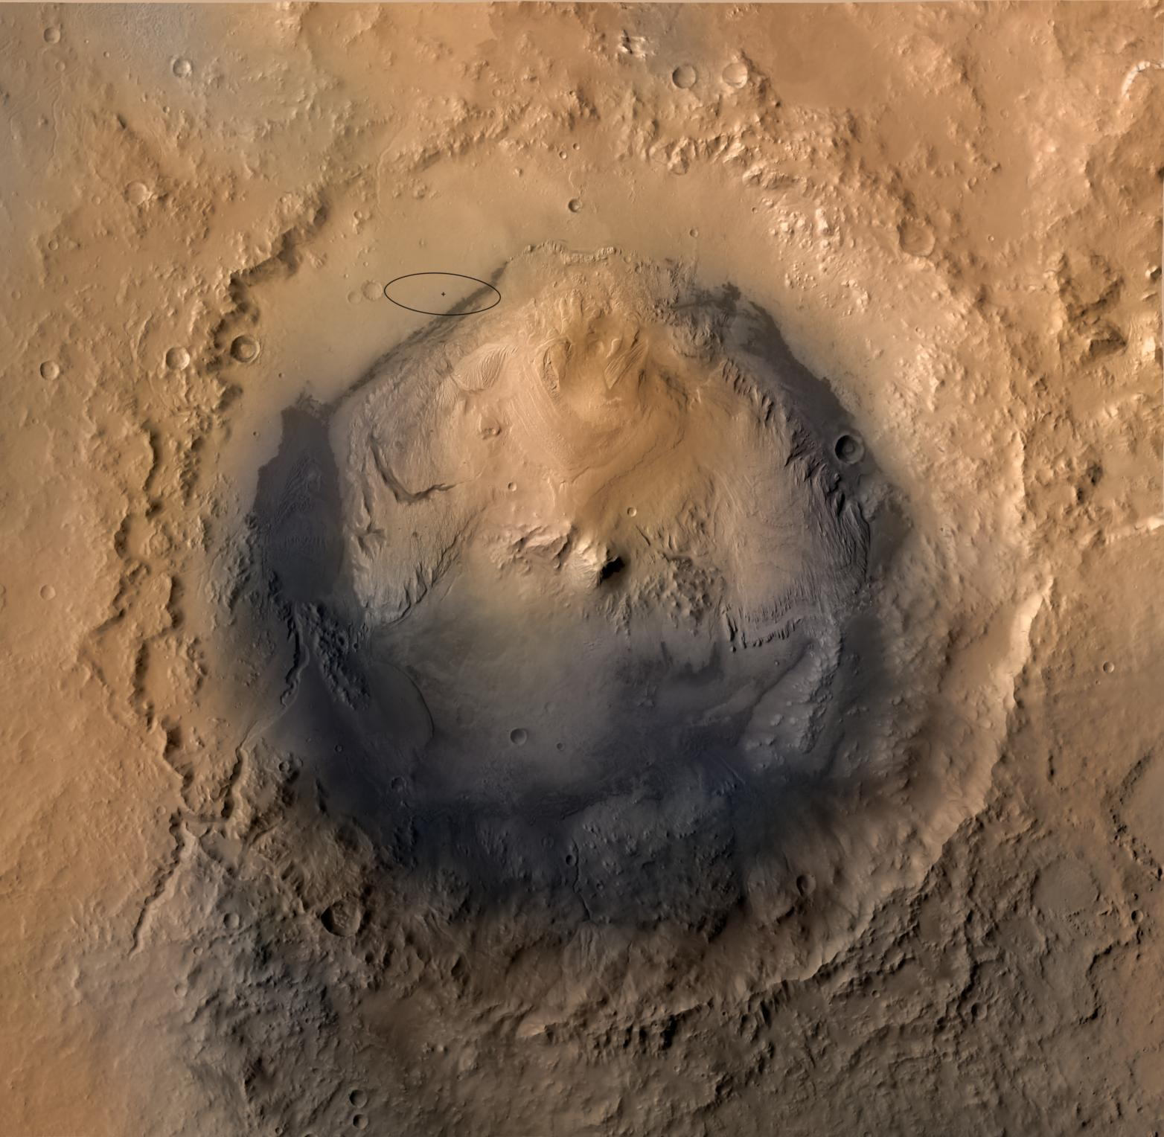
Why Did We Go to Gale Crater?
Good place to look for evidence of Mars’ past and/or present habitability
May have been a lake
Contains a mountain of layered rock whose lower portion is carved by channels, while upper is not
Spans the transition from wet to dry Mars
Mound has minerals suggestive of water (including clays, which are good at preserving signs of life)
Curiosity landing site
Notes:
ST: Here we’ve zoomed in on Gale Crater. The little black ellipse is where Curiosity landed within the crater. Why did scientists choose to land here? (go through bullet points on the slide)
“Habitability” = conditions suitable for life (i.e., temperature, pH, atmospheric composition, presence of water)
“Signs of life” = fossils, biomarkers (things produced by life, such as waste products/certain minerals)
Image credit: Mars Reconnaissance Orbiter Context Camera (CTX) mosaic of Gale Crater, colourised using Mars Express HRSC data (NASA/JPL-Caltech/MSSS).

Slide 33
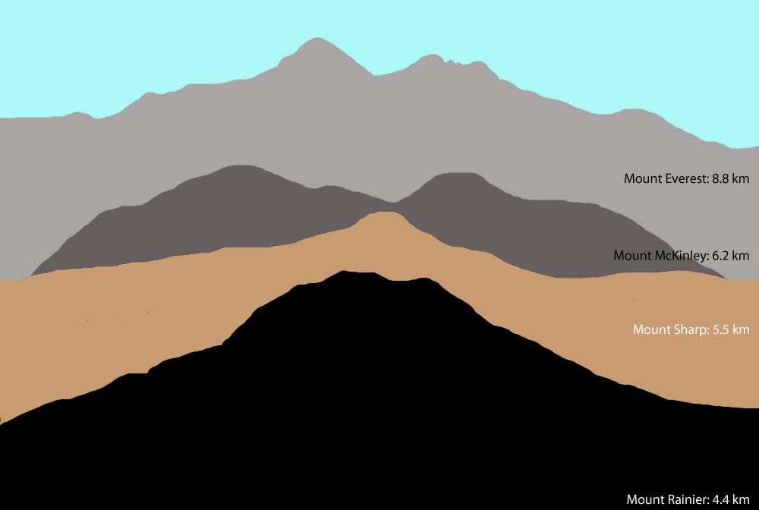
Notes:
ST: The mountain (“mound”) of layered material inside Gale Crater is informally called “Mount Sharp”.* It stands a whopping 5 km tall! To get an idea of just how tall that is, this image shows Mount Sharp compared to tall mountains here on Earth. It’s taller than Mount Rainier (near Seattle in Washington state) but shorter than Mount McKinley (the tallest mountain in North America). That’s a LOT of layers!
*Named by the Curiosity Science Team after Dr. Robert Sharp, an important figure in Mars planetary science who passed away; the mountain’s formal name is “Aeolis Mons.”
Image credit: Comparison of the heights of some mountains on Earth to Mount Sharp in Gale Crater (NASA/JPL-Caltech/MSSS/Tanya Harrison).

Slide 34
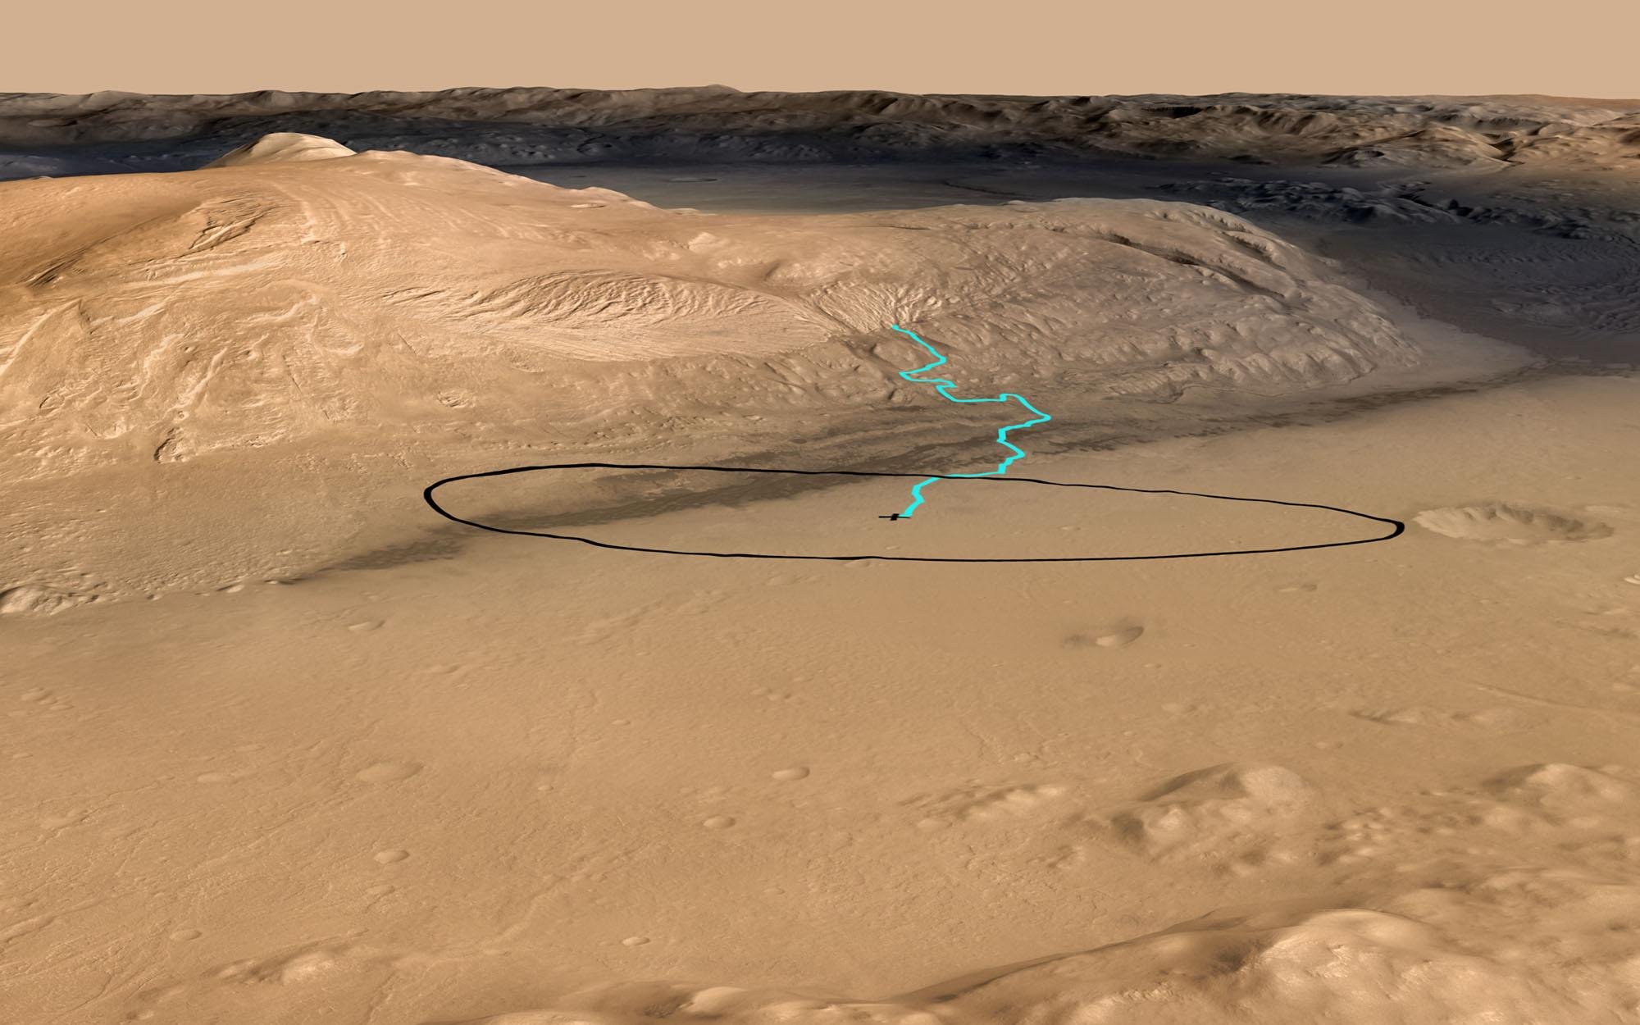
Notes:
ST: Curiosity landed in a safe, flat area away from the mound, and has been driving toward it for the past two Earth years.* The goal is for the rover to drive up the mound, inspecting the layers for signs of habitability. Just recently, the rover reached the lowest layers of the mound. The blue line in this 3D view shows the planned traverse for the rover from its landing site up Mount Sharp.
*A year on Mars is roughly 2 Earth years long—approximately 687 Earth days.

Slide 35
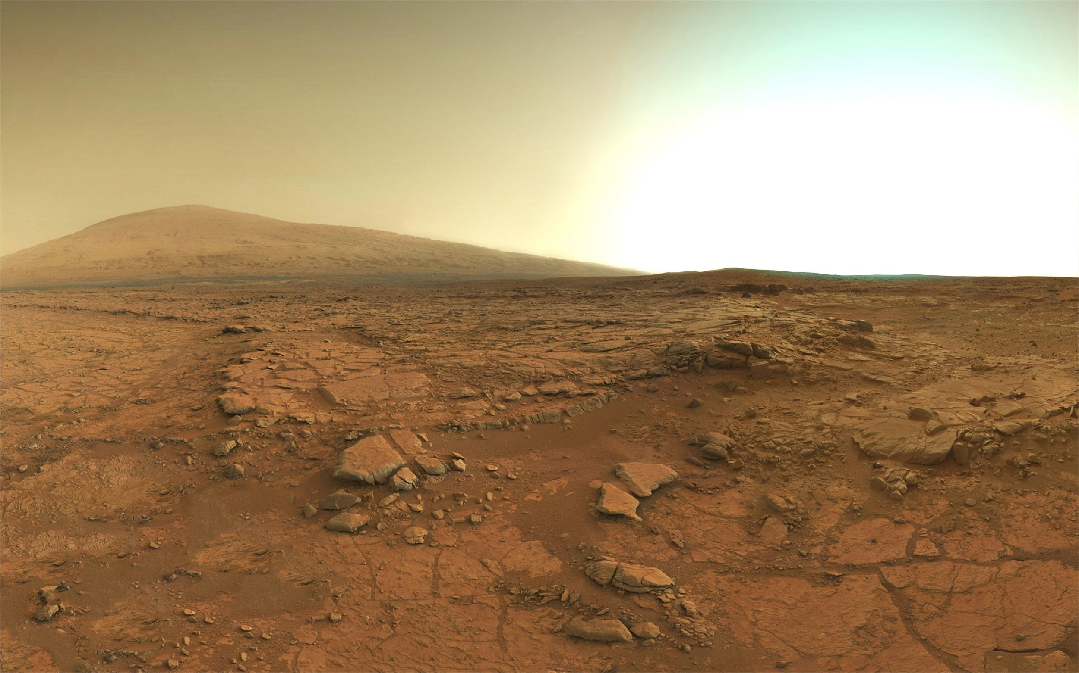
Notes:
ST: Curiosity took this image along its drive, looking toward Mount Sharp. It may not look very tall in the distance on the left—that’s simply because of the wide angle of the camera used to take the image.
Image credit: Mastcam mosaic (NASA/JPL-Caltech/MSSS)

Slide 36
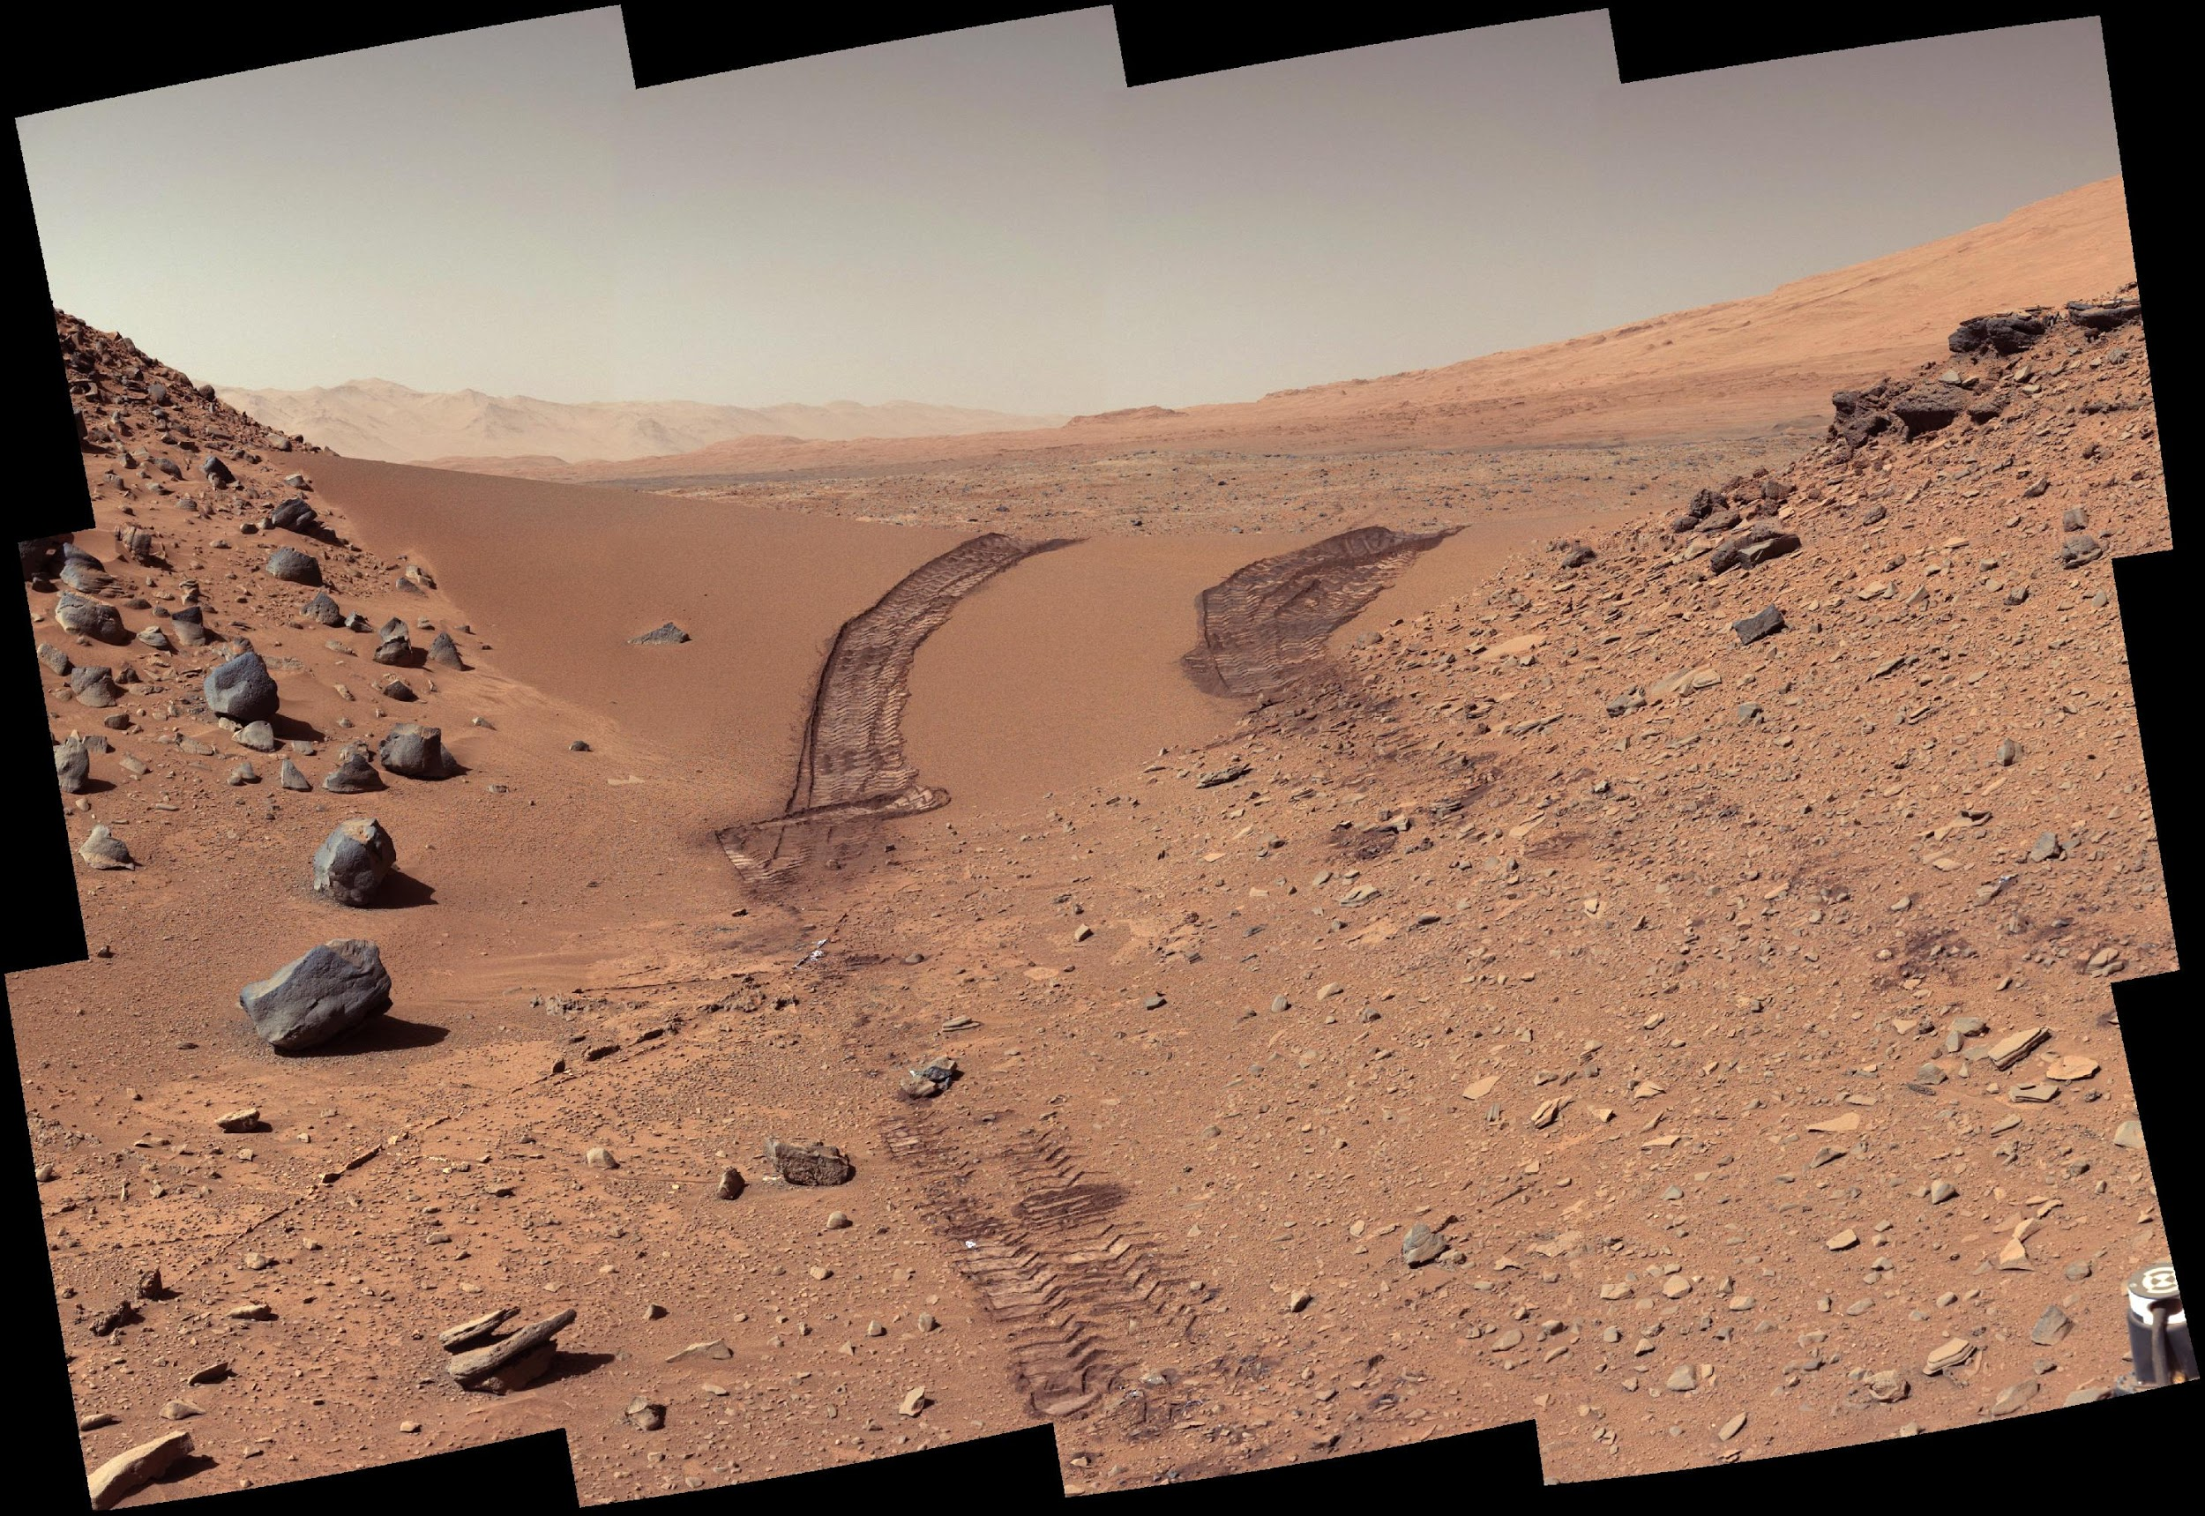
Notes:
ST: Sometimes the rover turns around to look behind itself. These are its wheel tracks after having driven through a patch of sand in an area called “Dingo Gap.” Do you remember all of the sand dunes near the base of Mount Sharp in our maps? Notice how the sand looks very smooth compared to the rocky terrain around it.
Q: Why do you think the sand looks smooth?
A: Small grains of the sand compared to the larger rocks around it.
Image credit: Mastcam mosaic (NASA/JPL-Caltech/MSSS)

Slide 37
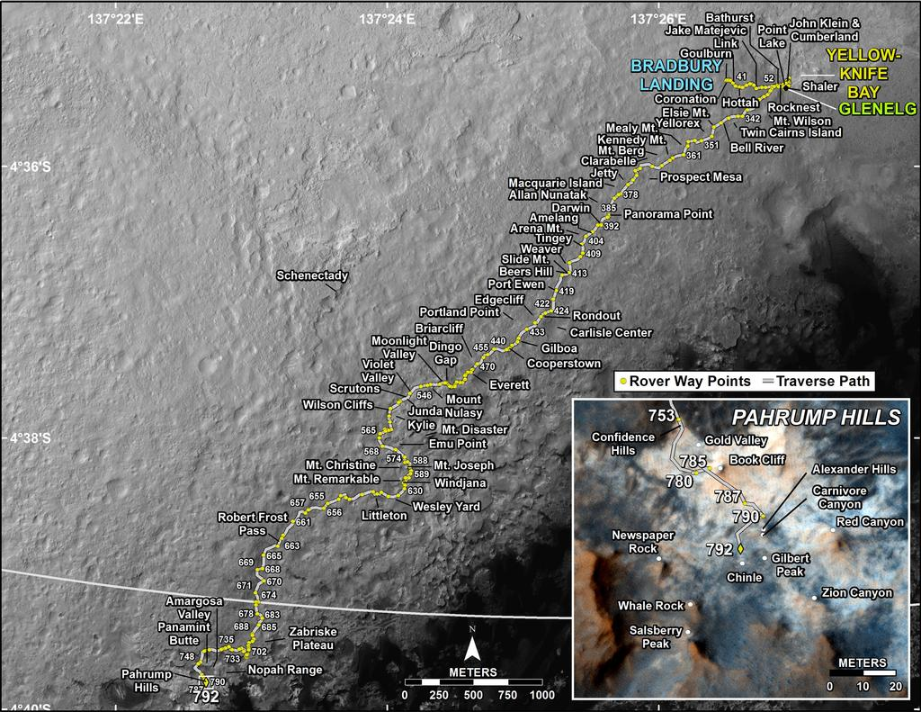
Notes:
This map shows the location of Dingo Gap (orange circle) relative to the large dune field at the base of Mount Sharp (black areas to the south/east). Yellow line is the rover’s traverse from landing (“Bradbury Landing” point) to sol 792 (792 Martian days since landing).
Image credit: NASA/JPL-Caltech/MSSS/UA

Slide 38
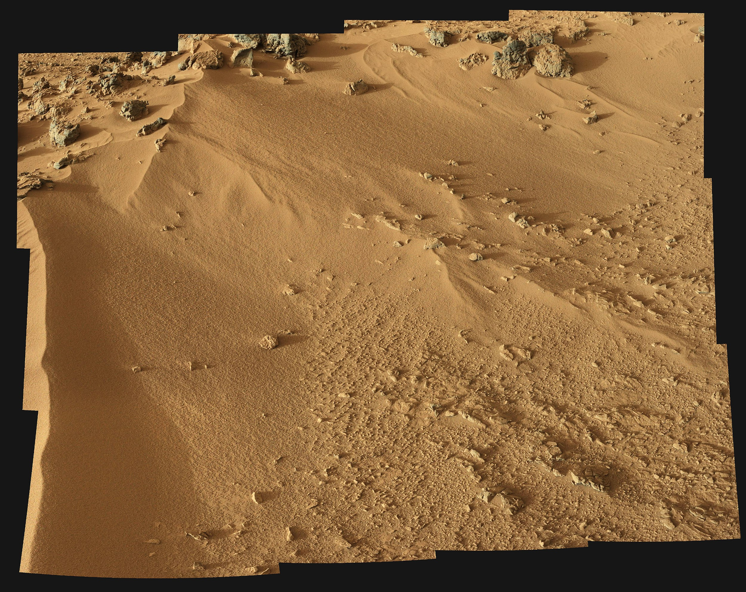
Notes:
ST: These are some more sand dunes near the base of Mount Sharp, imaged by the rover on the 55th day of its mission. It was very important for the rover scientists and engineers to know where these sand dunes are located using images from orbit as they pose a hazard—dunes are a place where rovers can get stuck. Unfortunately this is what happened to an older Mars rover, Spirit.
Image credit: Mastcam left (34 mm) (NASA/JPL-Caltech/MSSS)

Slide 39
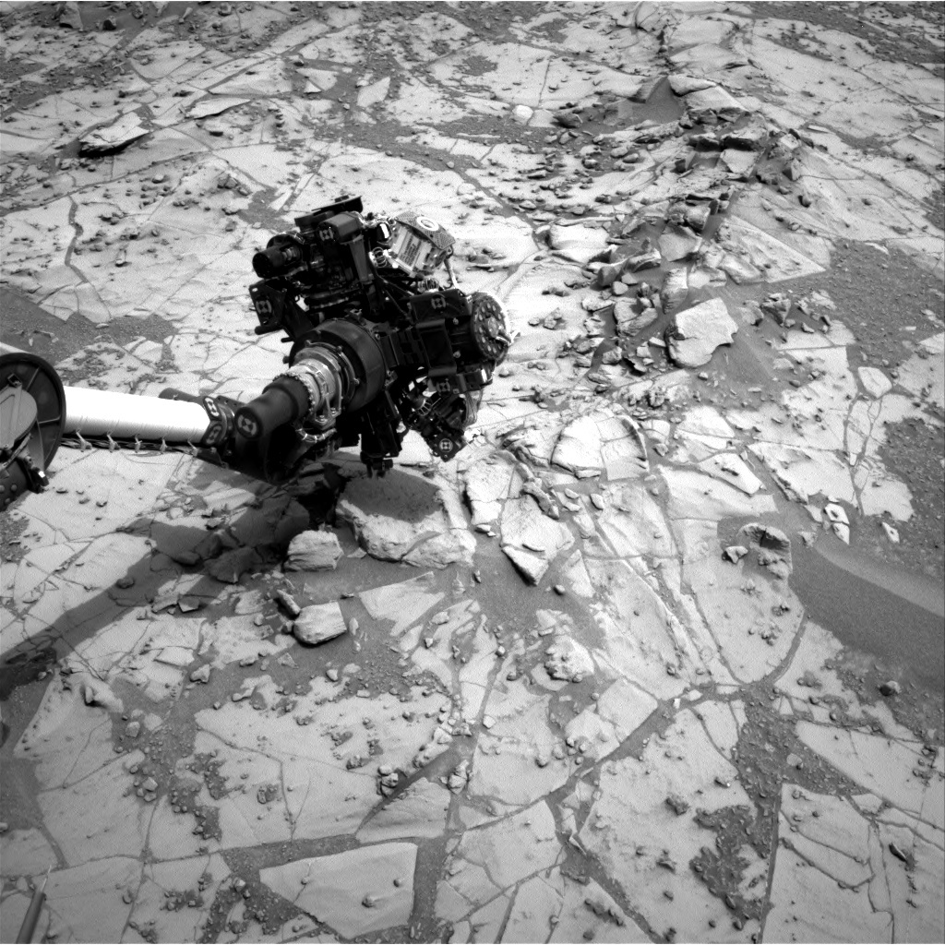
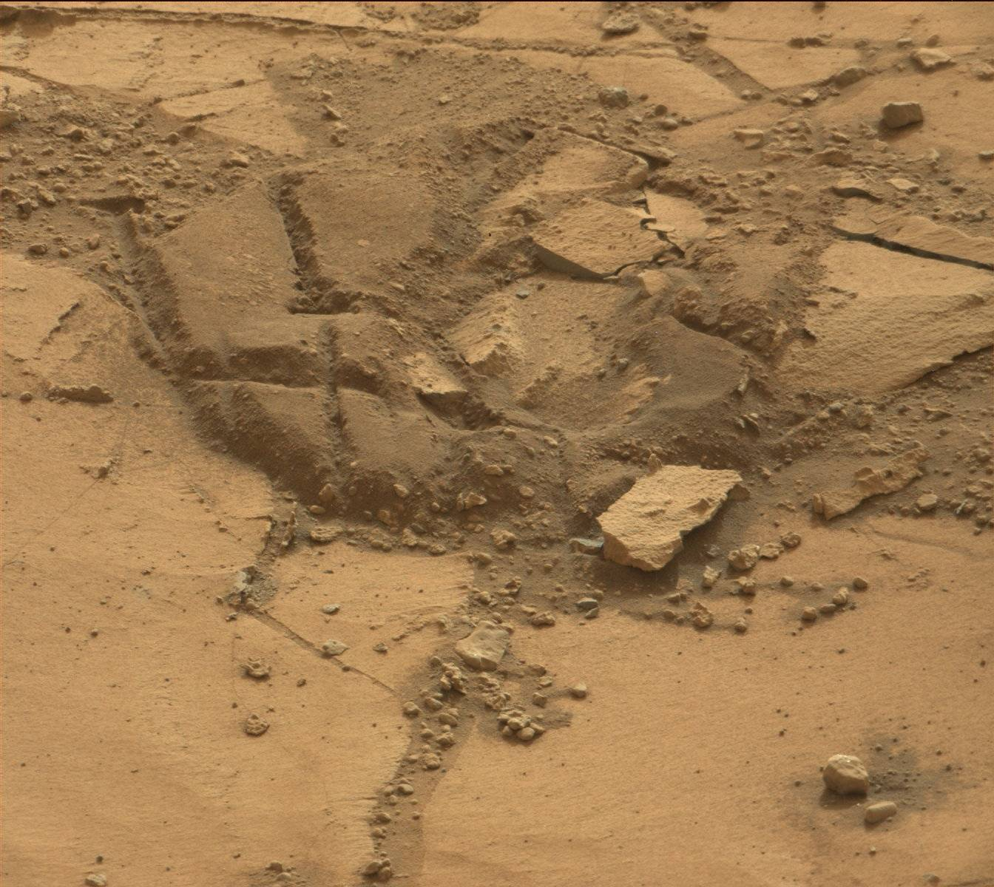
Notes:
ST: This is a close-up view of some of the broken up pieces of the very lowest exposed portions of Mount Sharp. The cracks likely formed when the rocks dried and contracted, as observed on Earth in certain rocks in dry conditions. Think about mud when it dries—it tends to form cracks like these.
Image credits: Left—Curiosity Navigational Camera (Navcam) of the rover arm drilling a sample (NASA/JPL-Caltech). Right—MAHLI view of the drill area (NASA/JPL-Caltech/MSSS).

Slide 40
Review
Martian landscapes resemble those on Earth
Volcanoes, valleys, canyons, craters, ice caps
We can use images to explore Mars from Earth
From these images we can choose the best places to explore next!
Where would YOU go?
Notes:
Background image: Sunset on Mars, imaged by the Spirit rover in 2005. (NASA/JPL-Caltech/Cornell)

Slide 41
Thank you!
Questions?

